Slide 1
RETOOLING OF SENIOR SCHOOL TEACHERS
Values-based Education (VbE)
15TH-19TH DECEMBER 2025
AT BULIMBO GIRLS

Slide 2
Session outcomes
By the end of this session, the participants should be able to:
explore values as brought out in CBC,
demonstrate values in their day-to-day lives,
acknowledge the importance of values in character formation among learners.
illustrate the role of different stakeholders in implementing VbE through the Whole School Approach (WSA),
design activities for nurturing values during the learning process and in the school as a whole,
explore varied strategies for implementing VbE,

Slide 3
Introduction
Values are standards that guide an individual on how to respond or behave in a given circumstance. They are important and lasting beliefs or ideals shared by the members of a particular society that spell out what is good or bad, desirable or undesirable
Therefore, parents, teachers and the whole school community have a collective responsibility in nurturing values in learners.
Values are one of the pillars in Competency Based Education.
They have been embedded in the curriculum in all the learning areas.

Slide 4
General Learning Outcomes of Values-based Education
a) explore various ways through which values can become part and parcel of their lives,
b) demonstrate a secure sense of personal identity for self-fulfilment and development,
c) exhibit cultural, moral and religious consciousness in their day-to-day life,
d) display empathy and respect for diverse groups of people for harmonious relationships
e) practise ethical behaviour that fosters responsible citizenship and good governance,
f) apply critical and creative thinking skills towards finding ethical solutions to challenges in society,
g) appreciate stewardship of resources and environment for sustainable development.
At the end of the Basic Education Cycle, the learner is expected to:

Slide 5
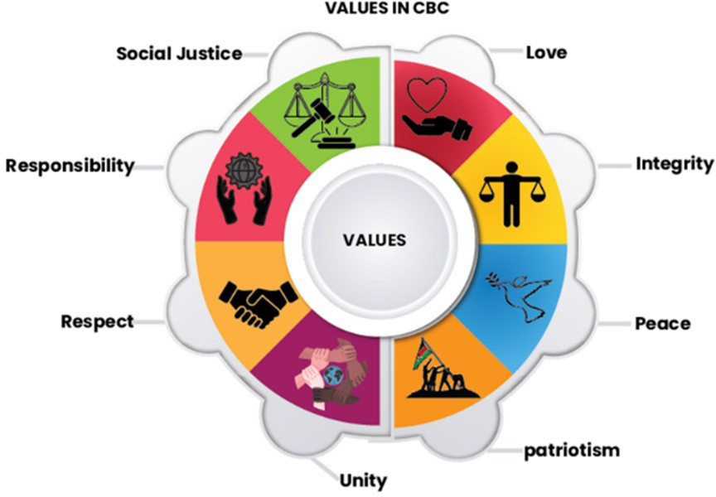
The Core Values in CBE

Slide 6
Examples of Indicators of Values
LOVE
Puts the interest of others before their own
Portrays a caring attitude
Avoids inflicting pain on others
RESPECT
Appreciates diverse opinions
Understands and appreciates others
Takes turns in activities and conversations/discussions
INTEGRITY
Chooses to do the right thing always
Displays honesty
Utilises resources prudently
PEACE
Displays tolerance
Displays calmness
Resolves differences amicably
SOCIAL JUSTICE
Fosters fairness and justice among peers
Shares resources equitably
Fosters inclusivity and non-descrimination
RESPONSIBILITY
Cares for own properly and those of others
Engages in assigned roles and duties
Observe safety precautions
UNITY
Strives to achieve a common goal
Displays team spirit
Shares available resources amicably
PATRIOTISM
Obeys class rules
Proud of their class
Conscious of their social and moral duties

Slide 7
Values –based Education through the Whole School Approach
VbE is one component of the education reforms targeting to produce ethical citizens as envisioned in CBE
Values-Based Education (VbE) through the Whole School Approach is a strategy where the entire school community intentionally nurtures, models, and integrates values in all activities, enabling learners to experience and live those values.
The Presidential Working Party on Education Reforms (PWPER) Report affirmed the implementation of VbE through the WSA.
KICD, in partnership with Zizi Afrique Foundation (ZAF), implemented a VbE pilot in primary schools across 19 counties within Kenya’s eight regions in 2025. This ushers in the national roll-out of the programme in 2026

Slide 8
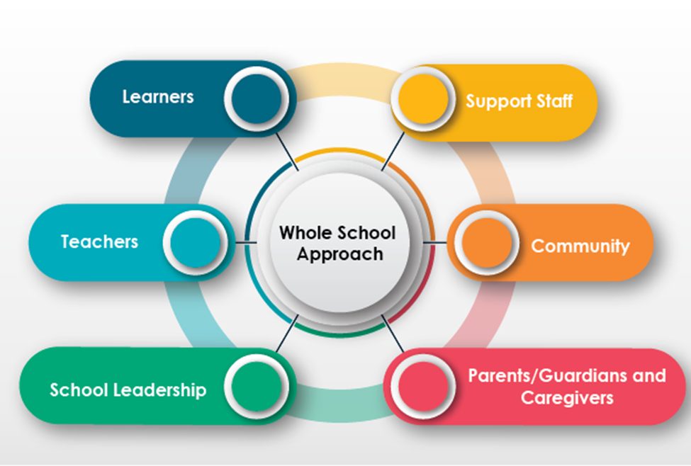
Participants in VbE Implementation

Slide 9
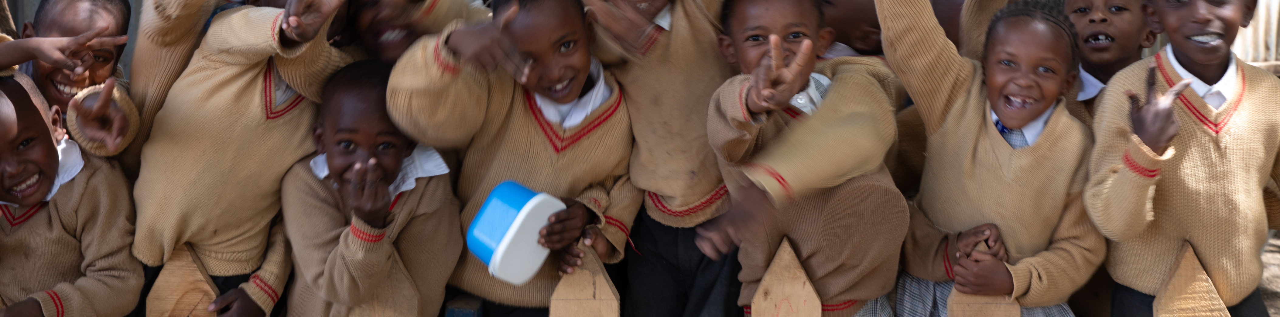
VBE PILOT STUDY BY KICD & PARTNERS 2024-25
The pilot was carried out in 3 phases:
1. Baseline phase
2. Midline phase
3. Endline phase

Slide 10
Objectives of Pilot Study
Endline
Determine the extent to which teachers are mainstreaming the values in the learning process.
Establish the strategies used to enhance nurturing of values in the whole school approach,
Determine the different roles played by stakeholders in nurturing values at schools,
Document the gains and challenges in implementing VbE in schools.
Baseline & Midline
Assess the practices used to nurture values among learners in the School.
Determine the different perceptions of the school culture in the acquisition and nurturing of values.
Find out the challenges experienced in upholding the school's value- system.

Slide 11
WAY FORWARD
Planned national rollout of the VbE Programme in 2026
1.Carry out sensitisation activities on VbE implementation to promote consistency, shared understanding and collective responsibility across the country.
2.Develop programmes to build teacher capacities in nurturing and assessing the values among learners.
3. Develop dissemination materials for effective implementation of VBE.
4.Conduct continuous Monitoring, Evaluation, Accountability and Learning (MEAL) for continuous improvement and enhancements in VBE implementation
5. Undertake preparations for the roll-out of VbE in all Basic Education learning institutions.

Slide 12
Group Activity
Select one value
write down the behaviours that correspond to the value selected
Display the information and a conduct gallery walk in order to give feedback on peers’ displays.
Display the information and a conduct gallery walk in order to give feedback on peers’ displays.

Slide 13
Ways of Embedding Values in Classroom and School Practices
Activity
Create a large mural or poster of a tree with branches where each branch represents a different way to implement VbE.
Brainstorm ideas on ways of nurturing values in the formal, non-formal and informal dimensions.
Write your responses on colourful leaves of the tree drawn.

Slide 14
Plug-in Points for Incorporating Values in School
Values in classroom Instruction | Values in non-formal activities | Values in informal activities
Values integrated in: Schemes of work Lesson plans Lesson presentations | Values integrated during: Drama festival activities Music Festivals activities Clubs & Societies activities Ball Games Sport activities | Values reflected during: Parents’ days Annual General meetings Class meetings School Environment School assemblies Day –to –day interatcions

Slide 15
Learner-centred Methods in Implementation of VbE
Learner-centred methods create opportunities for collaboration, critical thinking, and personal reflection, enabling learners to internalise values throughout the learning process.
Teachers should facilitate learning using learner-centred methods in ways that promote values during the lesson.
These methods include role play, discussion, storytelling, use of projects, debates, games, song and dances.

Slide 16
Features of a Classroom Environment that Promotes Values
Class rules
Accessible resources
Punctuality, cleanliness, maintaining silence when required and taking care of learning resources.
Create opportunities for self-directed and incidental learning using talking walls & trees, values corners among others
A safe class environment
Every learner feels cared for and loved
General safety of the classroom
Clear communication of roles and expectations
Healthy interpersonal relationships
Free expression of ideas
Consideration of learners with special needs and disabilities
Collaboration and participation
Learners assist one another during class activities, field work and projects
Recognition and celebration
Celebrating successes of learners in both personal talents, academic achievements, improvement in behaviour. NB: It should Not attract any budgetary implications

Slide 17
Assessment of Values
Assessment of values is an ongoing process that extends beyond the classroom.
Consider self-assessment, peer feedback, other teachers’ reports and informal conversations with parents/guardians or caregivers. Determine how well learners exhibit expected values.
Values should therefore be linked to observed behaviour.
Tools for assessing values include rubrics, checklist, rating scale, observation schedule, anecdotal records and reflective journal
You should also guide and encourage them to consistently apply values in different settings in school and in the community.

Slide 18
How To Involve Parents/Guardians and Caregivers in Nurturing Values
Make use of platforms such as class meetings, and academic days to empower the parent on their role in nurturing values in their children.
Encourage parents to share success stories or personal experiences demonstrating how practising values has positively impacted their children’s behaviour.
Guide parents on home or family practices to help nurture values prioritised in school.
Encourage parents to use scenarios, real-life experiences and storytelling as way of nurturing values among their children.
Encourage parents to model the expected values for their children to emulate.

Slide 19
Key Areas for Monitoring VbE Implementation
Heads of Institutions | Teachers | Parents
Policy Implementation. Teacher Support Resource Allocation Stakeholder Engagement Monitoring and Evaluation (establish clear indicators) | Classroom Integration Learner behaviour and growth Teaching Methods Feedback Mechanisms Collaboration | Home Environment Role Modeling Communication with Schools Support for Learning Community Involvement

Slide 20


