Slide 1
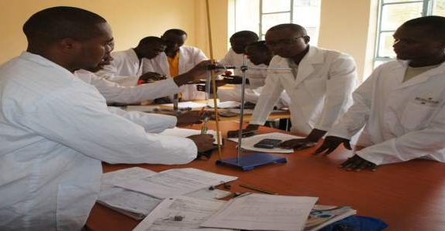

THE KENYA NATIONAL EXAMINATIONS COUNCIL
TYPES OF ASSESSMENTS
15TH-19TH DECEMBER 2025
BULIMBO GIRLS

Slide 2
What is assessment?
Assessment
Assessment in education is the purposeful and systematic process of gathering, analysing, and interpreting information about learners’ knowledge, skills, values, and attitudes to help make informed decisions.

Slide 3
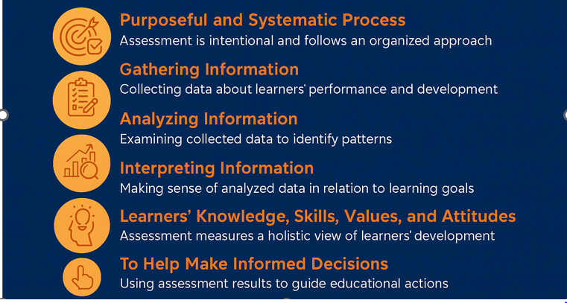
Components of the definition

Slide 4
To gather credible information…
Develop valid assessment tool/test (set and moderate)
Administering the test to learners following laid down procedures
Marking and awarding credible scores (measurement)
Grading and making decisions based on the performance (evaluation)

Slide 5
Types of Assessment
Formative Assessment
Assessment carried out during the learning process to provide feedback and guide improvement.
Includes:
1. Assessment for learning
2. Assessment as learning, which includes:
Summative Assessment
Assessment carried out at the end of an instruction period to determine achievement.
Also called Assessments of learning
Informs placement, transition, promotion, Certification among other critical decisions
(a) Peer Assessment
(b) Self-Assessment
Examples:
1. KEYA/KFLEA
2. KPSEA / KILEA
3. KJSEA / KPLE
4. KCBE / KVLEA

Slide 6
Types of formative assessment
Assessment for learning
Assessment carried out during the learning process to provide feedback and guide improvement.
Assessment as learning
Assessment where learners evaluate their own work or performance as individuals or peers.
Includes peer and self assessment.
Peer assessment: Assessment where learners evaluate the work, performance, or contributions of their colleagues or classmates.
Self Assessment: Learner evaluates own work or performance against the specified standards.

Slide 7
Assessment Methods Vs Assessment tools
Assessment Methods | Assessment Tools
The overall approach or strategy used to evaluate learning. | The specific instruments or techniques used to carry out the assessment method.
Describes how assessment is conducted. | Describes what is used to collect evidence of learning.
Observation, self-assessment, peer assessment, written test, project work, oral questioning, performance, | Rubrics, checklists, quizzes, questionnaires, portfolios, observation schedules, digital tools.
Analogy House construction: Method is like a construction techniques – Bricklaying; while tools are like the instruments/equipment – the hammer, concrete mixer.

Slide 8
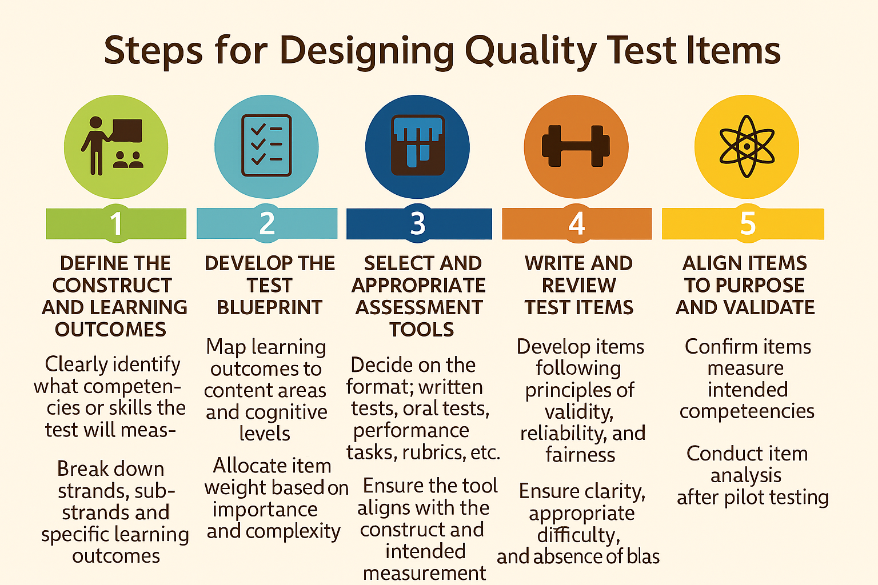

Slide 9
THE KENYA NATIONAL EXAMINATIONS COUNCIL
DEVELOPMENT OF AUTHENTIC TASK
DECEMBER 15TH-19TH 2025
BULIMBO GIRLS

Slide 10
AUTHENTIC TASK
An authentic task requires learners to apply acquired knowledge, skills, values and attitudes in a meaningful way that mirrors professional real-world situations.
Key Features of Authentic Tasks
Realistic Context
The task reflects real-life problems or scenarios (e.g., writing a business proposal, designing a marketing campaign, solving a community issue).
Application of Knowledge
It requires integrating concepts and skills rather than recalling isolated facts.
Complexity and Problem-Solving
Often involves open-ended questions, multiple steps, and decision-making.
Audience Beyond the Teacher
The outcome is intended for a real or simulated audience (e.g., clients, stakeholders, peers).
Performance-Based
Learners produce something tangible, like a report, presentation, prototype, or solution.

Slide 11
Types of Authentic Tasks
An authentic task can be
Constructed-Response tasks
Creating a product tasks
Performance tasks

Slide 12
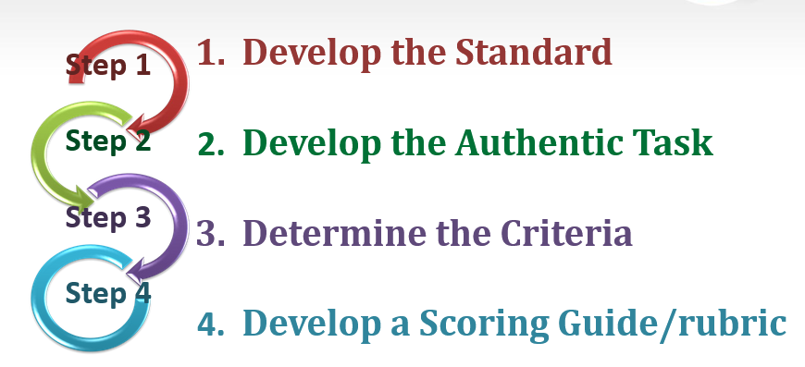
DEVELOPING AUTHENTIC ASSESSMENT

Slide 13

STEP 1: Develop the Standards
Standards are statements of what a learner can do.
They are derived from specific learning outcomes.
They should be observable and measurable.
Activity: Using the curriculum design for your learning area, develop standards.

Slide 14
STEP 3: Determine the Criteria
Criteria: Describes knowledge, skills and attitudes that the learner should demonstrate.
      Should be clearly stated.
      Should be aligned to the standard.
      Should be brief.
      Should be free of ambiguity

Slide 15
STEP 4: Develop
a Scoring Guide
How well did the learner perform?
To answer this question, develop a Scoring Guide/marking scheme/Rubrics.
Decide on the appropriate scoring guide for use e.g analytic/ holistic rubric, marking scheme, observation schedule, check list etc.
Descriptors should be clear to identify individual learner’s level of performance.
When rubrics are used, the levels of performance and the descriptors should discriminate learners according to their abilities.
The scoring guide should provide for alternative responses, without biasness.

Slide 16
Step 1: Identify the Learning Outcome
Learning outcomes communicate what A learner should be able to do and what skills they should develop during teachning & learning
Step 2: Study the Learning
Experiences for guidance on scope
Step 4: Construct the task:
Frame the task as a problem or project that requires decision-making. Embed the five.
Step 5: Specify Deliverables: Decide what learners will produce (report, presentation, prototype, etc.).
Step 6: Define the assessment criteria:
Focus on application, creativity, and problem-solving—not just correctness.
Step 3: Identify a real-world context
What real-life situation or problem does this task address?

Slide 17
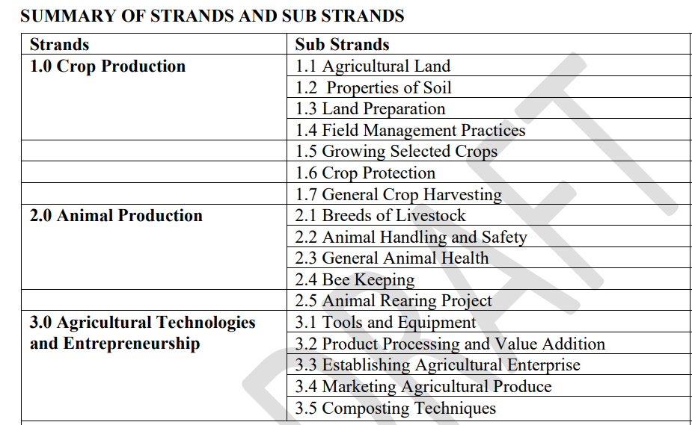
Grade 10 Agriculture Curriculum Design

Slide 18
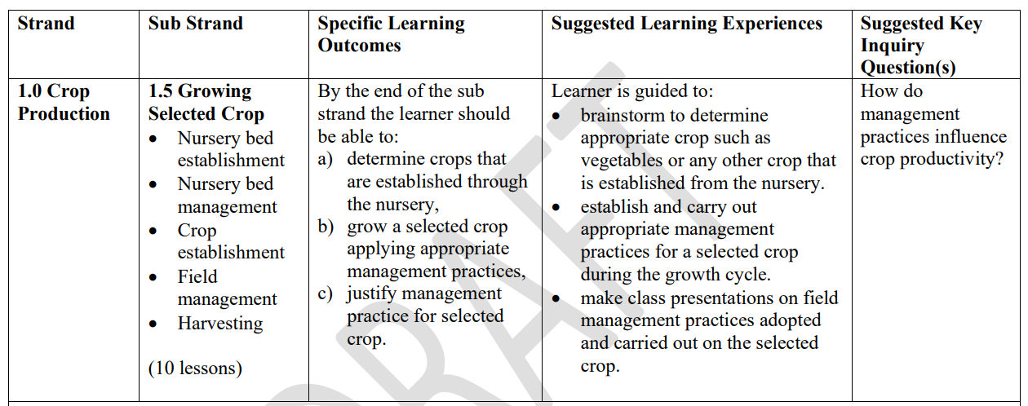
Step 1: Identify the Learning Outcome(s)

Slide 19
Other strands and sub strands
Strands :
Crop production,
Agricultural technologies and entrepreneurship.
Sub strands:
Crop production
Properties of Soil
Land Preparation
Field Management Practices
Growing Selected Crops
Crop Protection: Weed control.
General Crop Harvesting
Agricultural technologies and entrepreneurship.
Farm tools and equipment
Product processing and value addition
Establishing agricultural enterprise
Marketing agricultural produce
Composting techniques

Slide 20
Task:
In many rural and peri-urban areas of Kenya, communities face challenges of
limited access to fresh vegetables, especially during dry seasons,
youth unemployment, with few opportunities for income generation, and
unsustainable farming practices that degrade soil and water resources.
Individually analyse your community and search for information on the existence of these challenges and how they can be addressed. Present your ideas to your class or group, explaining with evidence, how the shortage of vegetables, unemployment, income generation and unsustainable farming practices can be addressed.
Individually or in your groups of up to five members, prepare a write-up proposing the project to address the challenges identified.
Work individually or in your groups of up to five to plan, design, establish, and manage a vegetable production project using sustainable farming practices to address the challenges identified.
NOTE: Vegetable production should start with nursery bed establishment.

Slide 21


