Slide 1







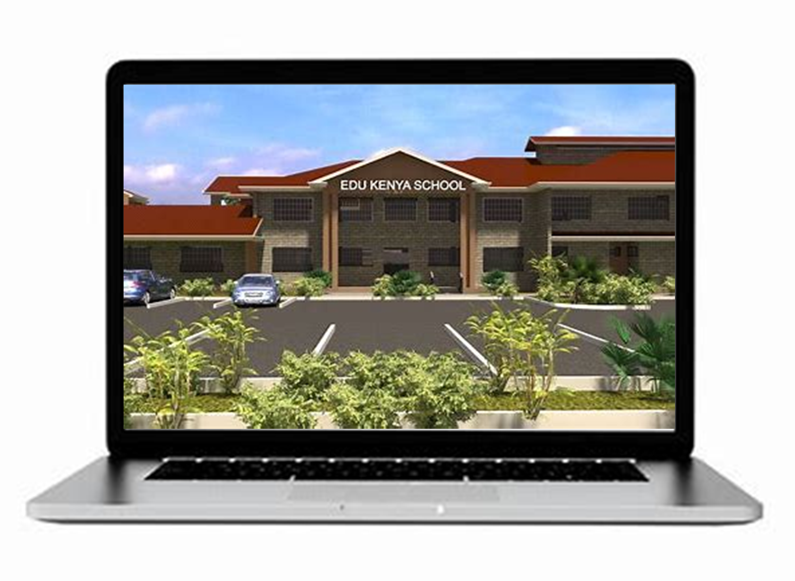

Ministry of Education
GUIDELINES
SELECTION AND PLACEMENT OF LEARNERS TO SENIOR SCHOOL (SS)

Slide 2
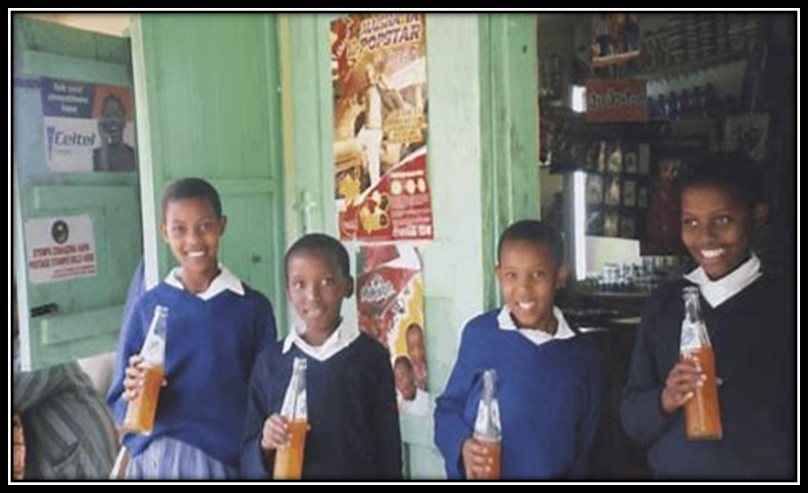




INTRODUCTION
03
There is need to ensure learners are placed into pathways that align with their interests, strengths, and career aspirations.
01
GOK introduced the Competency Based Curriculum (CBC) in 2017
02
These Educational reforms are founded on national and international legal and policy frameworks
04
These Placement guidelines will facilitate a smooth transition.

Slide 3
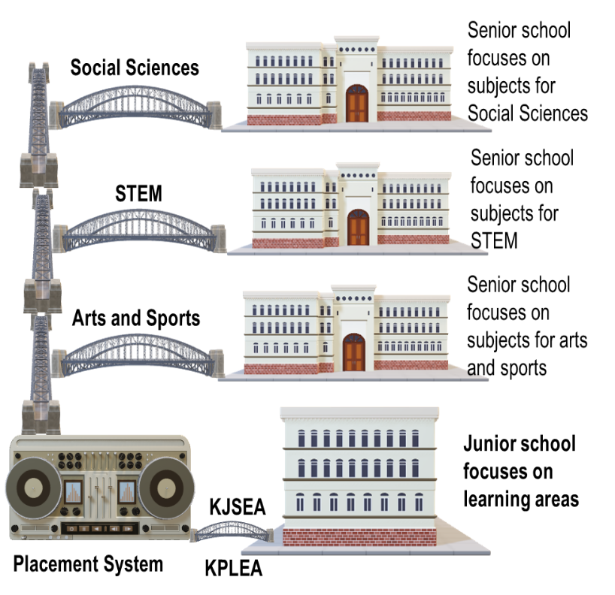
Objectives of Grade 10 Placement Guidelines
Ensure consistency in the placement learners from Grade 9 to Grade 10;
Inform all stakeholders on the selection and placement process for learners transiting from Grade 9 to Grade 10
Guide educators on appropriate admission of learners.
State the roles and responsibilities of various levels in the management of grade 10 selection and admission
Provide direction on a harmonized selection process throughout Kenya at all levels
Notes:
Our goal is to ensure that every learner is placed in an environment where they can thrive academically, socially and personally.

Slide 4
Legal and Regulatory Framework
Constitution of Kenya (2010)
Sessional Paper No 1 of 2019
Basic Education Act (2013),
Children Act (2022)
Data Protection Act (2019)
Kenya Vision 2030
United Nations Convention on the Rights of the Child
Sustainable Development Goals (SDG 4)
Basic Education Curriculum Framework (2017)
National Education Sector Strategic Plan (NESSP) 2023-2027
Sector Policy for Learners and Trainees with Disabilities (2018)
Notes:
The guidelines are grounded on a comprehensive legal and policy framework that;
Aligns with both national and international educational standards.
Ensure a transparent, fair, and equitable placement ,
Respect for learners' rights,
Supports national education goals,
Addresses the unique needs of learners transitioning to Senior School

Slide 5

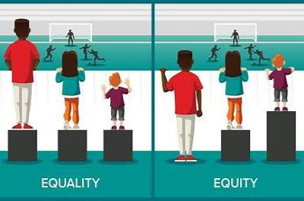



Principles Guiding Selection and Placement
Concept In Business
Learner-Centred Approach.
Equity and Fairness:
Inclusivity
Transparency
Emphasise the importance of focussing on the individual learner’s strengths, interests, and career aspirations.
Ensure that all learners, including those with special needs, are treated equitably in the placement process
Highlight the need to accommodate learners from diverse backgrounds and abilities, ensuring that no learner is disadvantaged
The placement process should be open, with clear criteria that all stakeholders (learners, parents, and educators) understand.

Slide 6
OVERVIEW OF PATHWAYS AT SENIOR SCHOOL
The STEM Pathway equips learners’ with the knowledge, skills, and competencies required to excel in scientific and technical disciplines. (60%)
The Arts and Sports Science Pathway nurture learners' talents, creativity, and physical abilities (15%)
The Social Sciences Pathway develops learners' understanding of society, human behavior, and global systems (25%)
Sports Science
Art
Language and Literature
Humanities and Business studies
Applied sciences
Pure Sciences
Technical Studies
Arts and Sports
Social Sciences
STEM
From Junior School
Senior School learners (Grades 10-12) shall take seven (7) subjects; Four (4) are core subjects; English, Kiswahili/KSL, Mathematics (Core or Essential) and Community Service Learning Three (3) shall be selected from the pathways and tracks of choice.

Slide 7

Foundation Stage:
Entry level for learners with special needs and disabilities who follow the specialized curriculum
01
Intermediate Stage:
After a learner demonstrates outcomes at the foundation level, they transit to this intermediate level
Structure of Stage-Based Pathway
02
Pre-Vocational Level:
Learners join from the intermediate level. At this level, learners are introduced to the pre-requisite skills in various vocational areas..
03
Vocational Level:
Learners join from pre-vocational stage. They learn vocational skills and acquire competencies required for various occupations, higher education in technical fields or entrepreneurship
04

Slide 8
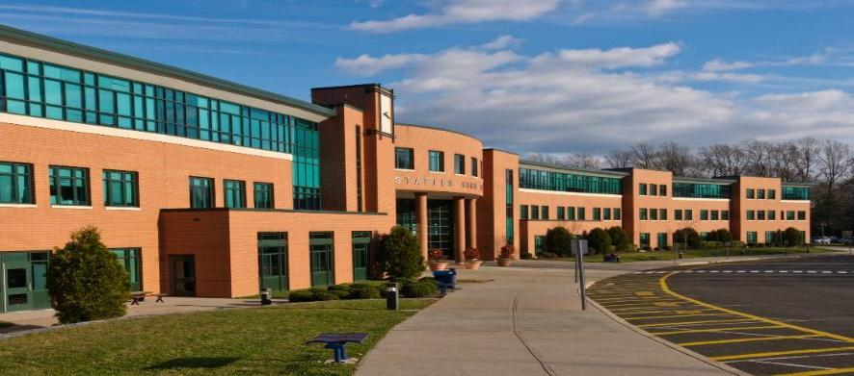
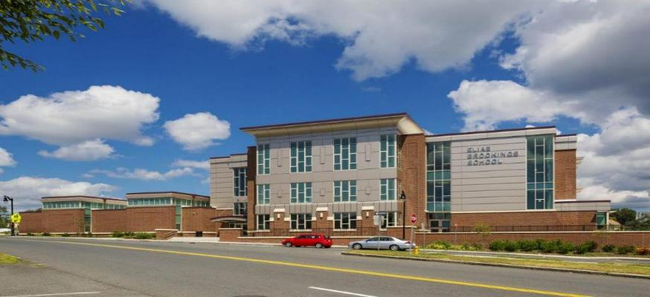



Categorization of schools
Notes:
Schools are categorized to primary ensure effective management, equitable resource allocation and appropriate policy implementation

Slide 9


Categorization of Senior schools..
Pathways
Accommodation
Gender
Special Needs
Triple Pathways Senior schools
STEM
Arts and sports
Social Sciences
Double Pathways Senior schools
STEAMS
STEM
Arts and Sports
STEMSS
STEM
Social Sciences .
Day Senior Schools
learners commute daily from their homes and do not reside on the school.
Hybrid Senior Schools
some learners do not reside in the school while others reside in the school
Single gender
Girls only
Boys only
Mixed gender
Boys and Girls
Special needs senior schools
Hearing impaired
Visually impaired
Physically impaired
Vocational senior schools
Learners with autism, cerebral palsy, cognitive difficulties and deaf- blind

Slide 10
Categorization of Senior schools..
Senior schools have further been categorized into four determined by the following:-
-Pathways offered by the school ( 3 pathways or 2 pathways)
-Breadth of the curriculum offered – ( Number of TRACKS – 7, 5,3)
- Level of available infrastructure for implementation of the curriculum
- Accommodation ( Boarding, Day, Boarding and Day)

Slide 11
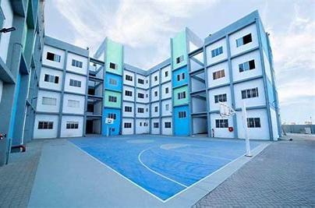
Placement of Grade 10 learners

Slide 12




Process of Transition of Learners into Grade 10
Selection
Placement
Admission
Parents and learners be allowed to select schools of their choices as per their abilities and interest (selection of pathways)
Junior school pupils and their parents should be sensitized on the modalities of placement to help them make informed decision as they select the SS
Determination of vacancies in senior schools
Determination of pathways per school
Selection of pathways, subjects’ combination and schools
Data validation and verification
Pre selection
Computation of quotas
Placement to SNE and integrated schools
Placement to boarding schools
Placement to day schools
Placement to vocational Schools
Release of selection results
Handling of Joining Instructions
Change and replacement process
Admission of learners to senior schools
Monitor Implementation

Slide 13


Placement of learners into Grade 10
It will be based on: -
school capacity
Learners’ choice
Merit
Equity
Pathways
Tracks
Subject Combinations
schools
Learner Academic Performance in Grade 9 assessment
Regional balancing to ensure fair access for all learners
Availability of space and resources in respective schools applied for.
Learners who miss places in schools of their choice will be placed in schools offering the pathway and subject combination of their choice.
No learner will be denied the opportunity to join senior school

Slide 14
Cluster of Learning Areas for Placement
learning areas at JS will be clustered for Purposes of placement
Performance in cluster learning areas will be used in placement of learners in appropriate pathways in senior school.
The cluster of learning areas adopted for each track relate to subjects in the track
Pathway | Track | Subject at Senior School | Cluster of JS Learning Areas
STEM | Pure Science | Mathematics,Chemistry, Physics, Biology | Integrated Science, Mathematics Any other learning area
 | Applied Science | Agriculture Computer Home science | Agriculture, Pre-technical studies Any other learning area
 | Technical Studies | Aviation, Building construction, Electricity Power mechanic Metal work Wood work | Pre-technical Studies, Mathematics Any other learning area

Slide 15
Cluster of Learning Areas for Placement ..
Pathway | Track | Elective Subjects at SS | Cluster of Learning Areas at JS
Social Science | Language and Literature | Literature in English, Fasihi ya Kiswahili, Sign language, Arabic, French. German, Mandarin Chinese and Indigenous languages | English. Kiswahili/Kenya Sign Language (KSL) Any other learning area
 | Humanities and Business Studies | Religious education (CRE/IRE/HRE), History and Citizenship, Business Studies and Geography | Social Studies Religious Education Pre technical studies
Arts And Sports Science | Arts | Music and dance, Theatre and film and Fine Art | Creative Arts, Social Studies, Any other learning area
 | Sports Science | Sports and recreation | Creative arts Integrated science Any other learning area

Slide 16
Grading of Learners at Grade 9
The presidential Party on Education Reform (PWPER) Report recommended that grade 9 assessment comprise;
20% KPSEA,
20% SBAs in grade 7 and 8 and,
60% summative evaluation at grade 9. (KJSEA)
The rubrics used in CBC assessment have been the 4-point levels of EE, ME,AE and BE is now expanded to 8 Achievement levels:
Performance Level | Actual Performance Level | Points
Exceeding Expectation | Achievement Level (AL) 8 | 8.0
 | AL7 | 7.0
Meeting Expectation | AL6 | 6.0
 | AL5 | 5.0
Approaching Expectation | AL4 | 4.0
 | AL3 | 3.0
Below Expectation | AL2 | 2.0
 | AL1 | 1.0

Slide 17
Learner Personality and Interest
Placement will also take into account learners’ interest.
Learners are expected to meet some minimum requirement in their cluster for consideration for the track of choice.
PATHWAY | Track | Learner’s Personality | Learner’s Interest
Arts & Sports Science | Arts
 | Sports Science
Social Science | Language and literature
 | Humanities and business
STEM | Pure Science
 | Applied Science
 | Technical Studies

Slide 18



Assessment for a Pathway
This is meant to evaluate interests, skills, values, and personality traits to help learners explore and plan for various Pathways at senior. The following can be used:-
Narratives
Questionnaire
Learners will be guided to reflect on Pathways, personal experiences and future aspirations.
Career Inventories
Teachers will use Structured tools to assess career interests
Observation Checklists
Teachers will use career inventories to evaluate learners' skills and strengths.
Career Portfolios
Teachers will use checklists assess learners' behaviours, skills, and learning preferences.
Teachers will use these portfolios to assess the learners appropriate Pathway

Slide 19

Career Guidance and Counseling
Junior schools will provide career advisory services to help students make informed pathway choices.
01
Pathways
02
Career Readiness
03
Pathway Selection
Introduce learners to Senior School pathway
Enhance learners career readiness through co-curricular activities
Guide learners in choosing Senior School pathways
Learners will explore tracks at Senior School, aligning with their interests and career aspirations.
Students participate in skill development workshops, leadership programs, and extracurricular activities
Guidance sessions to help Learners select pathways that match their strengths and career ambitions

Slide 20
Selection of Pathways and SUBJECT COMBINATIONS
Grade 9 Learners will select a pathway and subject combination that they wish to join.
Selection will be done after registration for KJSEA/KPLEA by KNEC.
Selection will consider learner’s ability, interest, and personality
The selection of the pathway shall take the following format: -
Capture Bio Data of the learner
Select Pathways and subject combination of the learner.
Junior School shall consult parents/ guardians during selection
Information about subjects combinations is senior schools Be provided before Selection.
Subject Combination

Slide 21

Selection of Schools
Selection Based on Pathways
Selection Based on Accommodation
The learner will select 12 schools for their chosen pathway as follows.
  Four 4 schools in first choice track and subject combination
  Four (4) schools in second choice track and subject combination
  Four (4) schools in third choice track and subject combination (Total 12 schools)
Nine (9) will be boarding schools, three (3) from the learners’ home county, six (6) from outside their home county/county of residence.
Three (3) day schools in their home sub county/sub county of residence. (Total 12 schools)
Pathway(s) selected and Selection of school shall lead to a total of twelve (12) senior schools each

Slide 22
Pre select Schools
Pre-Select School refers to an institution that admits students based on specific criteria rather than open enrolment. E.g Forces schools
This School can apply to be pre-select if it meets the criteria defined by the Ministry of Education
Such a school will be allowed to pre-select learners prior to KJSEA and before the main selection.
The school shall only pre - select from the learners that choose to Join the school

Slide 23

Placement..
Double Pathway Senior Schools
For Learner from Refugee Camps
For Learners from Private Centers
Learners not placed in triple pathways schools shall be placed in Double Pathways Senior Schools.
Placement will be based on choice of pathways and subject combinations, performance, choice of boarding or day, and capacity of the schools
Placed alongside others learners
Centres shall be maintained as either public or private
Refugee Learners will be a selection unit - no effect the host Sub-county’s quota.
UNHCR will issue these learners with passes and identification documents.
If they are eighteen years and below in age
Will be placed in Day schools
Placed in Pathways of their choice
Placement will be based on their performance, interest and personality.

Slide 24



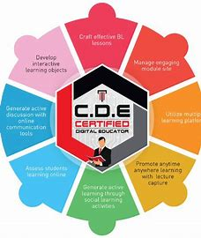

Handling of Placement Grievances
They will be handled as follows: -
01
02
03
04
Junior School
They will be channeled to the Head of Institution, Junior School
The HOI Junior school will assess the complaint and offer guidance and
Those requiring MOE intervention shall be recorded on the Placement system
Act on appeals from Junior schools
Act on complaints placed on the system
Those requiring CDE intervention are escalated through the Placement system
Act on appeals from SCDE
Act on complaints placed on the system
Those requiring RDE intervention are escalated through the Placement system
Act on appeals from CDE
Act on complaints placed on the system
Those requiring HDSE (SS) intervention are escalated through the Placement system

Slide 25


CHAPTER 5: ADMISSION AND REPLACEMENT PROCESS

Slide 26

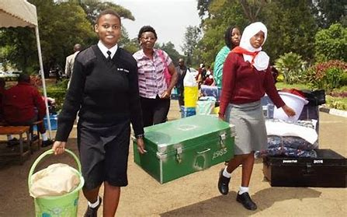


Admission of Grade 10 Learners
It will be automated and the following Guidelines will apply :-
Letters of admission
They shall be accessed online using the learner’s assessment Number.
Admit Learner through KEMIS
All schools, both public and private, shall admit Grade 10 through KEMIS.
Admit When Physical Present
No principal shall enter a learner into KEMIS before he/she reports to the school.
Reporting of Admission
Daily online reporting shall be monitored through KEMIS.

Slide 27




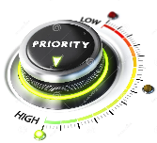
Management of Replacements
Request for Change
Priority
Documented Capacity
Vacancies
Senior schools with vacancies will declare through respective County Directors of Education
Those who wish to change schools will request through the Heads of Junior Schools at least 2 weeks before the official Grade 10 reporting date.
Priority shall be given to those who had earlier selected the senior schools they are currently requesting .
Requests will to be approved by Ministry of Education based on the Senior School’s documented capacity.

Slide 28




Management of Replacements..
Replacement approvals
Joining instructions
Multiple requests
Replacements for boarding schools shall maintain their catchment; declared vacancies benefit learners from counties that may not have taken up their first selection slots.
Extra-territorial requests will be handled by HDSE
At no time shall a school issue printed letters for replacement cases
Boarding Schools: HDSE
Day Schools: CDEs will have system rights to authorise replacement
Upon approval, the joining instructions shall be accessed online.
Replacements will be done once once approved they shall be irreversible.
One will be approved and candidate locked out from all the others.

Slide 29
Day Wings in Boarding Schools
Expand
Capacities
100% Transition
Enhance Participation
Delink admission from bed capacity.
Decongesting boarding facilities
maximizing use of available resources
Demystify the perception that boarders perform better than day scholars
Enhance parental responsibility to close monitor students’ discipline
Cater for learners with health challenges and climate issues

Slide 30
ROLES AND RESPONSIBILITIES OF OFFICERS

Slide 31

ROLES AND RESPONSIBILITIES
Cabinet Secretary
  Provide Parliament with full and regular reports concerning implementation of the guidelines.
  Facilitate the smooth implementation of the guidelines
  Advice His Excellency the President on the guidelines implementation process

Slide 32

ROLES AND RESPONSIBILITIES
Principal Secretary
  Facilitate achievement of the objectives of the Guidelines.
  Implement an effective performance management system to implement the guidelines
  Advice on Policies particularly to the Cabinet secretary, Education for the effective implementation of the guidelines
  Day to day management of budgets for implementation of the guidelines
  Leadership and oversight of agencies implementing the guidelines
  Manage senior team in the implementation of the guidelines

Slide 33
ROLES AND RESPONSIBILITIES
Director General of Education
  Advise the Principal Secretary on all matters pertaining to technical aspects in implementation of the Guidelines
  Coordinate technical functions related to Grade 10 placement and admission
  Leadership of the technical directorates
  Oversight of agencies dealing with Grade 10 placement
  Manage senior technical team in the Grade 10 placement process

Slide 34

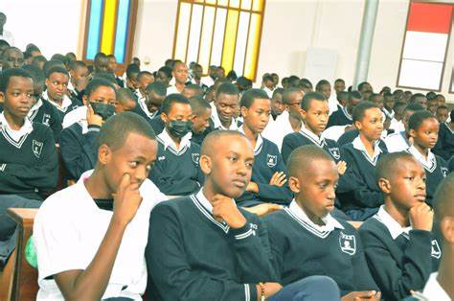

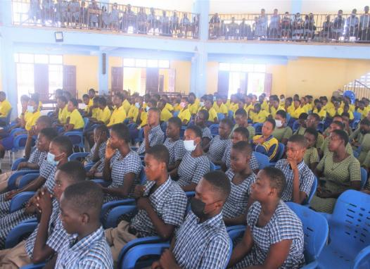

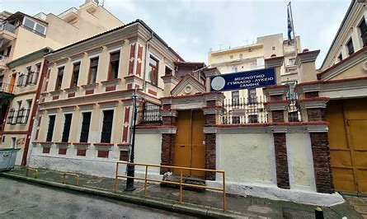

ROLES AND RESPONSIBILITIES OF OFFICERS..
Head of Secondary Education Directorate - Senior Schools
  Obtaining data from CDEs and SCDEs on all senior schools.
  Directing and coordinating operations of the selection exercise.
  Preparing selection process timetable.
  M&E of the admission process during and after the selection exercise.
  Handling any queries pertaining to Grade 10 admission nationally.
  Enforcing the Ministry’s selection and fees guidelines adherence.
  Overseeing the selection and placement issues from the field
  Coordinating the provision of online access to calling letters
  Approval of request for replacement through the NEMIS

Slide 35



Roles and Responsibilities of Officers..
Heads of Directorates/Units
01
02
03
04
05
06
0708
09
10
  Manage resources for the implementation of the guidelines.
Mobilize stakeholders’ support for implementation.
Monitor and evaluate the impact of the guidelines.
Communicate progress on implementation of these guidelines
Integrate priorities, targets, and timelines into the placement process
Ensuring Financial Accountability
Manage the MOE's workforce to support implementation of the guidelines.
Acquire goods and services necessary for the effective implementation
Oversee management of risks in the placement process
Develop and implement policies and procedures aligned to the guidelines

Slide 36
Roles and Responsibilities of Officers..
Regional Director of Education (RDEs)
County Director of Education (CDE)
Sub-County Director of Education (SCDE)
Coordinate CDEs in their respective regions to Manage selection and Placement of grade 10 learners
Oversee declaration of actual school capacities
Approve request for replacement through the NEMIS/KEMIS system
Managing data on available vacancies in their counties
Approving requests for replacement
Enforcing MOE guidelines within the County.
  Coordinating Regional launch
  Manage queries after placement and admission
Managing data on available vacancies in their sub counties
Enforcing MOE guidelines within the Sub County
  Manage queries after placement and admission
  Mop-up all selected learners to ensure they continue with their education

Slide 37




Roles and Responsibilities of Officers..
Officers Supporting Heads of Directorate
Officers supporting heads of Directorates/ Departments/Units will
  Manage resources, and oversee implementation timelines for the guidelines.
  Monitor progress towards guidelines objectives.
  Facilitate collaboration and coordination between various stakeholders
  Manage partnerships with internal and external stakeholders to gather feedback and address concerns
  Identify potential risks and challenges that may impact the implementation of the guidelines and develop risk mitigation strategies

Slide 38


Principals of Senior Schools
Roles and Responsibilities of HOIs..
Ensure accurate information on available vacancies is provided to MoE.
Prepare Grade 10 joining instructions as Guided by MoE
Invite selected learners to their senior schools.
Create a conducive learning environment for learners upon admission.
Effectively implement MoE guidelines on selection and fees

Slide 39


Roles and Responsibilities of Officers - Head of Junior School
The Head of Junior School plays a crucial role in the placement of learners into Senior School. Their responsibilities are
Academic Preparation and Assessment
Ensuring learners meet the required academic standards for progression.
Overseeing assessment processes and identifying students’ strengths and areas for improvement.
Providing recommendations based on performance, interests, and capabilities..
School Policies & Compliance
Adhering to national education policies and school regulations
Coordination with Senior School.
Facilitating transition programs such as orientation sessions or mentorship initiatives.
Ensuring students’ records, including academic and behavioral reports, are available to be shared with the Senior School if required.

Slide 40

Roles and Responsibilities of Officers- Head of Junior School
The Head of Junior School plays a crucial role in the placement of learners into Senior School. Their responsibilities are
Guidance and Counseling.
Advising students and parents on subject selection and career pathways.
Supporting students in making informed decisions about their future studies.
Identifying special needs learners and ensuring they receive appropriate support.
Parental Engagement
Communicating with parents on placement criteria, expectations, and available options.
Addressing concerns and advising on the best fit for each learner.

Slide 41



ROLES AND RESPONSIBILITIES OF OFFICERS..
Officers involved are required to co-operate and ensure fair and credible selection process to the satisfaction of all stakeholders.
This will ensure a smooth transition of students from Junior School to senior Schools

Slide 42





!
.
Your input is crucial
Let’s create fair and effective transition guidelines together

Slide 43





THANK YOU
FOR YOUR ATTENTION AND PARTICIPATION
CONTACT US
Phone
+254203318581
Email
ps@education.go.ke
Website
www.education.go.ke
Location
Jogoo House B, Harambee Avenue, Nairobi
Post Office Box
Box 30040- 00100 Nairobi

