Slide 1
ADDRESSING SCHOOL RELATED GENDER BASED VIOLENCE
CBE RETOOLING FOR
SENIOR SCHOOL TEACHERS
GRADE 10
DEC 2025
Notes:
At UNESCO, we believe that schools, and the learning process, provide a unique opportunity to deliver interventions that prevent violence.
Therefore, we are committed to investing in interventions that help to address this issue that is all too common in schools across the world.
One such intervention is the Connect with Respect programme, and I will take a few minutes to give you some more information about this programme now.

Slide 2
Session outline
Introduction
Data on school related gender based violence
Types of School related gender based violence ( SRGBV)
Learners with disabilities and special needs
Drivers, protective and risk factors of SRGBV
Seeking and giving help
School mapping for SRGBV safety
Dimensions of a Gender Happy schools
Conclusions

Slide 3
Understanding SRGBV
Activity 1: Think, pair and share (5 minutes)
Think of a Case/Cases involving children and young people who have experienced some form of violence in School.
Teachers to take note the sex of the child/young person and the form of Violence
Are learners with disabilities and special needs affected by SRGBV ?
Share in plenary

Slide 4
Preventing gender-based violence in schools
Knowledge
Understand the drivers and impact of gender-based violence
Values
Strengthen values for positive gender relations such as respect , responsibility
(core values and moral values)
Skills
Develop the social and emotional skills needed for respectful gender relationships

Slide 5
Using data to understand school-related gender-based violence
Notes:
At UNESCO, we believe that schools, and the learning process, provide a unique opportunity to deliver interventions that prevent violence.
Therefore, we are committed to investing in interventions that help to address this issue that is all too common in schools across the world.
One such intervention is the Connect with Respect programme, and I will take a few minutes to give you some more information about this programme now.

Slide 6
DATA ON GBV
Gender-based violence (GBV) remains a pressing issue in Kenya, as evidenced by a survey conducted by the Kenya National Bureau of Statistics (KNBS) and the Ministry of Health in 2022. The survey found that 39%-45% of women and girls in Kenya had experienced physical violence, while 14% had experienced sexual violence.
The 2019 Kenya Violence Against Children Survey (VACS) found that 49 percent of girls and 48 percent of boys aged 13–17 years had experienced physical violence, and 11 percent of girls and 4 percent of boys indicated that they had experienced sexual violence.
NB.: Learners with disabilities and special needs are also affected by SRGBV and should also be protected.

Slide 7
Learners with disabilities and special needs
Learners with disabilities and special needs have been found to be more vulnerable to School Related Gender Base Violence.
They should be protected from all forms of abuse taking place at home, in the community and the schools.
At times they may not know when abuse is happening..
Teachers should be very intentional in ensuring that the school environment is safe and free from any form of violence
Parents should also be sensitized on protecting their children from GBV.

Slide 8
ACTIVITY 2
In pairs,
Discuss factors which may cause SRGBV among learners
Discuss factors which may cause SRGBV among learners with special needs
Explain how to prevent SRGBV among all learners.

Slide 9
Ecological model
The ecological model helps us to understand how human beings interact in an environment
The ecological model helps in mapping the risks and protective factors of SRGBV
Each of the level of the ecological model has protective and risk factors causing SRGBV

Slide 10
Ecological model
The ecological model helps us to map both the causes of violence and potential prevention and response strategies at different levels of the individual’s environment
The model comprises:
Macro level- First two layers
Micro-Community, family, Church, School
Individual level-The person
Culture
exosyts
Education system
Religion
Economy
family
Health system
Justice system
church
person
school
community
Beliefs
Workplaces
Transport
Ideology
Derived from Bronfenbrenner, U. (1977). Toward an experimental ecology of human development. American psychologist, 32(7), 513.
Notes:
Figure:

Slide 11
Activity 3 : Mapping risk and protective factors
In groups, use the ecological model to identify the risk factors for SRGBV at each level:
Macro level
Micro level
Individual level
Culture
exosyts
Education system
Religion
Economy
family
Health system
Justice system
church
person
school
community
Beliefs
Workplaces
Transport
Ideology
Notes:
Distribute the relevant risk factor cards to the relevant group (risk factor cards categorized by group are provided).
Ask groups to review their set of risk factor cards and consider whether there are any additional challenges commonly encountered operating at their level of the ecology. Write each challenge on a blank card.
To demonstrate the interaction between different levels of the ecological model, ask groups to collect together their risk and protective factor cards and gather around the ecological model (lay the ecological model on the floor in a part of the room where there is sufficient space).
Highlight the way in which children and young people are affected by the interaction between each of the domains within the model. For example, the society level has an impact on what happens at the school, which has an impact on the person at the centre. So if, for instance, the Ministry of Education has policies in place to address stigma and discrimination in school settings, this can promote a positive learning environment in schools. Similarly, the society level (including messages/stereotypes in the media, broader economic situation of a country, and social norms and expectations) have an influence on all other levels.

Slide 12
Ecological model- Possible results from the group work
Individual level Lack of awareness of rights Low level of education Low socio-economic status
Family level Lack of parental care Alcohol/substance abuse Intergenerational violence
School level Lack of safe spaces Few female teachers/staff Disciplinary methods that reinforce violence
Community level Lack of services Tolerance of violence Opposition to girl’s education
Society level Lack of legislation Lack of sustained teacher training Lack of coordination between sectors

Slide 13
Interconnected causes of violence
Factors at one level of the ecological model influence factors at another level – for example, the education system affects the school
There is complex interplay between factors at the micro level where the individual spends their time – encompassing home, school, community, place of worship
It is necessary to act across multiple levels of the model at the same time to prevent violence

Slide 14
Activity 5
Think, pair and share
Discuss the meaning of violence
Outline the forms of violence
Discuss the effect of violence on alllearners.

Slide 15
Forms of violence
Physical
Verbal
Economic
Sexual
Psychological

Slide 16
What is violence?
Physical violence Hurting the body or damaging or stealing someone’s possessions | Verbal violence Involves written or verbal name-calling, labelling, intimidating behaviour, spreading rumours about someone, or shouting and screaming at them
Economic violence Preventing someone from accessing money or resources (e.g. stealing lunch money) | Sexual violence Sexual contact without consent includes rape and other sexual contact like touching private parts of the body without permission. It can also include saying sexual things about someone, telling stories or posting pictures of a sexual nature about someone, or forcing them to view pornography
Psychological violence
Hurting someone's mind or emotions
includes threatening, abusing, scaring, humiliating or shaming people – so that they feel bad even though no one has touched them
Notes:
Violence can take place person-to-person, via social media, or via posting of messages, graffiti or ‘hate’ mail. It may involve words, images, pictures, stories, signs, objects, possessions, or forms of physical contact.
When we are talking about violence, it is important to name the violent behaviour that people are engaging in.

Slide 17
Developing relevant vocabulary
Target (sometimes called the victim) = the person who experiences the violence | Perpetrator (sometimes called the bully or aggressor) = the person who carries out the violence or causes the hurt and harm
Accomplice = the person or people who encourage, join in, or show that they are entertained by the violence | Witness (sometimes called the observer or bystander) = the person who sees a violent act
Notes:
It is important to equip students with relevant language so they can name what is happening to themselves or others. There are a number of positions that people can be in when violence is happening. These include target, perpetrator, accomplice and witness.
Bring attention to the term ‘target’
TARGET: A lot of work has been done, particularly by the women’s movement, to move away from language around ‘victim’ and instead use terms such as ‘target of violence’ or ‘survivor of violence’. This is because the term ‘victim’ implies that the person experiencing the violence is lacking in personal resources and strengths. Use of the term survivor helps to highlight that people who experience violence often use their personal strengths to move forward with their lives and heal themselves from the trauma of violence.
Highlight the importance of acknowledging witnesses
WITNESS: There are some people who would argue that witnesses are the most important people to work with when it comes to changing social norms around violence. If the vast majority of people who witness violence do nothing about it, for example, ignore the behaviour, it’s a signal that it doesn’t matter.

Slide 18
What is gender-based violence ?
Any act that results in, or is likely to result in, physical, sexual, or psychological harm or suffering to someone (male, female, ) based on gender role expectations and stereotypes
Occurs as a result of normative role expectations associated with one’s gender, and unequal power relationships between genders
Can affect anyone (including males, females) but some are at heightened risk
Notes:
Gender-based violence is violence that targets individuals or groups on the basis of their gender.
Gender-based violence is any act that results in, or is likely to result in, physical, sexual, or psychological harm or suffering to someone (male, female, or transgender people) based on gender role expectations and stereotypes.
Gender-based violence occurs as a result of normative role expectations associated with one’s gender, and unequal power relationships between genders.
Not all violence is gendered. For example, name-calling such as “sissy” or “bimbo” are gendered names that can be used that are forms of GBV, and not just violence.
Gender-based violence can affect anyone (including males, females, and transgender people) – but females are more at risk of being the victims of gender-based violence. Males who are thought to be, or who are, same-sex preferred are also at heightened risk of gender-based violence, as are transgender people.

Slide 19
Activity 6 :
SHARING EXPERIENCES ON SRGBV
Choose a scenario for your group and discuss:
What type of gender-based violence is happening in the scenario (physical, verbal, psychological, sexual, economic)?
How might this affect the victim?
What needs to change to prevent this from happening?
What needs to change so that effective responses are made if the problem does happen?

Slide 20
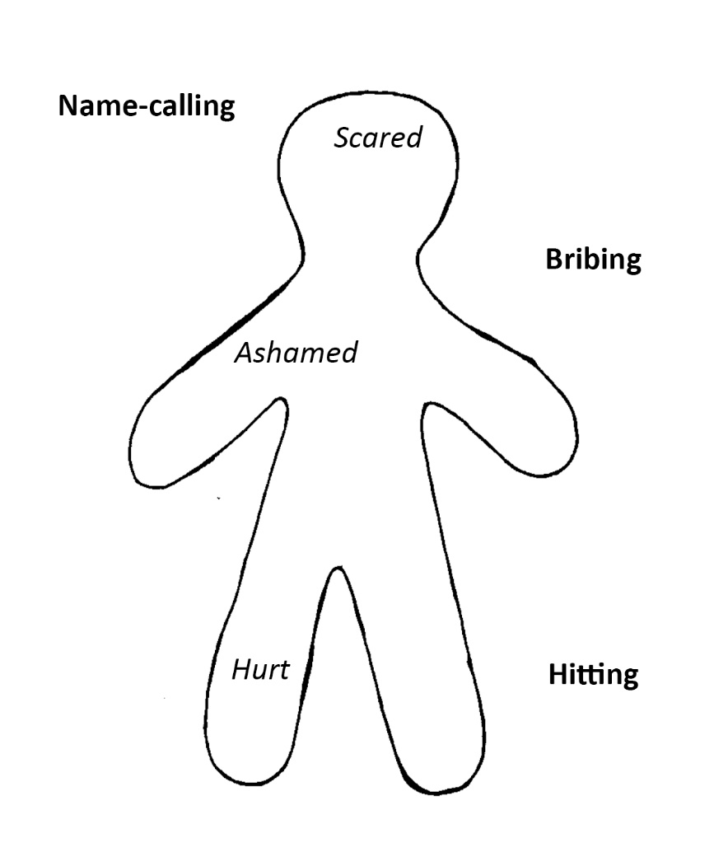
Effects of school related gender-based violence
Activity 7-
In groups, list some types of GBV perpetrated against either male/female learners
(You will be allocated one gender). Write these around the outside of the body.
List the feelings that these kinds of violence might cause inside the body.
Compare with other groups and discuss similarities and differences between genders.
Discuss the effects of gender-based violence on both male and female learners.
Example:
Notes:
When groups report back, ask them:
What are the most commonly experienced forms of violence? Are they the same for females and males?
What types of violence do males tend to perpetrate against males? Against females?
What types of violence do females tend to perpetrate against females? Against males?
Do you notice any patterns?

Slide 21
Effects of SRGBV
SRGBV has a number of negative impacts on the physical and mental health of young people
Experience of SRGBV can lead to depression, feelings of worthlessness, drug and alcohol abuse, and increased risk of suicide and violent behaviour
SRGBV can also impact school attendance, engagement, and performance
Fear of sexual abuse in schools is one of the key factors that hinders girls from accessing and completing their education.
Notes:
Effects of SRGBV
A significant body of research exists around the effects of SRGBV indicating negative impact on school attendance and physical and mental health. Studies demonstrate that the experience of SRGBV is linked to negative health outcomes including depression, feelings of worthlessness, a higher likelihood of drug and alcohol abuse, and increased risk of suicide (Smith, Ward, Dixon, Mitchell, & Hillier, 2014).
School engagement and performance can be negatively impacted when young people experience sexual violence (Muhanguzi; United Nations 2006).
The experience of sexual assault is often detrimental to girls receiving a full education, contributing to lack of access to the workforce, perpetuating a cycle of poverty. Similarly, fear of sexual abuse is often a reason for parents withholding their daughters from school, particularly when there is a high risk of assault occurring within the school ground and during travel to and from school.
According to the United Nation’s Secretary-General’s Study (2006) ‘this fear for girl’s sexual safety is only exasperated when coupled with strong prevalence of HIV within the community’ (p. 136). For girls who experience sexual violence, the risk of contracting HIV or other sexually transmitted infections increases dramatically, and the occurrence of depression and alcohol abuse is common (Ameli, Meinck, Munthali, Ushie, & Langhaug, 2017, p. 306). For males, exposure to violence during adolescence contributes to a heightened likelihood of engagement in antisocial and violent behaviour, and increased vulnerability to depression and drug use.
**For more information, please refer to the Desk review informing approaches to the prevention of school-related gender-based violence in Eastern and Southern Africa

Slide 22
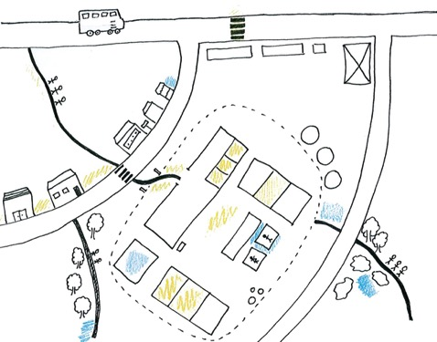
Activity 8
School mapping of GBV-
1. Draw a simple map of your school
You may include the streets, forested areas, social spaces, pathways and buildings around the school
Mark the different routes that learners take to school and the different modes of transport they use (walking, bus, taxi, etc.)
2. In different colours/symbols, mark:
The places in and around the school that are safe and friendly for all learners- you can use a circle
Which places in and around the school learners are most likely to witness or experience violence- you can use a box
Notes:
Topic 4, Activity 1: School mapping of GBV
Indicate what types of violence happen in these places by drawing one of the symbols below to represent the different types of violence:
◉ Psychological violence
◆ Verbal violence
# Physical violence
 Sexual forms of violence or sexual harassment
Discussion:
Do boys and girls experience violence in the same places in school?
Where is violence most likely to occur?
Why do people get away with violence in these places?
What needs to be done to stop this violence?

Slide 23
Reflections
‘Share your reflections on safety in our schools in relation to SRGBV’

Slide 24
What is positive discipline?
Positive discipline:
Focuses on strengthening positive behaviour
It can help in preventing SRGBV
Aims to encourage children to become responsible for managing their own behaviour, rather than leaving it to those in authority to make them behave
Is a positive alternative to corporal punishment
Is designed to help children learn, rather than to make them suffer.

Slide 25
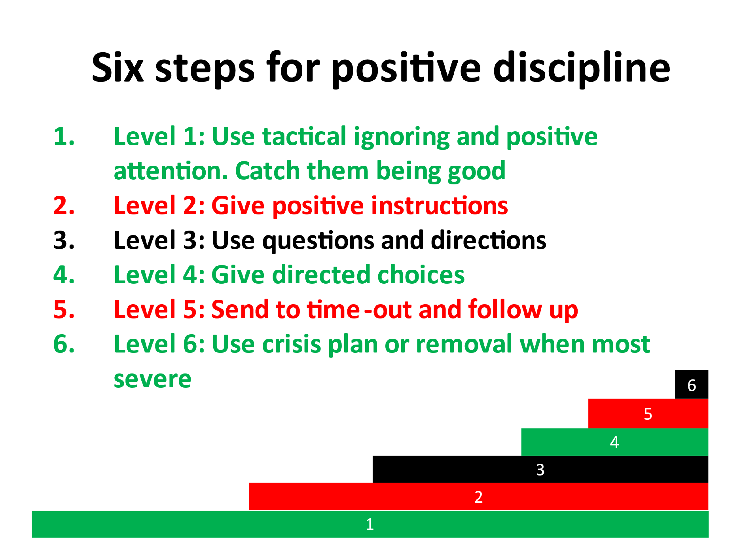

Slide 26
A whole-of-system approach in preventing SRGBV

Slide 27
Understanding the approach
A range of elements need to be in place to support effective school-based prevention responses to SRGBV, including:
Leadership & governance Prevention education Teacher training & support Code of conduct and ethics Reporting & mapping | Counselling & support Referral Partnerships with parents & community Monitoring & evaluation

Slide 28

Gender-Happy School
Working towards the gender-happy school
Leadership & governance
M & E
Teacher training & support
Prevention
education
Partnerships
Code of conduct and ethics
Referral
Counselling & support
Reporting &
mapping

Slide 29
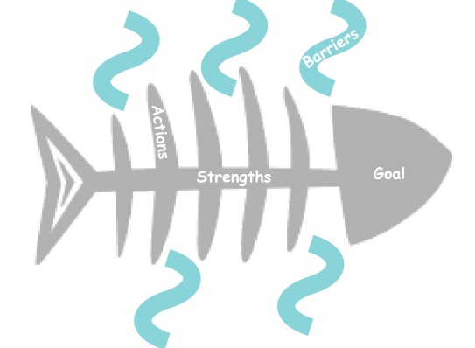
Activity 10 : Planning for action in the school
Schools can develop an action plan on how to handle SRGBV
At the head of the fish write your goals and objectives
Along the skeleton of the fish write the strengths and resources you already have that will help you to work towards this goal
Along the waving lines representing the tide write the barriers that you may have to work against in your efforts to move towards your goal
Along the fins identify all the key actions that will help the fish to swim towards its goal of implementing the programme and reducing SRGBV

Slide 30


LET US JOIN HANDS TO CREATE SAFE LEARNING ENVIRONMENT FOR ALL LEARNERS!

