Slide 1
COMPETENCY BASED ASSESSMENT FRAMEWORK
A PAPER PRESENTED DURING
SENIOR SCHOOL TEACHERS RETOOLING
15th-19th DECEMBER 2025
MARY SEAT OF WISDOM BULIMBO GIRLS

Slide 2
Session Outcomes
By the end of the session, the participant should be able to;
justify the rationale for change of assessments modes in CBE;
explain the meaning of CBA;
explore the linkage between CBC and CBA;
explain the CBA Framework;
explore the theories and principles underpinning CBA;
appreciate the paradigm shifts in assessment.

Slide 3

Why Change Assessment Modes under CBE
Reduce
To reduce exam-centric pressure on learners: Uses both formative & summative assessments
Emphasize
To emphasize practical skills and real-world application: Bridges the gap between school and world of work, making learner to thrive and not to survive.
Promote
To promote equity and inclusivity ensuring that no one is left behind due to rigid timelines or standardized examinations.
Align
To align with global best practices in assessment- to ensure our education system remains relevant and competitive globally
Prepare
To prepare learners for 21st-century skills and challenges: current world demands skills like collaboration, communication, digital literacy, lifelong learning and adaptability—skills that traditional exams rarely assess.

Slide 4
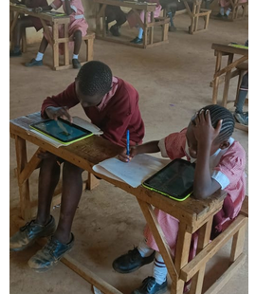
Assessment framework
An assessment framework is a structured plan that defines the
          purpose of assessment,
          tools to be used,
          modes of delivery,
          Feedback and reporting mechanisms.
It ensures that assessments are purposeful, consistent, and aligned with specific goals, while providing clear criteria for measuring performance and guiding improvement.

Slide 5
Pillars of Assessment
The term "Pillars of Assessment" refers to components or foundational element that supports an effective assessment system.
Before conducting any assessment, educators should reflect on key foundational pillars:
1. Purpose – WHY?
What is the goal of the assessment?
Is it for:
2. Mode – HOW?
Based on the purpose, choose the appropriate assessment method:
Project method
Written test
Oral assessment
Practical assessment
3. Reporting – WHAT & WHO?
Determine:
How learner achievement will be reported.
Who will receive the feedback (e.g., learners, parents, administrators).
Placement?
Transition?
Informing instruction?
Which approach will be effective in communicating of results.
Portfolio

Slide 6
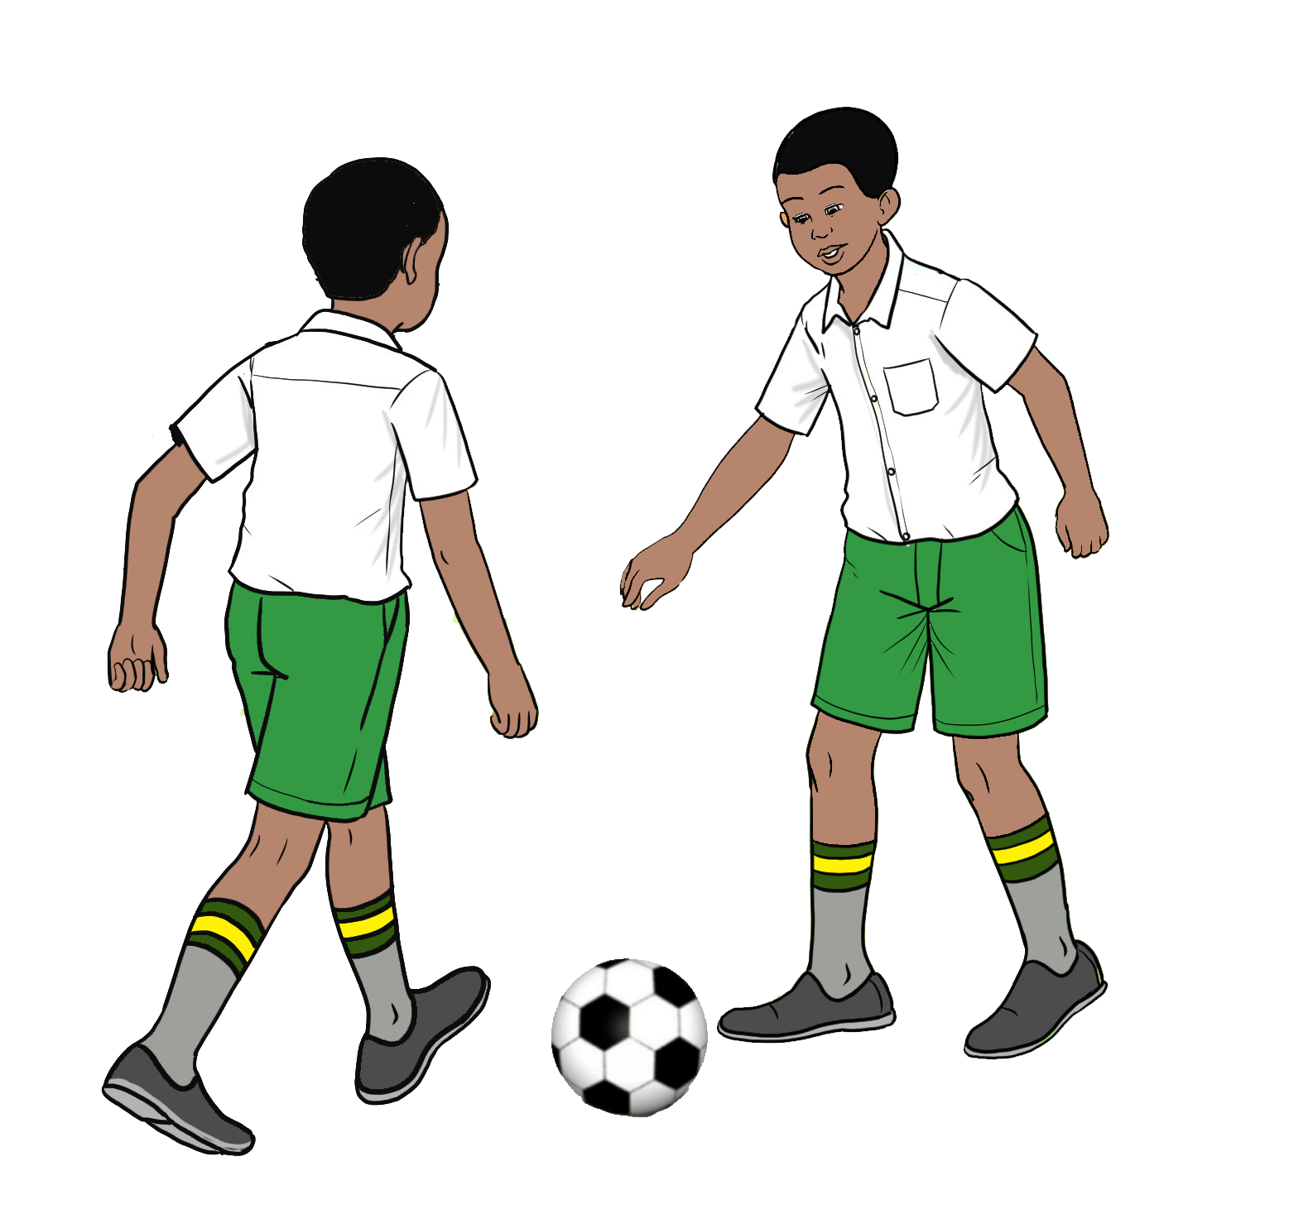


What is CBA?
  Is the process of evaluating a learner’s ability to apply knowledge and skills in real or meaningful contexts
  Involves intentional process of collecting credible evidence and making informed judgments about what a learner understands and can do.
  carried out using a variety of tools and methods, including written tests, projects, and practical activities, to capture diverse aspects of learning

Slide 7
Activity 1
1. What is a competency?
2. When have you seen competency demonstrated clearly by someone either a peer, colleague, or mentor and what made their actions ‘competent’?
3. What do you personally think distinguishes a competent performer from someone who is still learning? Give an example from your own experience.
Invite a few randomly selected participants to briefly share their personal experiences

Slide 8
Competency
Is the ability to apply appropriate knowledge, skills, values and attitude to successfully perform a real-life task
Example
A senior school science teacher can demonstrate competency by:
  Applying subject knowledge to explain concepts clearly using relevant examples.
  Using instructional skills to engage learners through experiments and discussions & fieldwork aligned with CBC
  Showing professional values by respecting learners’ diverse backgrounds and learning needs across urban and rural settings
  Maintaining a positive attitude that fosters curiosity, resilience, and a growth mindset among learners.
  Successfully managing a classroom and adapting lessons to real-world scenarios

Slide 9

Therefore
CBA is a continuous process that focuses on documenting what a learner knows and can do:
    Before learning – to identify prior knowledge and readiness
    During learning – to monitor progress and guide instruction
    After learning – to assess mastery of skills and to inform transition

Slide 10

Shifts in Assessment

Slide 11
Activity 2
What are some of the major shifts in assessment practices in Kenya that you are aware of?
Invite a few randomly selected participants to briefly share their personal experiences

Slide 12
What are the major shifts in Assessment
Focuses on Competencies: skills, knowledge &values
Continuous Assessment: learner assessed throughout the learning process.
Authentic Assessment: Assesses the application of knowledge and skills to solve real world problems
Assessment tools: Uses variety of assessment tools to gather information about a learner’s achievement and cater for diverse learner needs and abilities
Integration of ICT in assessment
Learner-Centred: From Teacher-Centered to Learner-Centered Assessment, tailored to meet individual learners’ needs
Holistic Approach in Assessment: Evaluates emotional and social development alongside cognitive achievements.
Formative Feedback: Continuous and constructive feedback to guide learning.

Slide 13
The linkage between various components of CBC and CBA
CBC | CBA
Learning outcomes | Assessment standards
Learning Experiences | Assessment Tasks
Assessment Rubrics for Sub strands | Assessment Rubric for Tasks

Slide 14
Theories Underpinning Competency-Based Assessment in Kenya
Theory | Major Assertions | Implications for Assessment
Experiential Learning (Kolb) | Learning is best through experience and reflection. | Use of fieldwork, experiments/practical, role plays, and projects.
Situated Learning (Lave & Wenger) | Learning is social and context-bound. | Design authentic, real-world tasks and collaborative assessments.
Multiple Intelligences (Gardner) | Learners have diverse intelligences (e.g., linguistic, spatial, kinesthetic). | Use varied assessment tools to capture different strengths.
Constructivist Theory (Piaget, Vygotsky) | Learners construct knowledge through interaction and exploration. | Encourage formative assessment, scaffolding, and learner reflection.
Bloom’s Taxonomy | Learning progresses from remembering to creating. | Design assessments that target higher-order thinking skills.
Social Learning Theory (Bandura) | Learning occurs through observation and modeling. | Incorporate peer assessment, group work, and role modeling.
Authentic assessment theory | emphasizes assessment of learners through real-world tasks and performances | focuses on learners’ ability to apply knowledge, demonstrate creativity and solve problems in authentic contexts.

Slide 15
PRINCIPLES OF ASSESSMENT
Principles of assessment establish the fundamental standards that guide the development and implementation of all assessment practices. They ensure that assessment processes are credible, equitable, and aligned with the intended learning outcomes.
Adherence to these principles will promote consistency, transparency and accountability, while ensuring assessment feedback effectively informs learning, teaching and decision-making. These principles include:

Slide 16
Validity - degree to which an assessment accurately measures what it is intended to measure based on curriculum design and assessment standards.
Reliability - the extent to which the assessment tasks consistently produce similar results if the same assessment was administered to the same cohort of learners under similar conditions.
Efficiency - an efficient assessment effectively distinguishes between learners who have acquired the expected knowledge, skills, attitudes and values and those that have not.
Equity - an assessment must uphold fairness and justice by taking into account the diverse learning needs of all learners.
Confidentiality and Dignity - Information about a learner’s disability should be treated respectfully and used solely to enhance support.
Currency - Assessment tasks should remain relevant and reflective of current local and global contexts, as well as emerging community needs.
Objectivity - Assessment should be free from bias in both the interpretation of tasks and the evaluation of learner performance.
Practicability - This refers to the feasibility of conducting an assessment in relation to available resources, time, length, cost and ease of administration and scoring.
Accessibility - Assessment should be accessible to all eligible learners, regardless of socio-economic background or special needs.
Flexibility - Assessment should be responsive to the diverse needs and circumstances of learners.
Sufficiency - Sufficiency pertains to the adequacy and quality of assessment evidence.

Slide 17
DIFFERENTIATED ASSESSMENT
Differentiated assessment is the practice of modifying assessment methods, tools, tasks, and conditions to meet the varied readiness levels, learning styles, interests, and abilities of learners while measuring the same competency or learning outcome.
Differentiation of assessment environment may include simplified language, extended assessment time, use of a reader or scribe, enlarged print, breaks, use of assistive technology among others.
The teacher’s role in differentiated assessment includes identifying learner needs using formative data, developing varied but aligned assessment tasks, providing scaffolding and enrichment, using rubrics to ensure fairness and consistency, giving targeted feedback for improvement and collecting evidence from multiple sources.

Slide 18
CBA Journey and the Key Milestones
KNEC administered Grade 9 PILOT
Conducted Pilot study for Grade 3
Successfully Conducted 4th SBA and the
1st KPSEA &KILEA
KNEC administered 2nd SBA (Grade 3, 4)
Start of CBC implementation
2017
2018
2019
2020
2021
2022
2023
2024
2025
MLP(KEYA)
Conducted the 1st assessment to Grade 3
& KFLEA
Conducted the 3rd assessment (Grade 3,4,5)
KNEC administered 1ST KJSEA & KPLEA
Successfully Conducted 5th SBA & the 2nd KPSEA &KILEA

Slide 19
Organization of CBA Age-Based Curriculum

Slide 21
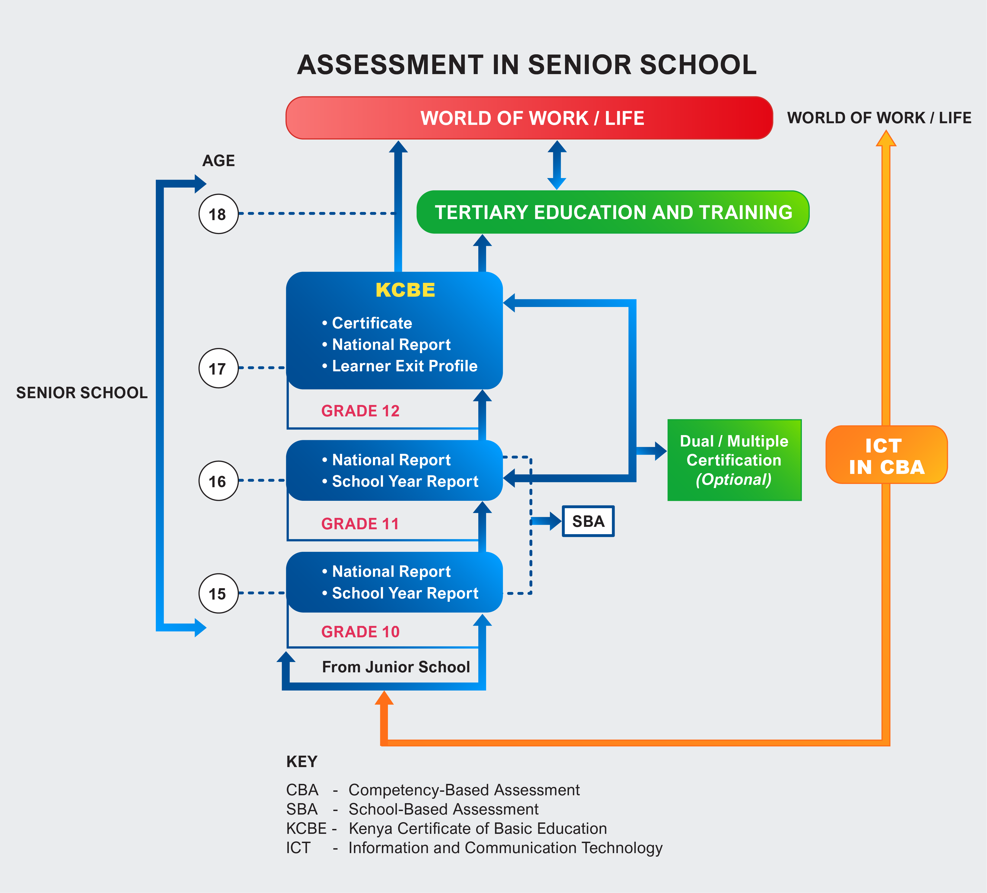

Slide 22
Organisation of CBA Stage-Based Curriculum

Slide 25
What types of assessments are administered by KNEC under the CBA framework do you know of?
Activity 3
Invite a few randomly selected participants to briefly share their personal experiences

Slide 26
JS Assessment structure
Grade 8
(SBA)
20% of SBAs(7,8)
40%
100%
20% KPSEA
Grade 9
Grade 7
(SBA)
20% KPSEA
KJSEA
60% summative

Slide 27
Senior School Assessment structure
Grade 10
(SBA)
SBA30%
100%
30%
Grade 12
Grade 11
(SBA)
KCBE
70% summative

Slide 28
HOW SUBJECTS ARE ASSESSED
 | Grade -KPSEA | Junior School-KJSEA | Senior School-KCBE
1 | English | 1. English | English
 |  |  | Literature in English
2 | Kiswahili/KSL | 2. Kiswahili/KSL | Kiswahili
 |  |  | Fasihi ya Kiswahili
 |  |  | KSL
3 | Mathematics | 3. Mathematics | Core Mathematics
 |  |  | Essential Mathematics
4 | Integrated Science (Science & Technology, Agriculture, Home Science, PHE) | 4. Integrated Science | Biology
 |  |  | Physics
 |  |  | Chemistry
 |  |  | General Science
 |  | 5. Agriculture | Agriculture
 |  |  | Home science

Slide 29
5 | Creative Arts & Social studies (Music, Art & Craft, Social Studies & Religious Education-CRE-HRE, IRE) | 6. Social Studies | Geography
 |  |  | History & Citizenship
 |  | 7. CRE/IRE/HRE | CRE/IRE/HRE
 |  | 8. Creative Arts & Sports | Music and Dance
 |  |  | Fine Arts
 |  |  | Theatre and Film
 |  |  | Sports & Recreation
 |  | 9. Pre-technical Studies | Computer STUDIES
 |  |  | Business Studies
 |  |  | Aviation
 |  |  | Building Construction
 |  |  | Electricity
 |  |  | Metalwork
 |  |  | Power mechanics
 |  |  | Woodwork
 |  |  | Media Technology
 |  |  | Marine and Fisheries Technology
 |  |  | Arabic/French/German/ Chinese Mandarin
 |  |  | Indigenous Language

Slide 30

DUAL CERTIFICATION AT SENIOR SCHOOL

Slide 31
The Competency based assessment Framework for Senior School incorporates a dual certification model, whereby learners can be awarded both an academic certificate and a occupational qualification that reflects industry recognised skills.
This will be voluntary, and learners interested will register through their schools.
This model acknowledges the diverse strengths of learners and expands their opportunities for them to effectively transit to the world of work, employment and entrepreneurship.
The significance of dual certification lies in its alignment with current labour market demands, as it validates the skills and competencies acquired through vocational learning at the senior school level.

Slide 32

The CBE curriculum at senior school, for age-based
Curriculum enables learners to acquire both practical
skills and academic learning in each pathway.
Similarly, the Stage-based Curriculum enables
Learners to acquire both practical skills and
academic learning in each pathway.
Senior school subjects will equip learners with
academic and vocational skills. These skills can be
linked to real occupational requirements in different
industries. When learners achieve both types of
competencies, they will be awarded two certificates,
hence dual certification at the end of
senior school education.

Slide 33


