Slide 1
KENYA INSTITUTE OF CURRICULUM DEVELOPMENT
A Skilled and Ethical Society
OVERVIEW OF BASIC EDUCATION AND ORGANISATION OF LEARNING
15TH-19TH DECEMBER 2025
BULIMBO GIRLS

Slide 2
CURRICULUM DEVELOPMENT
The National curriculum is developed by KICD as empowered by Act of Parliament the Kenya Institute of Curriculum Development (KICD) Act, 2013 (Revised 2019). Basic Education Curricula include:
      Pre-primary education
      Primary education
      Junior School
      Senior School
      Special Needs Education
      Teacher Education
      Adult and Continuing Education
      Technical and Vocational Education and Training.

Slide 3
Core Competencies in the Basic Education
The seven core competencies in the curriculum are:
Communication and Collaboration
Critical Thinking and Problem Solving
Citizenship
Imagination and Creativity
Digital Literacy
Learning to learn
Self Efficacy

Slide 4
Values in the Competency Based Curriculum
The eight values in the curriculum are:
Love
Responsibility
Respect
Unity
Peace
Patriotism
Social Justice
Integrity
How Values are Integrated in the Curriculum mainly through:
Infusion in the learning experiences
Guidance and Counselling programmes
Whole-School Approach- involving learners, teachers, support staff, Board of Management, family members, wider school community and relevant stakeholders.

Slide 5
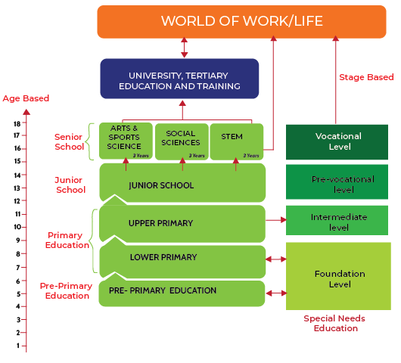
Organisation of Basic Education

Slide 6
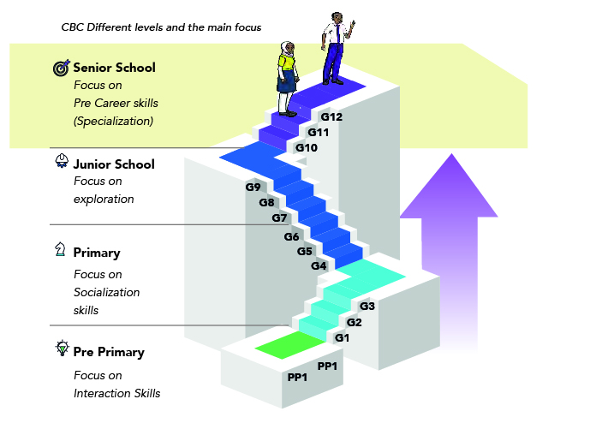
FOCUS OF BASIC EDUCATION LEVELS
PP2

Slide 7
LEARNING AREAS: PRE-PRIMARY (PP1 & PP2)
The five learning areas in pre-primary curriculum are:
S/no | Activity learning area
1 | Language activities
2 | Mathematical activities
3 | Creative activities
4 | Environmental activities
5 | Religious activities
 | Pastoral/Religious programme of instruction

Slide 8
LOWER PRIMARY (GRADES 1, 2 & 3)
The seven learning areas in lower primary curriculum are:
1. Indigenous Language Activities
2. Kiswahili Language Activities / Kenya Sign Language Activities
3. English Language Activities
4. Mathematical Activities
5. Religious Education Activities
6. Environmental Activities
7. Creative Activities
Pastoral/Religious Programme of Instruction
The curriculum is adapted for Hearing Impaired, Visually Impaired and Physically Impaired.
A stage based curriculum for the Mentally challenged for
foundational level

Slide 9
UPPER PRIMARY (GRADES 4, 5 & 6)
.
The eight learning areas in the upper primary curriculum are:
1. English
2. Kiswahili/ Kenya Sign Language
3. Mathematics
4. Religious Education
5. Science & Technology
6. Agriculture
7. Social Studies
8. Creative Arts
Pastoral/Religious Programme of Instruction
The curriculum is adapted for Hearing Impaired, Visually Impaired and Physically Impaired.
A stage based curriculum for the Mentally challenged for
intermediate level

Slide 10
JUNIOR SCHOOL (GRADES 7, 8 & 9)
The nine learning areas in the Junior School curriculum are:
1. English
2. Kiswahili/Kenya Sign Language
3. Mathematics
4. Religious Education
5. Social Studies
6. Integrated Science
7. Pre-technical Studies
8. Agriculture
9. Creative Arts and Sports
Pastoral/Religious Programme of Instruction
The curriculum is adapted for Hearing Impaired, Visually Impaired and Physically Impaired.
A stage based curriculum for the Mentally challenged for
pre-vocational level

Slide 11
SENIOR SCHOOL (GRADE 10, 11 & 12)
Senior school comprises three years of education for learners between 15 and 18 years.
It lays the foundation for further education and training at the tertiary level and the world of work.
Learners will specialise in a career path of choice based on their potential, interests and personality.
Learners will undertake core subjects and elective subjects based on career choice, interests, personality and aptitude.

Slide 12
ARTS AND SPORT SCIENCE PATHWAY
SPORTS SCIENCE
Sports and Recreation
ARTS AND SPORTS SCIENCE
Music and Dance
Theatre and Film
Fine Arts
ARTS

Slide 13
SOCIAL SCIENCE PATHWAY
SOCIAL SCIENCES
LANGUAGES & LITERATURE
HUMANITIES & BUSINESS STUDIES
Literature in English
Indigenous Languages
Fasihi ya Kiswahili
Sign Language
Arabic
French
German
Mandarin Chinese
Christian Religious Education
Islamic Religious Education
Hindu Religious Education
Business Studies
History and Citizenship
Geography

Slide 14
STEM PATHWAY
Mathematics
Biology
Chemistry
Physics
General Science
PURE SCIENCES
SCIENCE, TECHNOLOGY, ENGINEERING AND MATHEMATICS (STEM)
APPLIED SCIENCES
Agriculture
Computer Studies
Home Science
Aviation
Building and Construction
Electricity
Metalwork
Power Mechanics
Woodwork
Media Technology
Marine and Fisheries Technology
TECHNICAL STUDIES

Slide 15
Scope of Learning in Senior School
Core Subjects
English
2. Kiswahili /KSL
3. Mathematics/Essential Mathematics
4. Community Service Learning (CSL).
Pastoral / Religious Programme of Instruction
Support Subjects
Physical Education
Information Communication Technology(ICT)

Slide 16
ELECTIVE SUBJECTS
Elective subject 1
Elective subject 2
Elective subject 3
NB: Schools will get official communication on this scope of learning later this year.

Slide 17
      LIST OF ALL SUBJECTS AT SENIOR SCHOOL
Literature in English
Indigenous Languages
Fasihi ya Kiswahili
Sign Language
Arabic
French
German
Mandarin Chinese
Christian Religious Education
Islamic Religious Education
Hindu Religious Education
Business Studies
History and Citizenship
Geography
Biology
Chemistry
Physics
General Science
Agriculture
Computer Studies
Home Science
Aviation
Building Construction
Electricity
Metalwork
Power Mechanics
Woodwork
Media Technology
Marine and Fisheries Technology
English
Kiswahili/KSL
Core Mathematics/ Essential Mathematics
Physical Education (PE)
Community Service Learning
ICT
Sports and Recreation
Music and Dance
Theatre and Film
Fine Arts
Notes:
© Copyright PresentationGO.com – The free PowerPoint and Google Slides template library

Slide 18

"Curriculum is never static.
It is ever-changing and needs to adapt to the needs of society."
Linda Darling-Hammond
THANK
YOU

