Slide 1
RETOOLING OF SENIOR SCHOOL TEACHERS
INTERPRETATION OF THE CURRICULUM DESIGN
DECEMBER, 2025

Slide 2

KWL
1. What do I know about the Curriculum Design?
2. What do I want to know about the Curriculum Design?
Notes:
The outcome is linked to the outcome of the previous session on Audio based and video based modes of remote learning
2

Slide 3

Curriculum Design
A Curriculum Design is a document that outlines the components or elements of a curriculum.
It’s a core document that guides learning institutions on how to organise learning.
A Curriculum Design provides details that show the relationship between the components.
Curriculum Designs ensure the curriculum can be implemented within the time allocated and with the infrastructure in the schools.

Slide 4
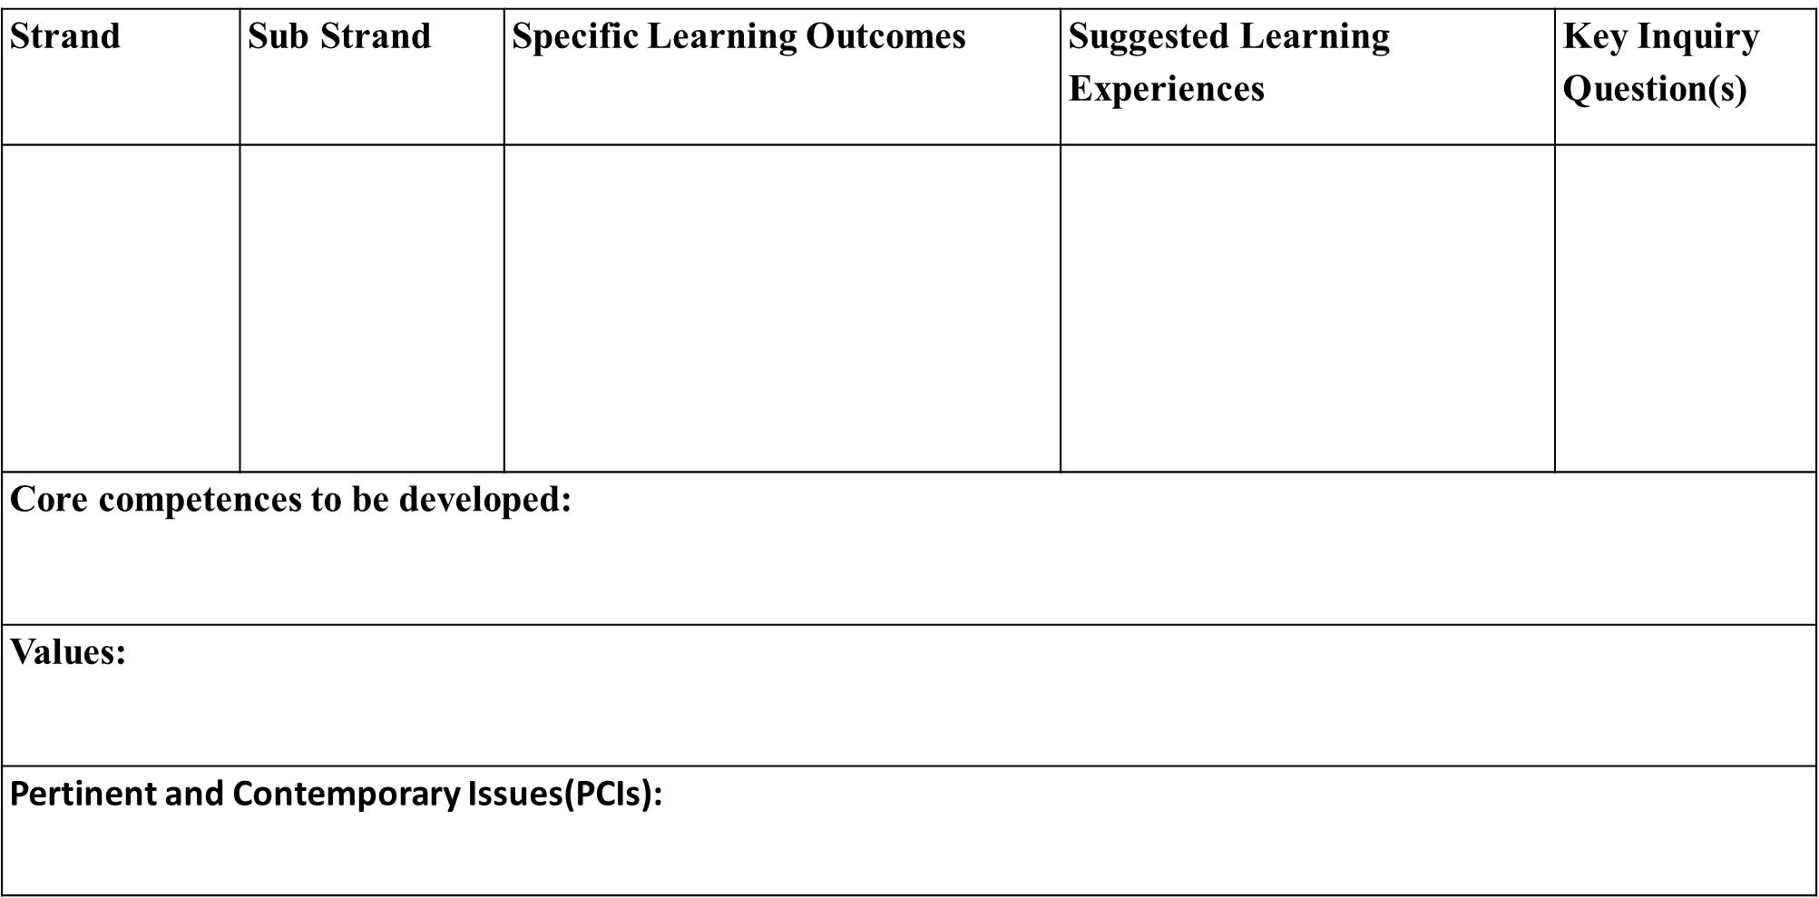
Components of a Curriculum Design
National Goals of Education
Learning Outcomes for Senior School
List of Subjects
Lesson Distribution
Essence Statement
Subject General Learning Outcomes
Summary of Strands and Sub strands

Slide 5
Essence Statement
The curriculum design for each Senior School subject includes an Essence Statement.
The essence statement;
Describes the subject – what it is it all about
Links its foundation to Junior School (JS) learning
Outlines the specific skills the learner will develop from the subject
Highlights potential career opportunities related to the subject

Slide 6
Strand and sub strands
Strand: A strand is a broad category or domain within a curriculum design that represents a major area of learning. Strands typically encompass a group of related knowledge, skills and attitudes.
For example:
The Grade 10 Curriculum Design for Core Mathematics has 3 Strands;
1.0 Numbers and Algebra
2.0 Measurement and Geometry
3.0 Statistics and Probability
Sub strand: A sub-strand is a more specific subset or subdivision within a larger strand. It further breaks down the content or competency areas into more focused and manageable components.
For example:
Grade 10 Curriculum Design for Core Mathematics
STRAND 3.0 (Statistics and Probability) has 2 sub strands;
1.1 Statistics I
1.2 Probability I

Slide 7
Learning Outcomes
Learning outcomes are the end result or what the learner is able to demonstrate upon completion of a lesson, sub strand, strand or level.
Learning outcomes express what a learner is expected to do after going through a learning experience.
They indicate the expected observable behavioural changes in the learner after a learning experience.
Learning outcomes are expressed through the application of knowledge, skills and attitudes.

Slide 8
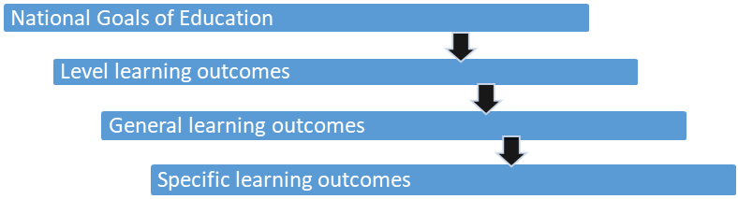
Progression of Learning Outcomes

Slide 9

Group Activity
Access the Grade 10 Curriculum Designs from the KICD Website at https://kicd.ac.ke/cbc-materials/curriculum-designs/grade-ten/.
Pick a Specific Learning Outcome (SLO) and trace it back to a National Goal of Education.

Slide 10
Lesson Learning Outcome (LLO)
A Lesson Learning Outcome is statement that clearly illustrate what action a learner will undertake to demonstrate a competence by the end of a lesson.
The action should demonstrate a change at the level of knowledge, a skill or an attitude.
KNOWLEDGE
Acquisition of facts, ideas, concepts; their application, synthesis to get new ideas and evaluation of the information
SKILLS
Using the knowledge acquired, a learner is able to apply it to perform certain tasks against a given standard. The standard to which a learner should perform the task is referred to as a competence.
ATTITUDE
Desirable beliefs and personal attributes that a learner acquires through knowledge and skill that influence performance.

Slide 11
The ‘verb, object and context’ in a learning outcome
  The VERB represent the three domains of learning including knowledge, skills and attitudes.
  Example;
By the end of the sub-strand the learner should be able to:
  identify types of operating systems used in digital devices,
  use an operating system to organise files and folders in a computing device,
  appreciate the role of operating systems in an ICT device.
The learning outcome also has an OBJECT, which answers the question “what”
Example;
By the end of the sub-strand the learner should be able to:
  identify types of operating systems used in digital devices,
  use an operating system to organise files and folders in a computing device,
  appreciate the role of operating systems in an ICT device.
The learning outcome also has a context, which answers the question “why”, “where”, “how” and “when”
Example;
By the end of the sub-strand the learner should be able to:
  identify types of operating systems used in digital devices,
  use an operating system to organise files and folders in a computing device,
  appreciate the role of operating systems in an ICT device.

Slide 12
Designing Lesson Learning Outcomes (LLOs)
A good learning outcome begins with an action verb, followed by the object of the verb and a phrase that gives the context.
Preferably only one verb is used in a learning outcome.
The learning outcomes should be observable.
Learning outcomes should be amenable to assessment.
Avoids vague terms like know, understand, learn, be familiar with, be exposed to, be acquainted with or be aware of.

Slide 13
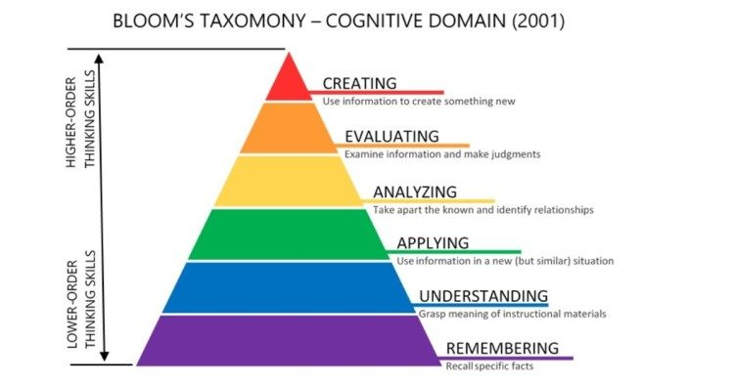
Formulating Lesson Learning Outcomes
Lesson learning outcomes in Senior School should address higher order thinking skills as outlined in the bloom's taxonomy.

Slide 14
Generating Lesson Learning outcomes (LLO) from Specific Learning Outcome (SLO)
Specific Learning Outcomes (SLOs) that cannot be achieved in a single lesson should be broken down into Lesson Learning Outcomes (LLOs).
In breaking down a specific SLO into LLOs, a teacher should consider the following;
scope of the SLO as per the curriculum design
the concept(s) to be developed during the lesson
element of competency being broken down (Knowledge or Skill)
expected skills to be developed by the end of the lesson (cognitive, psychomotor)
learning experiences that the learner will need to undertake to achieve the SLO
observable assessment evidence expected
resources available to attain the SLO

Slide 15

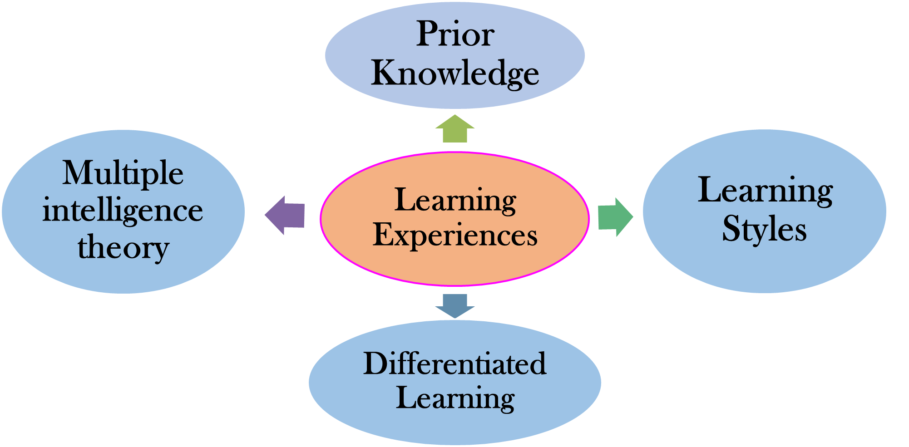
Learning Experiences
What are learning experiences?
Learning experiences are activities or tasks that the learner should carry out in order to develop desired knowledge, skills, values and attitudes
Learning experiences focus on developing the trainees cognitive, physical and emotional domains.
They are interactions in which learning takes place.
“Learning Experience is the interaction between the learner and external conditions in the environment to which he/she can react.” - Ralph Tyler
What informs Learning Experiences?

Slide 16
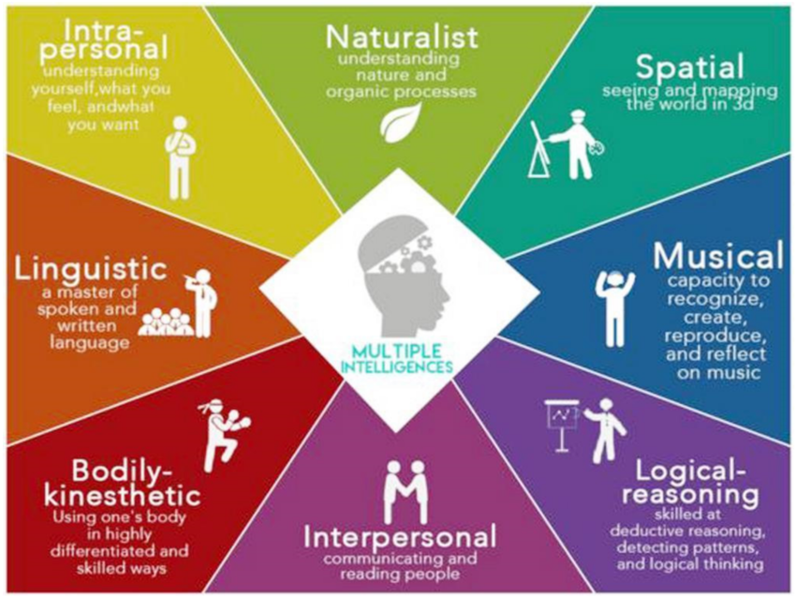
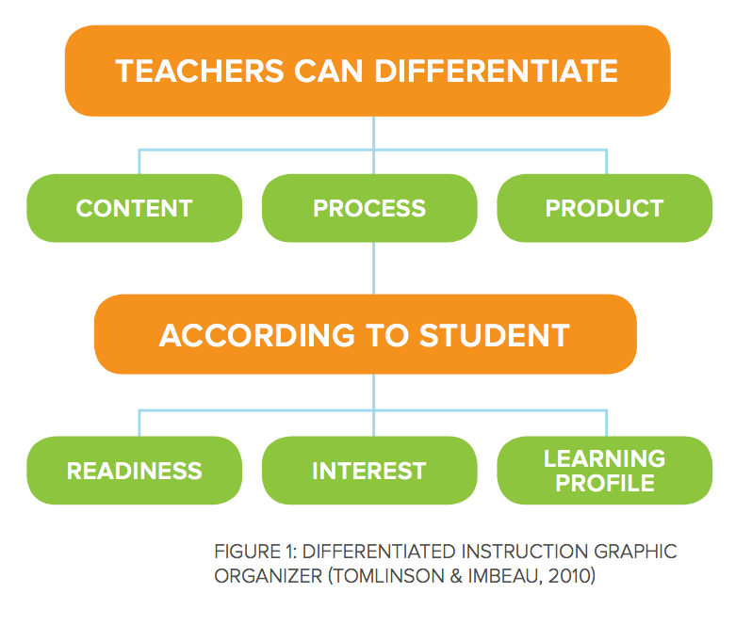
MULTIPLE INTELLIGENCIES
DIFFERENTIATED LEARNING

Slide 17
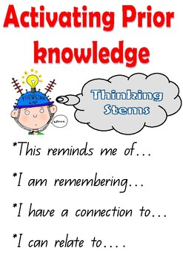
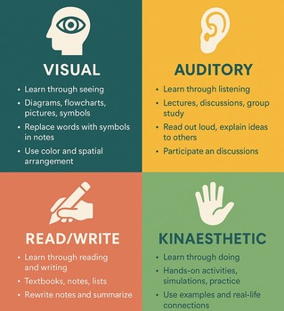
PRIOR KNOWLEDGE
LEARNING STYLES

Slide 18
Learning Experiences
The learning experiences in the Curriculum Design are SUGGESTED.
When developing learning experiences for the lesson, the teacher should consider their environment including:
Resources available (materials, equipment, digital tools, realia).
Learner characteristics (abilities, interests, prior knowledge, learning needs).
Local relevance (using examples, scenarios, problems, and contexts familiar to learners).
Safety considerations (ensuring learning experiences are suitable and safe for the age group).
Opportunities for active engagement (collaboration, hands-on tasks, problem-solving).
Formative Assessment (whether the experience allows the teacher to observe or collect evidence of achievement of LLO).

Slide 19

Key Inquiry Questions (KIQs)
Key inquiry questions form the foundation of Inquiry-Based Learning (IBL), a critical methodology in Competency Based Education (CBE) as it involves asking questions.
Such questions help the learner retain information and invariably encourage them to investigate concepts under study by asking further questions about what they are learning.
KIQs help learners focus on learning by prompting deeper meaning, encouraging curiosity, and fostering critical thinking and higher-order skills such as problem-solving.

Slide 20

Characteristics of Key Inquiry Questions
A well-formulated Key inquiry question:
is thought-provoking and intellectually engaging.
integrates technology to support the learning process.
calls for higher-order thinking.
cannot be effectively answered by recall alone.
raises additional questions and sparks further inquiry.
is open-ended, non-judgmental, meaningful and purposeful.
requires support and justification, not just an answer.

Slide 21
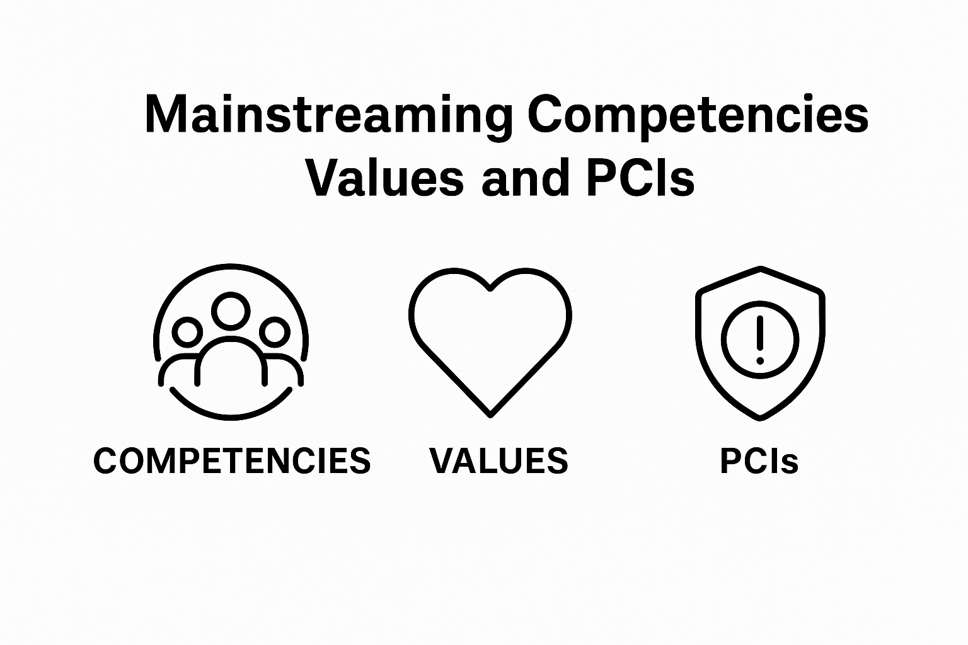
Mainstreaming Core Competencies, Values and PCIs in the Learning Experiences
Mainstreaming is the process of identifying suitable opportunities to incorporate the development of Core Competencies, nurture Values and address Pertinent and Contemporary Issues (PCIs) in the learning experiences.
Core Competencies, Values and PCIs to be mainstreamed in the learning experiences are clearly outlined in the curriculum designs for proper guidance.

Slide 22
Mainstreaming Core Competencies in the learning experiences
Core Competencies are key skills and abilities that learners need to develop to succeed in the 21st century. These competencies aim to provide a holistic education that prepares students for the demands of modern life.
1. Communication and Collaboration
Embed learning experiences that will make learning take place collegially, in a group or a team.
2. Critical Thinking and Problem Solving
Structure learning around situations that will require learners to use logic and evidence to arrive at conclusions or solve problems.
3. Communication and Collaboration
Embed learning experiences that will make learning take place collegially, in a group or a team.
4. Citizenship
Create a learning environment that will require learners to demonstrate their rights, privileges, and duties as citizens.

Slide 23
Mainstreaming Core Competencies in the learning experiences
5. Creativity and Imagination
Exploit learning activities as avenues for learners create new ideas that result in products that add value to their lives and to the lives of those around them.
6. Learning to Learn
Regularly remind learners that learning is a continuous process that requires personal organization, effective management of time and information, both individually and in groups.
7. Self Efficacy
Use the learning environment to instil in learners the belief about their capabilities to perform assigned tasks, prospects for accomplishment and personal well-being.

Slide 24
Mainstreaming Values in the learning experiences
Values are principles or standards of behavior that guide individuals in making decisions, building relationships and conducting themselves in a manner that is considered morally and socially acceptable.
Love (care and compassion)
Embed learning activities that help learners care for others, show kindness, and build positive relationships within the school and community.
Responsibility
Provide tasks that require learners to take ownership of their actions, complete assigned duties, and be accountable for outcomes.
Respect
Create routines and interactions that require learners to treat others with dignity, honour differences, respect property, and follow classroom norms.

Slide 25
Mainstreaming Values in the learning experiences
Unity
Design collaborative learning situations that encourage learners to work together harmoniously, appreciate diversity, and promote national cohesion.
Peace
Structure learning around experiences that promote conflict resolution, empathy, and calm problem-solving in group and peer interactions.
Patriotism
Embed activities that help learners value their country, participate positively in community life, appreciate national symbols, and uphold civic duties.
Integrity (honesty and trustworthiness)
Use scenarios, projects, and classroom routines that encourage learners to act honestly, keep promises, and demonstrate ethics.
Social Justice
Design learning experiences that require learners to uphold fairness, equity, human dignity and respect for the rights of all.

Slide 26
Mainstreaming of Pertinent and Contemporary Issues (PCIs) in the learning experiences
Pertinent and Contemporary Issues (PCIs) refer to the current and significant challenges or topics that impact society and require attention and action.
The PCIs for Senior School are categories into 4 broad categories
Health Promotional Issues
Embed learning activities that help learners to:
Practise behaviours that prevent diseases.
Manage personal health and wellbeing safely.
Prevent drug and substance abuse.
Challenge harmful gender-related health practices.
Socio-Economic & Environmental Issues
Create learning opportunities that guide learners to:
Apply safety measures in real-life situations.
Promote environmental conservation and sustainability.
Make responsible financial and social decisions.
Prevent exploitation, extremism, and harmful practices.

Slide 27
Mainstreaming of Pertinent and Contemporary Issues (PCIs) in the learning experiences
Citizenship Education
Structure learning experiences that enable learners to:
Uphold good governance and ethical conduct.
Promote peace and positive social cohesion.
Respect and protect human rights for all.
Participate responsibly in civic and cultural life.
Life Skills, Moral Education & Human Sexuality
Provide activities that support learners to:
Develop self-management and emotional control skills.
Practise effective communication and social skills.
Demonstrate assertiveness and resist negative influence.
Make responsible decisions on sexuality and personal growth.

Slide 28
Cluster Activities
In your respective subject clusters, you will be expected to:
Interpret the curriculum design in your specific subject,
Break down the Specific Learning Outcomes (SLOs) into Lesson Learning Outcomes (LLOs),
Generate learning experiences to achieve the lesson learning outcomes
Mainstream Core Competencies, Values and Pertinent and Contemporary Issues as per the curriculum design.

Slide 29

THANK YOU!
“The heart of effective learning lies in the correct interpretation of the Curriculum Design”
- UNESCO

