Slide 1



ICT INTEGRATION IN TEACHING AND LEARNING
ENHANCING LEARNING EXPERIENCES
DECEMBER 2025

Slide 2
Session Objectives
Understand the importance of ICT integration in modern teaching and learning
Explore ICT tools for teaching and learning.
Apply ICT-based strategies in Teaching and learning

Slide 3
Join at ment.com: user code 81064519 :create YOUR OWN
What Is ICT Integration In teaching and learning?

Slide 4
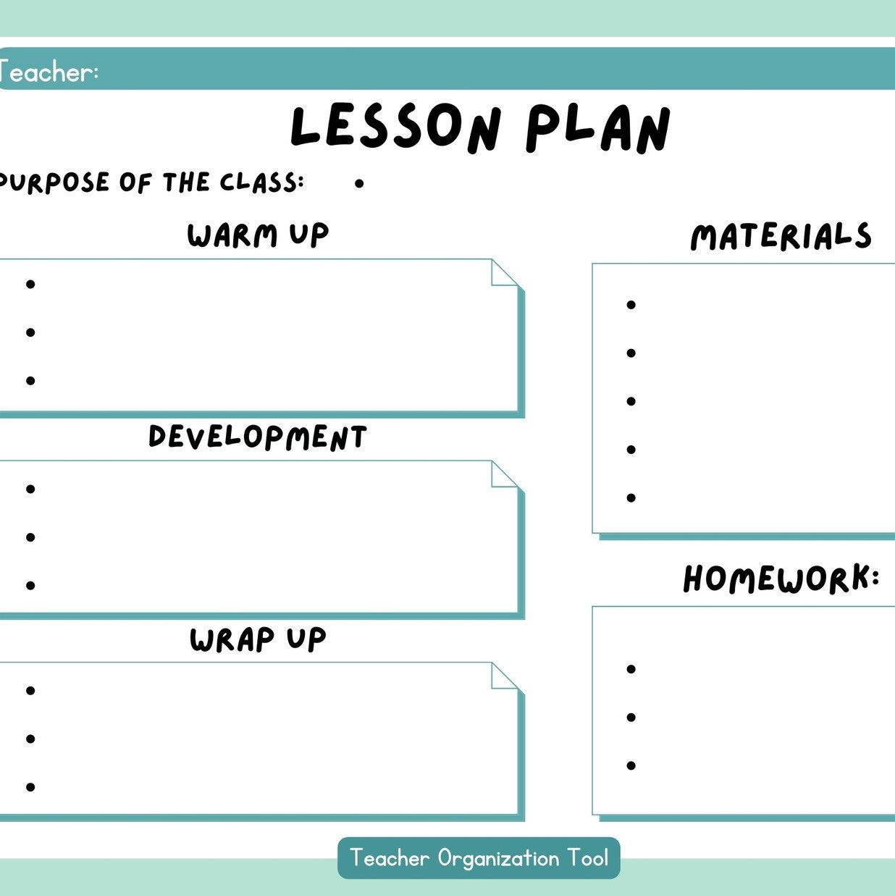
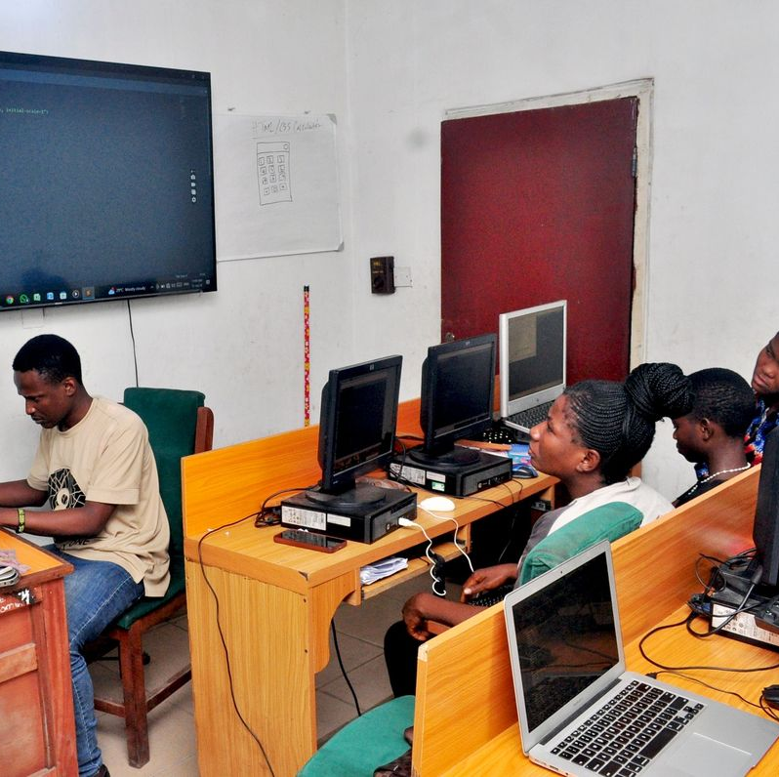

What Is ICT Integration in teaching and learning?
Use of technology to plan
Use of technology to transform learning experiences.
Use of technology to deliver and assess learning.

Slide 5
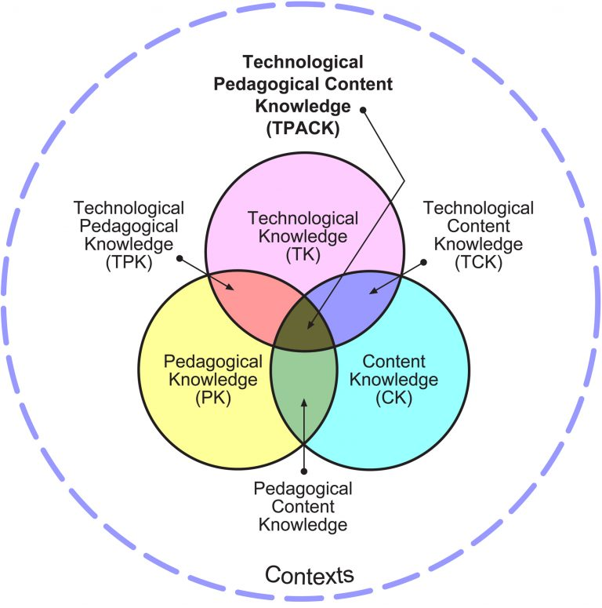
ICT Integration Continues….
Supported by TPACK framework (Technology + Pedagogy + Content).

Slide 6



Why ICT matters in teaching and learning
Promotes active, collaborative learning.
Enhances digital literacy and learner engagement
Expands access to diverse resources and learning styles.

Slide 7
Begin With A Digital Icebreaker
Useful ICT Tools for Teachers and Learners
What ICT tools teachers already use and how they use them in teaching and learning

Slide 8
Useful ICT Tools for Teachers and Learners
ICT Devices such as computers, Televisions, Radios, Digital Cameras, LCD Projectors Interactive boards, Smartphones, Data storage devices (CDs, DVDs, Memory sticks)
Productivity Tool such as Word processing , spreadsheets, Presentation software, database management software , desktop publishing ,photo editing software,Graphic software, Microsoft 365 Office
Communication tools such as Email, telephone, mobile phones, SMS/Text Messaging, and social networking

Slide 9
Useful ICT Tools for Teachers and Learners
Meeting Tools: such as Attendify, Calendar
Assessment Tools: such as E- portfolios, Kahoot, Mentimetor, E-forms, polls, Quizizz, Socrative, digital rubrics,
Searching Tools such as e-library, Google Google Scholar, Bing, DuckDuckGo
Virtual Conferencing Tools: such as Zoom, Google Meet, Webex, Microsoft Teams ,Google Hangouts, Skype, Meta platform (Facebook Live), YouTube live.

Slide 10
Useful ICT Tools for Teachers and Learners
Social network platforms : such as Twitter, Instagram, Facebook WhatsApp, tik-tok
Learning Management Systems: such as Kenya Education cloud (KEC-LMS) platform, google classroom, Moodle, Edmodo
Creativity and Content Creation tools: such as canva, capcut, digital camera
Collaborative Tools such as WhatsApp, Google Docs,one drive padlet,Trello,
Cloud storage: such as google drive, one drive, drop box
Vedios, Simulations, Animations

Slide 11
AI Tools Used in Teaching and Learning
Category | Purpose | Examples of AI Tools
Lesson Planning & Content Creation | Create lessons, worksheets, presentations, assessments | ChatGPT, Gemini, Claude, Canva AI, Curipod
Assessment & Feedback | Automated grading, plagiarism detection, feedback generation | Gradescope, Turnitin, Google Classroom AI features, Quizizz AI, Kahoot AI
Classroom Management | Track behavior, attendance, communication | ClassDojo, AI-enabled school management systems
Learning Support (leraners ) | Tutoring, explanations, practice exercises | Khan Academy (Khanmigo), Duolingo, Photomath, Mathway
Writing & Research | Improve writing, citations, research exploration | Grammarly, ChatGPT, Semantic Scholar, DeepSeek, Gemini Perplexity AI
Creativity & Projects | Create posters, videos, code, digital projects | Canva AI, Scratch with AI, Notion AI
STEM & Lab Tools | Virtual labs, math tools, coding support | Labster, GeoGebra, GitHub Copilot

Slide 12
Group Work: Design a Mini ICT-Integrated Lesson
Divide teachers into small groups by subject area.
Ask them to use ICT tools to prepare a lesson plan
Ask them to design a short lesson that integrates one or more ICT tools — e.g A science teacher uses PhET simulations, Language teacher can use mobile apps eg duoligo, Canva for creative Arts
Each group presents their lesson idea to others.
NB Tip: Encourage peer feedback focused on learning outcomes and tool suitability.

Slide 13
ACTIVITY: Live Demonstration
Conduct a short mini-lesson using a platform like Google Meet or Zoom, Google classroom
E- forms e.g google forms for quick quiz to show real-time assessment and generate a link to the learners
Then discuss:
What worked well?
How can this translate to their subjects?

Slide 14

PARTING SHORT
ICT integration in teaching is not about replacing good teaching—it’s about enhancing learning.

Slide 15


