Slide 1
COMPETENCY BASED ASSESSMENT
TOOLS
15TH-19TH DECEMBER 2025
AT BULIMBO GIRLS

Slide 2

The session discusses:
the tools used in Competency-Based Assessment
how the tools are used to assess Competencies
how to design the tools for different assessment purposes
how the tools can be adapted to suit learners with special needs and disabilities.

Slide 3
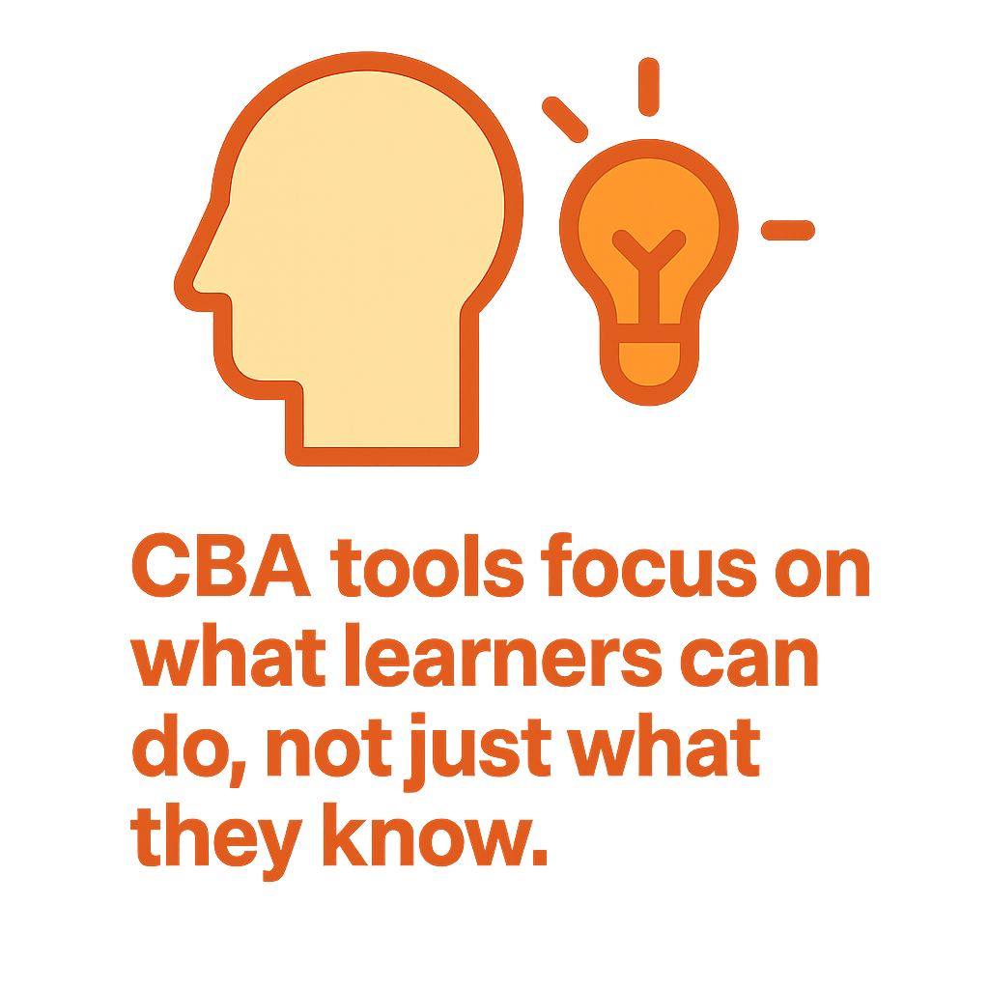

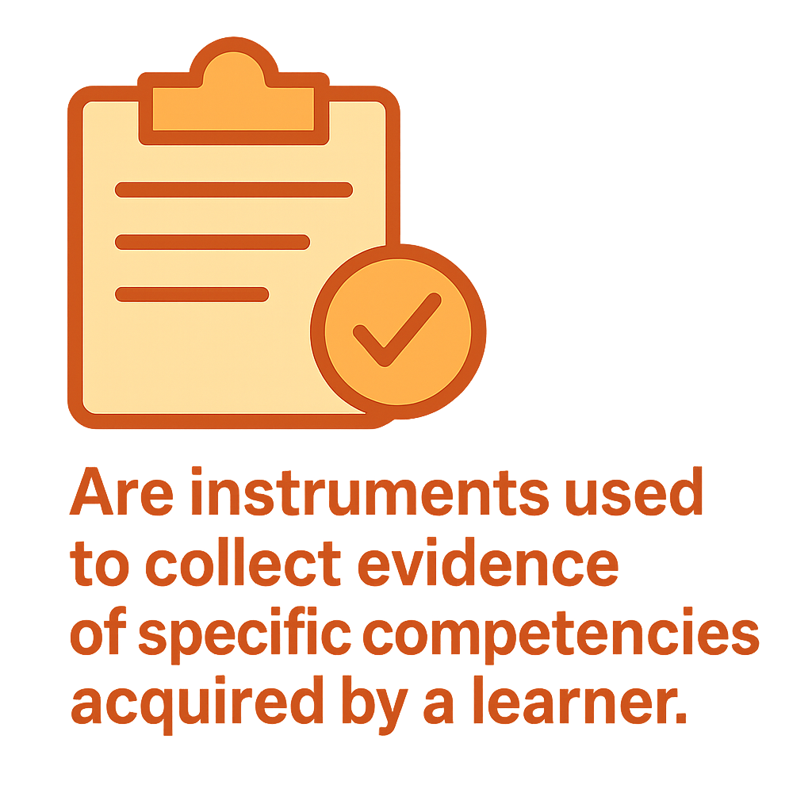

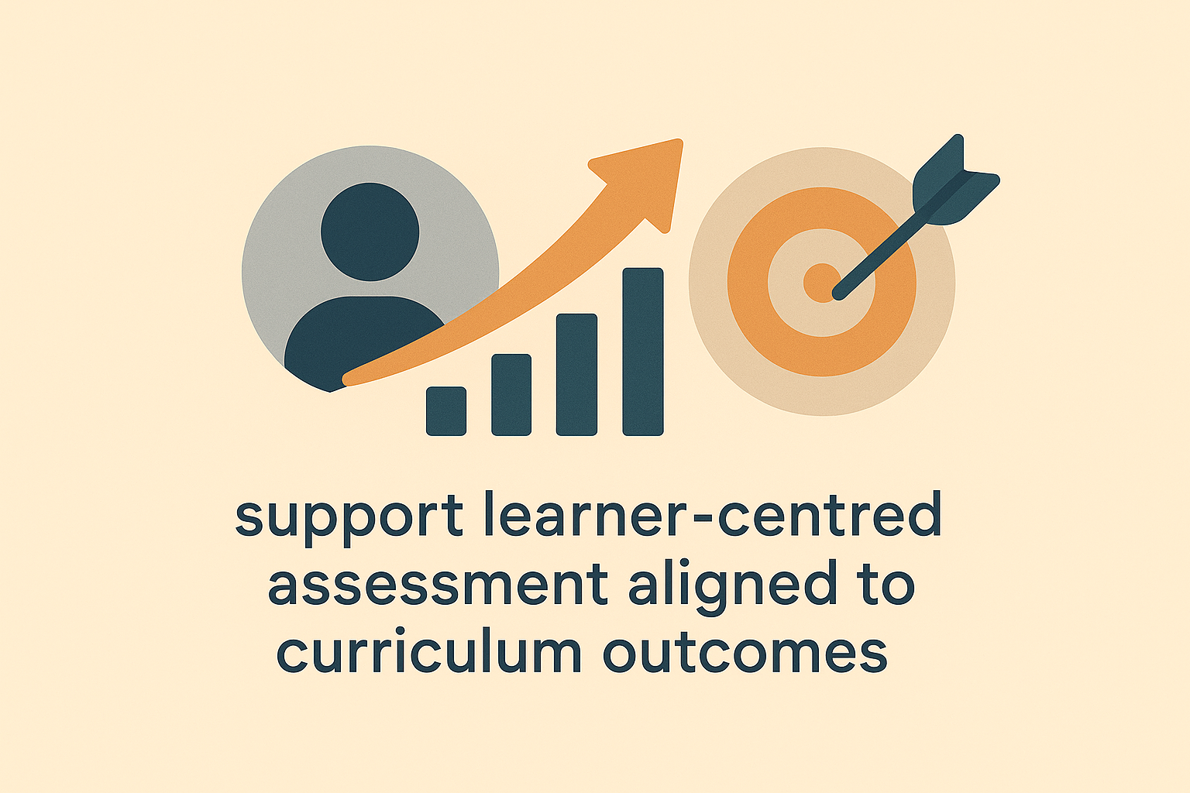
What Are Competency Based Assessment
Tools (CBA-Tools) ?

Slide 4

Participants brainstorm on various examination tools used in 8-4-4.
Participants discuss additional assessment tools used in the 21st century to assess competencies.
Participants randomly give their findings after discussions.

Slide 5
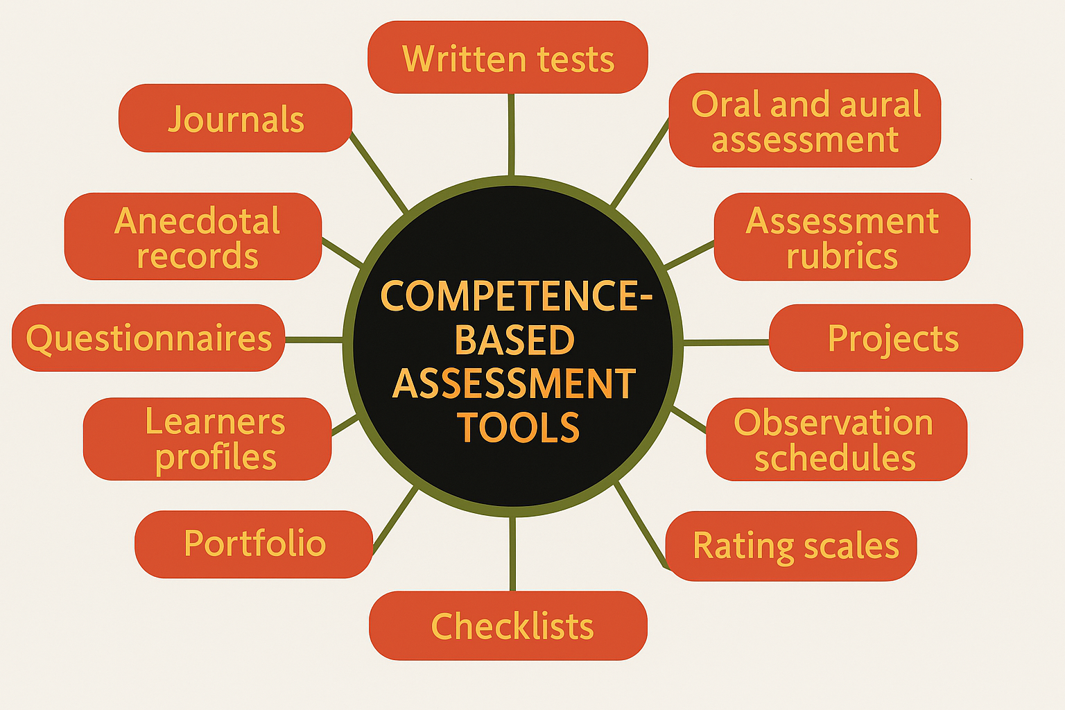
Examples of CBA-Tools
Notes:
WRITTEN ASSESSMENTS
It involves writing the responses rather than doing them practically or orally.
It is designed to elicit evidence from the learner on their acquisition of learning outcomes.
They may take the form of :-multiple choice, true or false, matching items, completion, short-structured, essay questions.

Slide 6
Key Steps in Designing an Assessment Tool
Define the assessment purpose clearly.
Diagnostic – To identify learners' strengths, prior knowledge.
Formative – To monitor learning progress and guide instruction.
Summative – To evaluate learning outcomes at the end of a period.
Placement – To determine appropriate levels or groups for learners.
Evaluative – To assess the effectiveness of instructional methods or programs.
Certification – To validate achievement for credentials or qualifications.
2. Specify learning outcomes to be assessed-Tools must reflect what is being taught
and what learners are expected to know, value and do.
-Involve learners through self and peer assessments-Allow for learner voice, choice
and reflection.

Slide 7
3. Select the appropriate assessment tool.
  Ensure tools are age-appropriate and culturally responsive.
  Use a variety of tools to gather a holistic view of learner progress.
  Continuously evaluate and improve tools based on data and classroom realities.
  Use digital tools where possible (e.g., digital portfolios)
4. Draft the tool with clear instructions and scoring criteria.
  Emphasize real-world tasks, performance tasks and portfolios
  Use rubrics with performance levels clearly defined.
  Give feedback not just scores

Slide 8
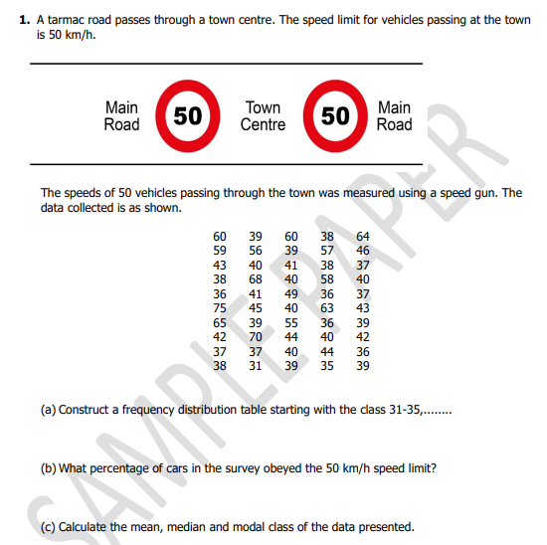
Written Test

Slide 9
Participants, working in subject-specific groups, will develop a written test item
Select groups to present

Slide 10

Oral assessments
are questions asked verbally and require the learner to respond by speaking.
It assess a learner’s skills of speaking and listening.
teachers may prepare questions that are posed orally to the learner.
Click the icon to play

Slide 11

Aural assessment
assesses the learner’s ability to listen to prerecorded tasks and respond appropriately.
It is aimed at assessing the learner’s skills in listening.
The teacher may record a story, then play it to the learners who are supposed to give responses to questions from the passage.
Responses can be given orally or in written form.

Slide 12
Participants in groups of their subjects develops Oral or Aural Assessment Tool.
Using their smartphones,they record the assessments developed.
Participants to record a video while carrying out the assessment developed.
Participants to share the pre recorded video with the trainer for plenary comments.

Slide 13
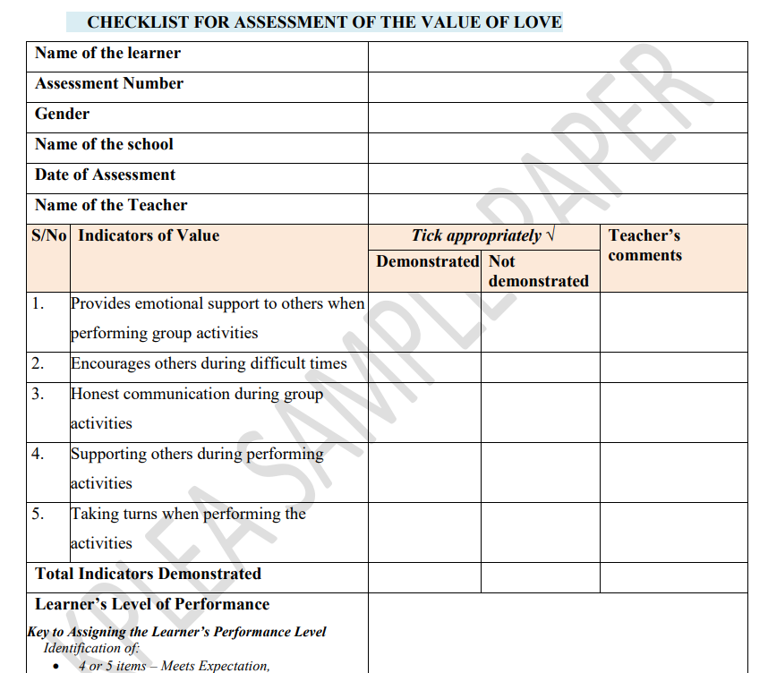
Checklist

Slide 14
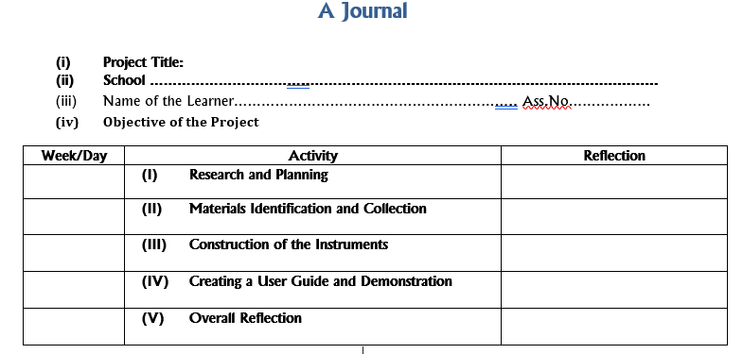
Making a durable and portable thermometers

Slide 15
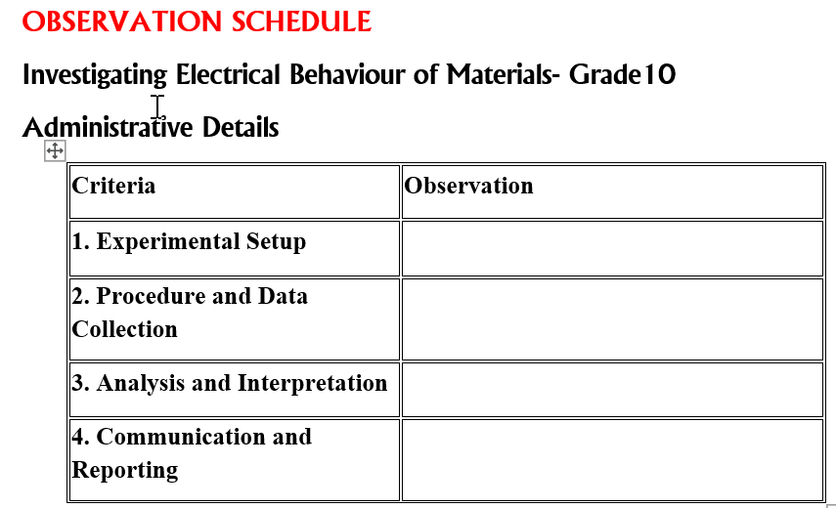
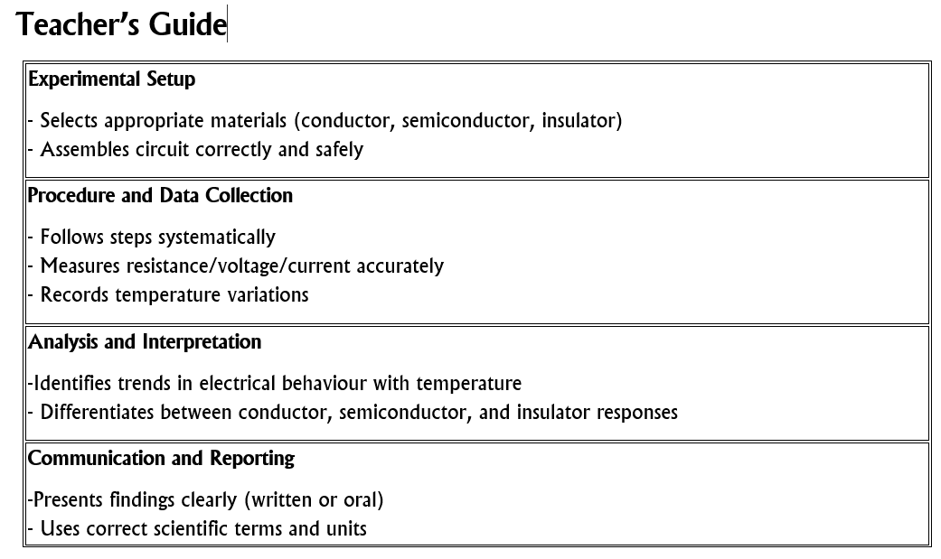

Slide 16
Project Assessment
PRE-TECHNICAL STUDIES PROJECT
TASK: A porridge vendor who sells porridge on a construction site wants to make a sieve so that her porridge is made of well sieved flour.
1. Make a freehand pictorial sketch to show how the sieve will look like and indicate the measurements.
2. Choose locally available materials such as wood, metal, plastic etc for making the sieve.
3. Select appropriate tools for marking sieve
4. Make the Sieve.

Slide 17
ACTIVITY
Using the project on MAKING THE SIEVE, develop an Observation checklist and observation schedule you will use to assess the learner's work.
Invite a few randomly selected groups to present there work

Slide 18

A portfolio is a purposeful collection of learner’s work samples /evidence that shows their competency, effort, progress and mastery of specific learning outcomes.
Portfolio file contains all the major learning activities, assessment projects and documents.
The learner may choose the work samples to place in the portfolio, but the teacher may also recommend that specific work samples be included.

Slide 19
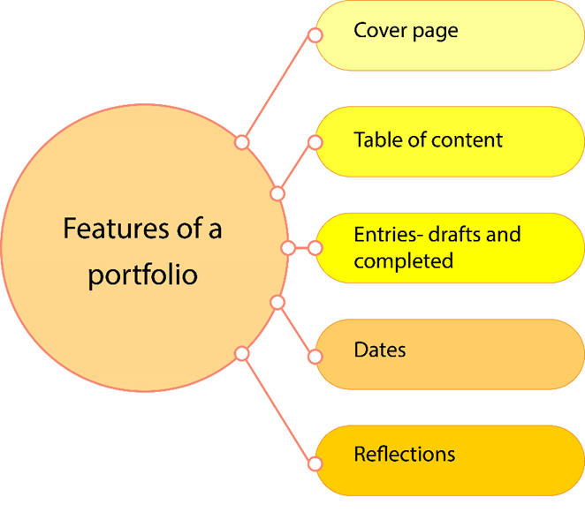
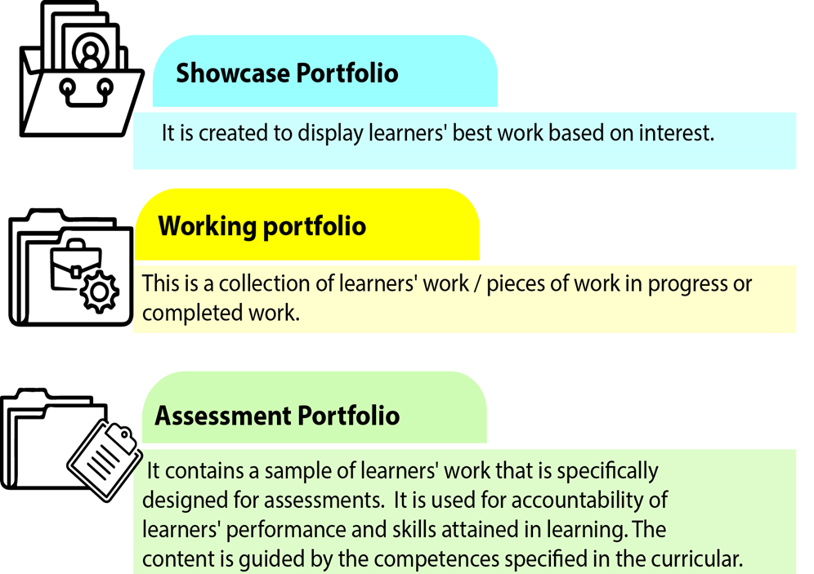
Types of portfolio
Features of a portfolio

Slide 20
ASSESSMENT RUBRIC
Used to interpret and assess learner’s performance in a task.
AUTHENTIC TASK
It is an assignment that assess learner’s ability to apply knowledge and skills to solve real world problems.
STANDARDS
These are statements of what students should know and be able to do.
CRITERIA
These are statements that describe knowledge and skills or standards by which a learner is judged upon as they undertake the task.
Performance Level
Are numerical values used to define the competency.
DESCRIPTORS
These are words or expressions used to identify individual learner’s level of performance.
NB: A teacher must decide on the concepts or skills to be assessed and how he expects the learners to display the skills?
Notes:
Criteria is key- leads the teacher to objectivity-exactly what the learner can do

Slide 21
Types of Rubrics
There are two types of rubrics.
Analytic Rubric
  Breaks down content or tasks being assessed into smaller parts.
  Each part is assessed separately.
1
Notes:
Depends on what the teacher wishes to assess

Slide 22
SAMPLE RUBRICS
TASK
(i) Look at the matchbox placed on the table by your teacher.
(ii) Draw the matchbox, in varied views to depict one point perspective.
(iii) Display and explain to your classmates how you arrived at the final product.

Slide 23
Analytic Rubric
Criteria | Exceeding Expectation | Meeting Expectation | Approaching Expectation | Below Expectation
Drawing a matchbox in varied views to depict one-point perspective | Neatly draws the matchbox from multiple views. All lines converge at a single vanishing point. Shows strong grasp of perspective. | Draws the matchbox from varied views with lines converging at the vanishing point. Minor errors present. | Draws the matchbox from varied views, but some lines are misaligned or do not converge accurately. | Drawing lacks varied views. Lines do not converge. Shows minimal understanding of perspective.
Displaying and explaining to classmates the final product | Displays neat final product and confidently explains steps using correct terms. Shows clear understanding. | Displays neat work and explains steps using appropriate terminology. | Displays the product but struggles with explanation or uses limited vocabulary. | Displays poorly drawn work and cannot explain the process. Shows little understanding.

Slide 24
Interpretation of Assessment Results
Exceeding Expectation (Level 4)
A learner demonstrates exceptional achievement in terms of technical skills, originality, creativity and initiative.
Meeting Expectation (Level 3)
A learner demonstrates Proficiency as having acquired and mastered the aspects of the targeted competency: technical skills, originality, creativity and initiative.

Slide 25
Approaching Expectation (Level 2)
A learner at this level demonstrates proficiency with some inconsistencies in the task performed. It is a developing stage the learner has acquired some aspects of the targeted competency but not fully mastered.
Below Expectation (Level 1)
A learner has difficulties in demonstrating proficiency in the task performed in terms of technical skills, creativity. It is the beginning level and the learner is yet to acquire the specified competencies.

Slide 26
Holistic Rubric
  Assesses overall performance on a task as a single entity.
  Scores the overall competencies of the learner.
2

Slide 27
Criteria | Exceeds Expectations | Meets Expectations | Approaches Expectations | Below Expectations
Drawing a matchbox in varied views to depict one-point perspective, displaying and explaining the final product. | Draws a matchbox neatly and accurately from different views, with all lines converging at a vanishing point, and clearly explains the process using correct technical terms. | Draws a matchbox from different views with lines converging at a vanishing point, and clearly explains the drawing process | Draws a matchbox from different views, but some lines are off and don’t meet at the vanishing point; struggles to explain parts of the process. | Drawing lacks different views, lines don’t converge at the vanishing point, and the explanation is unclear or prompted

Slide 28
Using Rubrics Effectively
Share rubrics with learner before giving the task
Have learners evaluate their own work using the rubrics
Have learners evaluate each other’s work using the rubrics
Use the rubrics as the basis for feedback discussions with learner(s) while their work is developing and when their work is completed
Grade learners based on the rubrics.

Slide 29
ACTIVITY
Using the project on MAKING THE SIEVE, develop rubrics you will use to assess the learner's work.
Invite a few randomly selected groups to present

Slide 30
THANK
YOU

