Slide 1


December 2025

Slide 2
Session Objectives
List
the core competencies outlined in the BECF.
Describe
the indicators of each core competency.
Develop
tools for assessing core competencies.

Slide 3
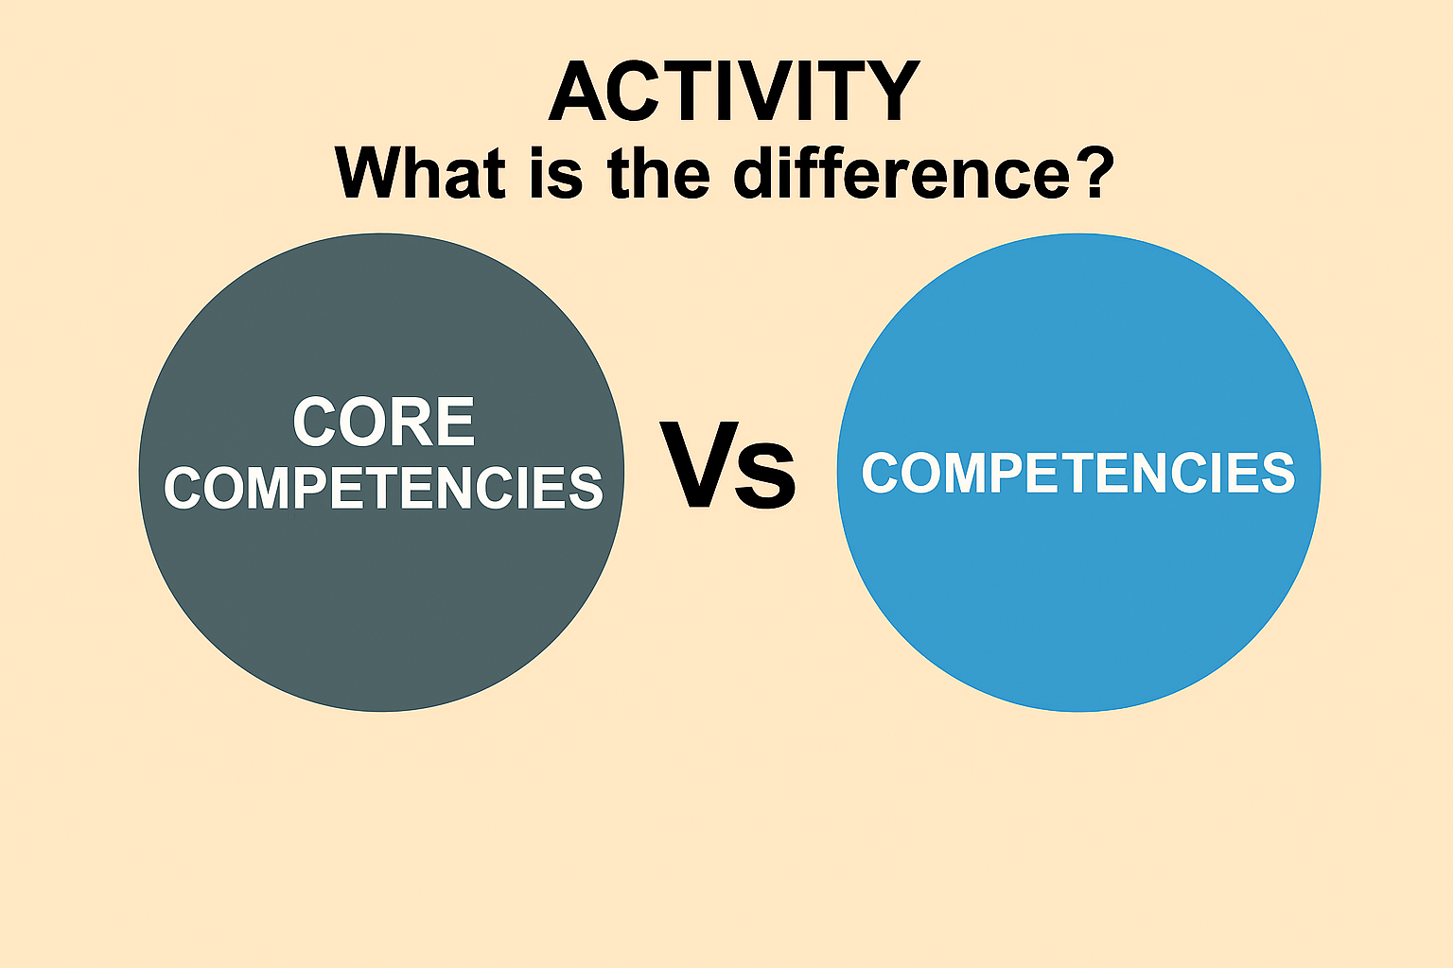

Slide 4
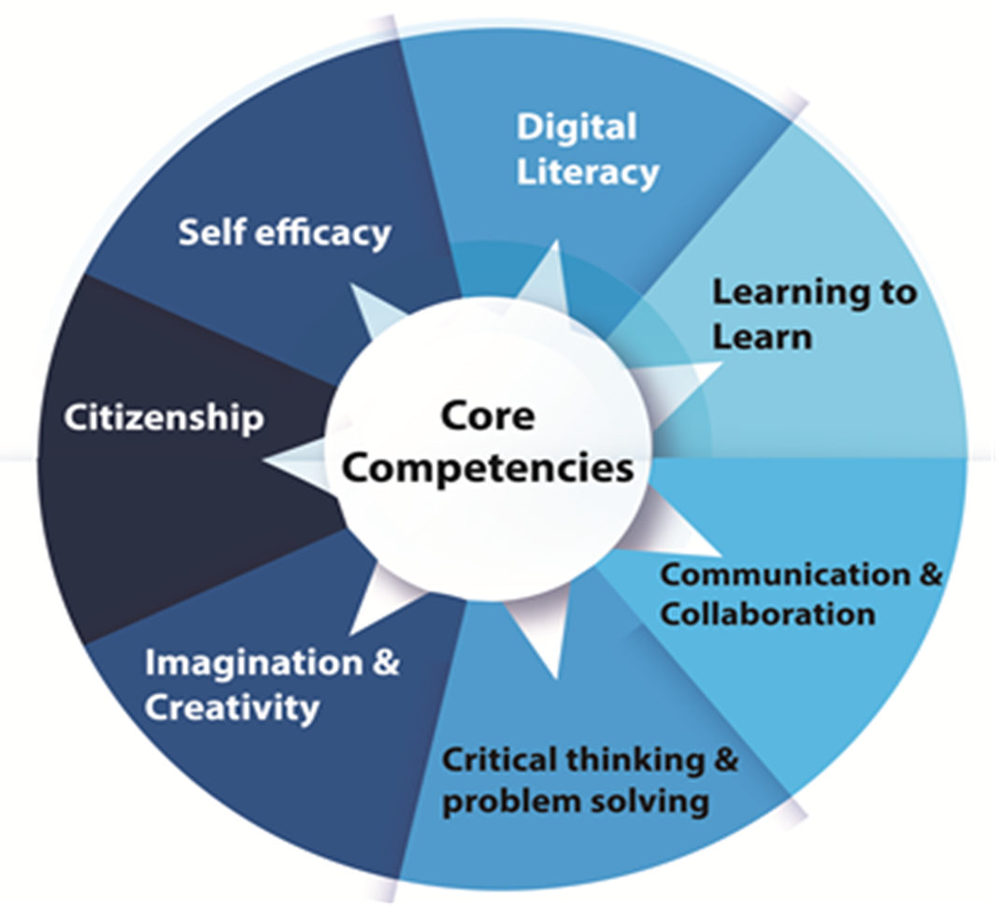

Slide 5




Skills of communication
        There are four skills of communication:
        1. Listening
        2. Speaking
        3. Reading
        4. Writing

Slide 6

Listening: Is receiving, retaining and processing information.
1. Focus: Listens attentively for a short time.
2. Check: Remembers simple instructions.
3. Retell: Asks questions when something is unclear.
4. Active Listening: Accurately passes on information.
5. Summarize: Shows attentiveness
6. Summarize: Rephrases or summarizes what was learned.
7.Identify Influence: Identifies tone of communication.

Slide 7

Speaking: Is transmission of information or ideas.
INDICATORS
Sharing clearly: Communicates clearly with someone he/she knows.
Discussing together: Communicates clearly in a small group.
Meeting others: Communicates with new people when he/she needs to.
Organising thoughts: Order his/her points to be understood.
Knowing the audience: Adapts his/her communication to what the audience already knows.
Choosing language: Chooses appropriate language for the situation.

Slide 8
Continuation: Speaking
Expressing self: Uses tone, expression and gesture to be understood
Using facts: Use facts and examples to support his/her communication
Sharing visuals: Uses images, charts or diagrams when it helps his/her communication
Communicating sensitively: Talks about difficult or sensitive topics effectively
Speaking engagingly: Communicates in a way that is engaging for the audience

Slide 9
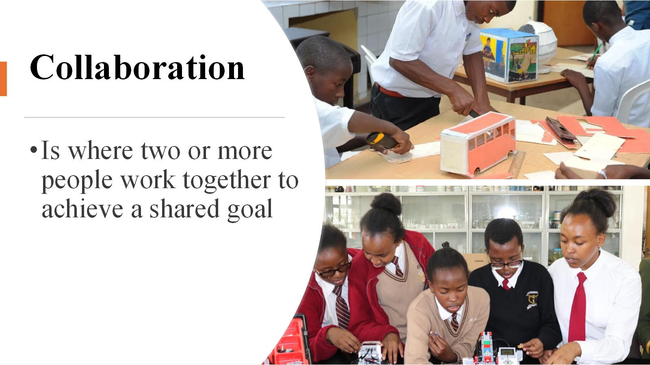

Slide 10
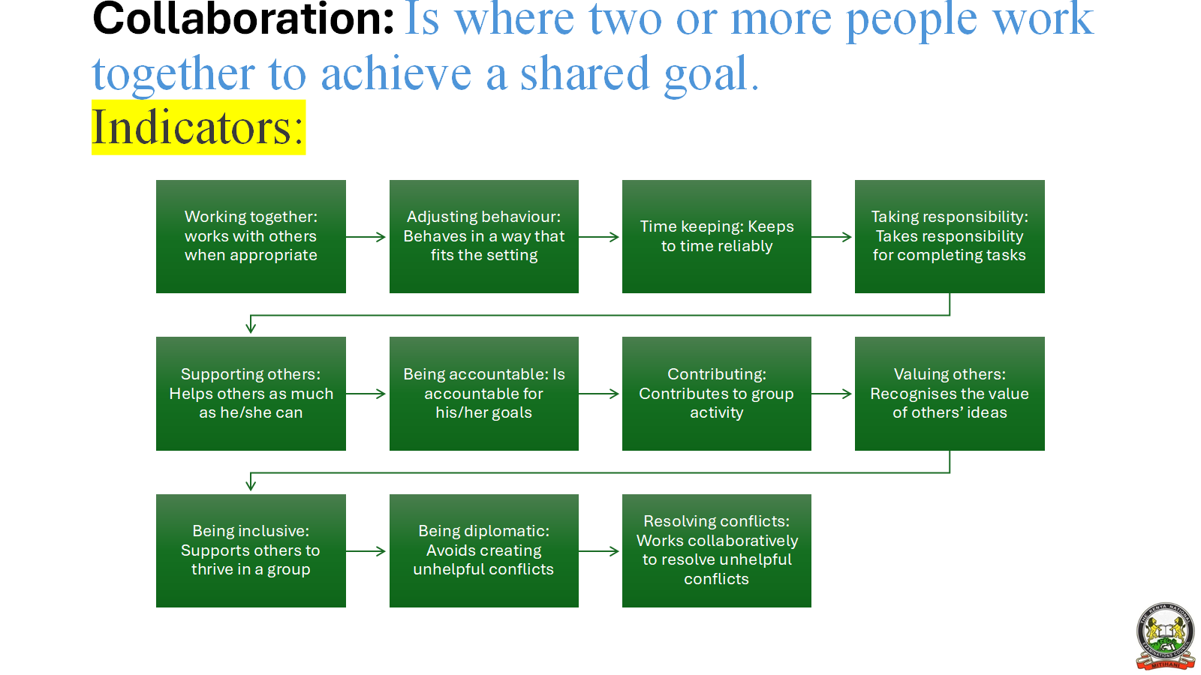

Slide 11
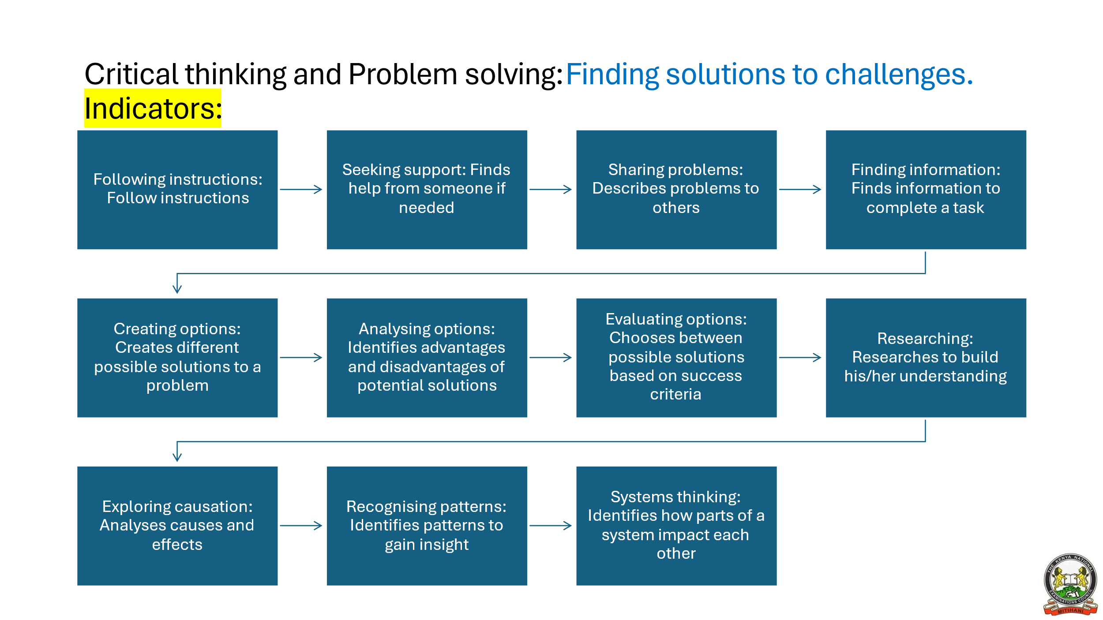

Slide 12
Citizenship: Is the state of being vested with the rights, privileges, and duties of a citizen.
Indicators:
Understanding reactions: Knows how an idea makes him/her feel
Sharing reactions: Explains how an idea makes him/her feel
Recognising reactions: Knows when others have strong feelings about something
Organising tasks: Divides up tasks in a fair way
Managing resources: Manages team time and resources to complete tasks
Mentoring: Uses his/her experience to support others
Self-awareness: Recognises how others see his/her strengths and weaknesses
Evaluating others: Identifies others’ strengths and weaknesses
Allocating roles: Allocates roles based on strengths and weaknesses
Facilitating discussions: Structures group discussions
Managing disagreements: Supports shared decision making

Slide 13
Learning to learn: Setting goals and designing routes to achieve them.
Indicators
Sensing difficulty: Knows when something is too difficult
Identifying successes: Knows what doing well looks like
Working carefully: Works with care and attention
Recognising strengths: Recognises what he/she is good at
Facing challenges: Takes a positive approach to new challenges
Setting goals: Sets achievable goals
Thinking ahead: Thinks about routes to achieve a goal
Prioritising: Orders and prioritises tasks to achieve goals
Resourcing: Secures the resources needed to achieve goals
Involving others: Engages others to achieve goals
Using skills: Plans how to use and build his/her skills to achieve goals

Slide 14
Imagination and Creativity:
Imagination is the ability to form mental picture of something that one has not seen or experienced.
Creativity is the ability to bring the imaginations into reality.
Indicators
Imagining: Imagines different things
Sharing imagination: Shares what is imagined with someone
Expressing imagination: Shares what is imagined in different ways
Generating ideas: Creates ideas to solve a problem
Suggesting improvements: Creates ideas to make something better
Combining concepts: Identifies opportunities for innovation
Defining success: Sets out success criteria for creating new ideas
Flexible thinking: Challenges his/her assumptions about ideas
Reflecting critically: Questions own ideas to improve them
Seeking perspectives: Seeks different perspectives to develop ideas
Prototyping: Creates quick tests of an idea

Slide 15
Digital literacy: Is the responsible use of digital tools to find, create, share, and understand information.
Indicators
Device Familiarity: Identify and name common digital devices (tablet, phone, computer).
Basic Interaction: Use touch gestures (tap, swipe) to interact with learning apps.
Navigation Skills: Open and close apps or programs with guidance.
Digital Expression Use drawing tools and type letters using a keyboard.
Multimedia Use: Play educational videos and take simple photos.
File Management: Save, open, and name files on a device.
Safe Browsing: Use a browser to access safe educational websites.
Digital Messaging: Send and receive messages via email or platforms (with supervision).
Word Processing: Create and format documents (e.g., MS Word).
Spreadsheets: Enter data and create basic charts.
Presentations: Design and deliver digital presentations.
Digital Citizenship : Understand online safety, privacy, and ethics.
Collaboration Tools: Use cloud tools (e.g., Google Drive, Teams) for group work.
Digital Research: Conduct online research and cite sources ethically.

Slide 16
Self-efficacy Overcoming challenges and setbacks to achieve goals
Indicators
Identifying emotions: Can tell how he/she is feeling
Recognising emotions: Can tell how others are feeling
Persisting: Keeps going when faced with challenges
Managing Reactions: Responds calmly when faced with challenges
Reflective learning: Reflects and learns from challenges
Supporting others: Helps others face challenges
Encouraging others: Encourages others to keep going
Managing wellbeing: Has routines to manage his/her wellbeing
Balancing workload: Manages own workload effectively
Improving performance: Seeks opportunities to grow his/her experience expertise
Practising resilience: Looks for opportunities when faced with challenges

Slide 17
How to Assess a Core Competence
Curriculum
From the curriculum design, identify the learning outcome(s) that can address Core Competency.
Assessment task
From the learning experiences, develop tasks that address Core Competency.
Assessment tool
Develop the assessment tool for collecting information on the learner’s performance.
Performance
Engage the learners in the task and collect the information on the learner’s performance.

Slide 18
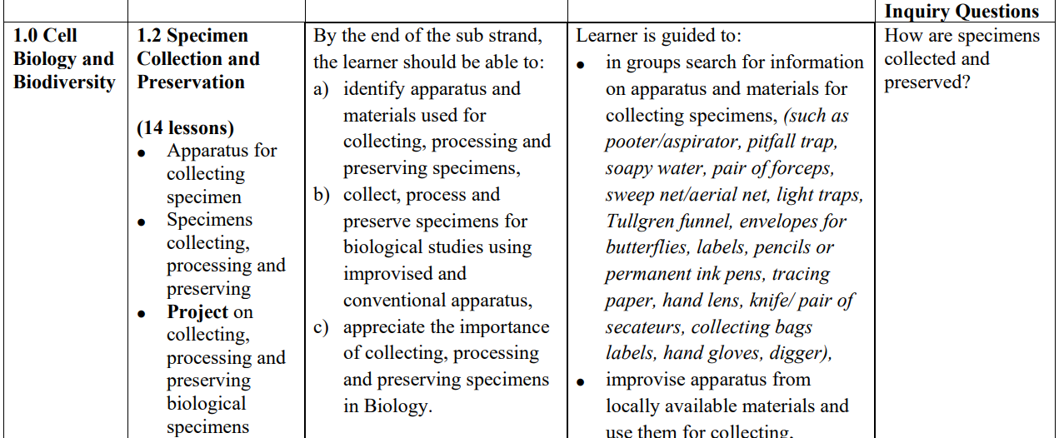
Curriculum design extract
(Grade 10 Biology)

Slide 19
Assessment of communication and collaboration
Task | Targeted Core Competence and Tool to be used for Assessment | Suggested Indicators
Using a digital device, search and share information on apparatus used to collect specimens | Digital literacy Tools: Checklist | Safely handles the digital device Connects to the internet Identifies the apparatus Gives correct use of the apparatus Uses the digital device to present. (5 marks)
Notes:
Which tools can one use to assess the learners as they watch the video?

Slide 20
Assessment of communication and collaboration
Task | Targeted Core Competence and Tool to be used for Assessment | Suggested Indicators
In groups of 4-5, each learner to present information on apparatus used to collect specimens. | Communication and collaboration Speaking/presentation | Speaks clearly Organizes his/her points to be understood Uses facts and examples to support his/her communication Uses visuals(pictures, charts, diagrams to support the communication Engages the audience
Notes:
Which tools can one use to assess the learners as they watch the video?

Slide 21
Communication
Criteria | Exceeding Expectation (4) | Meeting Expectation (3) | Approaching Expectation (2) | Below Expectation (1)
Knowledge of Apparatus | Clearly identifies and explains all specimen collection tools with accurate use cases. | Identifies and explains some tools with most of the information accurate | Identifies few tools with limited or partially accurate explanations. | Struggles to identify tools or provides inaccurate information.
Clarity of Explanation | Speaks clearly and explanations are easy to follow and are well-organized. | Speaks clearly with minor issues in organization or clarity. | Some difficulty in speaking clearly or organizing thoughts. | Hard to understand due to unclear speech or poor organization.
Engagement & Participation | Actively participates, listens to others, and responds appropriately. | Participates and listens with minor lapses. | Limited participation or engagement with group. | Rarely participates or engages with group members.

Slide 22
Activity:
In groups of 4-5 use a curriculum design to develop a task to assess one of the following competencies
Collaboration
Critical thinking and problem solving
Imagination and creativity
Citizenship

Slide 23
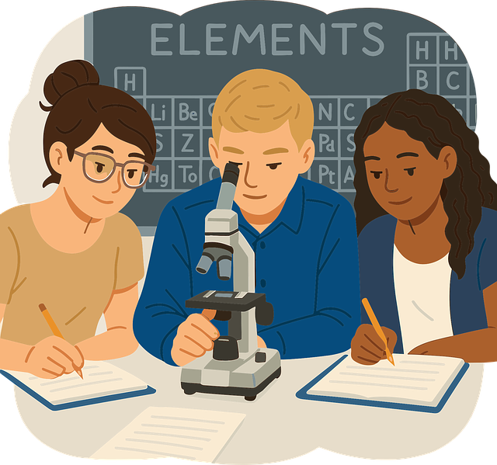
Assessing learning to learn
In your groups, create a learning experience from a learning outcome which you can use to develop the attributes of learning to learn in learners.
Using the learning experience created, develop a task for assessing learning to learn.

Slide 24

Assessing Citizenship
You have taken learners for a visit to a waste disposal site in the locality.
In your group,
  discuss the indicators of citizenship that are likely to be exhibited by learners during the visit.
  prepare a task to assess citizenship during the visit.
Present to the plenary.

Slide 25
PERTINENT AND CONTEMPORARY ISSUES (PCIS)
Pertinent
relating to the matter at
hand; relevant.
living or occurring in the present
Contemporary
Issue
important topic or problem for
debate or discussion.
Pertinent And Contemporary Issues (PCIs) are problems currently affecting people or places and are unresolved. PCIs are designed and addressed in CBE to ensure that education is relevant.

Slide 26
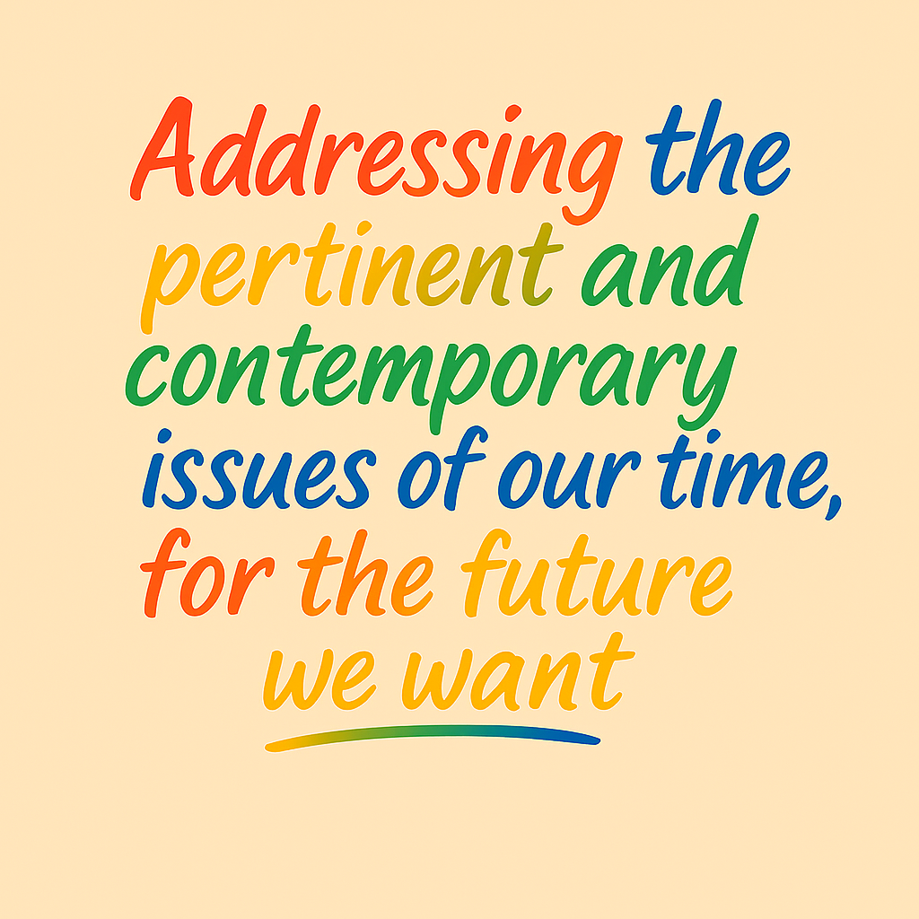
Assessment of PCIs
Identify the target PCI
Define the indicators of PCI(s) as per the learning experience
or task
Infuse the PCI(s) in the learning experience or task taking
into consideration the local contexts.
Suggested learning activity
From the curriculum design,
  identify a strand or learning experience of your choice;
  identify and infuse the target PCI(s) in the learning
experience or task.

Slide 27

From the curriculum design,
  identify a strand or learning experience that addresses a PCI(s);
  develop an assessment tool to assess the learners on the PCI(s).

Slide 28


