Slide 1
FEEDBACK ON LEARNING OUTCOMES
SENIOR SCHOOL GRADE 10-12
KNEC PRESENTATION
DECEMBER 2025

Slide 2
Session Outcomes
By the end of the session, the participant should be able to:
Understand the meaning of assessment feedback.
Describe approaches to assessment feedback.
Explain why feedback is necessary.
Describe qualities of good assessment feedback.
Explain feedback modalities.
Describe the rationale for assessment feedback.
Tools for reporting assessment feedback.
Notes:
When the white man learned to shoot without missing, the birds learnt to fly without parching….

Slide 3

What is assessment feedback?
Feedback is the information given about a learner’s performance in relation to learning outcomes after completing an assignment, test, project or any form of evaluation.
The information is used to adjust and improve teaching and learning process.
Feedback is effective when it aims at improving learning.

Slide 4

Approaches of feedback
(a) Informal Feedback
is unstructured.
can occur at any time.
emerges spontaneously during action.
requires the teacher to build rapport with learners to encourage, coach or guide them.
May occur in class, over the phone, online conversation or virtual classroom.

Slide 5

Approaches of feedback
(b) Formal Feedback
it is planned and systematically scheduled within the assessment process.
It is associated with assessment tasks.
It includes school year reports and assessment sheets.
It informs stakeholders on learner’s competencies, performance levels, acquisition of values, pertinent and contemporary issues.

Slide 6
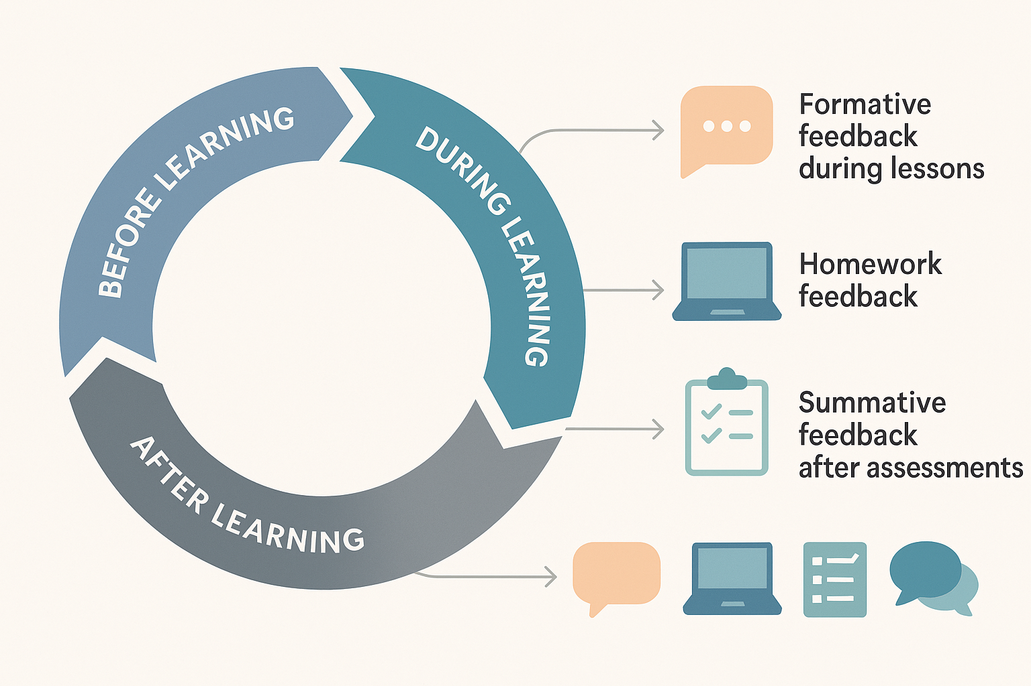
BRAINSTORMING SESSION
At what point of learning do we give assessment feedback?
How should we give the assessment feedback?

Slide 7
FEEDBACK DISCUSSION
Feedback, like assessment, takes place at all levels of the learning cycle. During classroom discussions it can be as simple as saying, that’s very good Peter. Give an example on the same.
The classroom itself is not the only place that an instructor can provide feedback.
Homework is another useful tool. While often considered an assessment tool, it is a missed opportunity for excellent feedback.

Slide 8
Discussion cont’d
When going through students’ homework/tasks, consider refraining from immediately assigning a grade. Instead, provide comments on places where they did well, as well as where they could improve or dig deeper.
Allow students to respond or reflect to this feedback and improve both their work and their understanding.

Slide 9

Understanding Assessment Feedback
Feedback provides insights into learner performance relative to learning outcomes.
Effective feedback enhances learning and instructional quality.

Slide 10
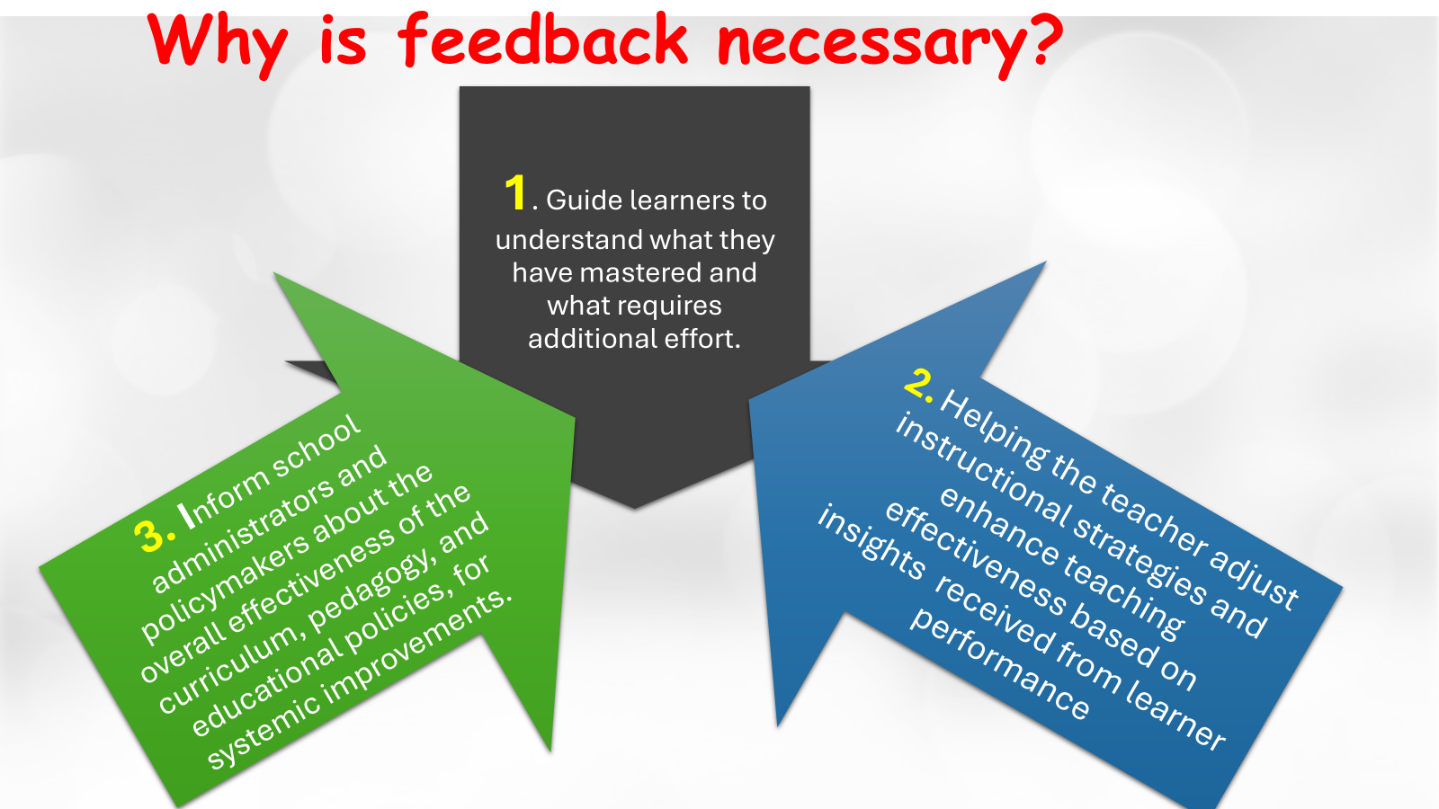

Slide 11
Qualities of a good feedback
Activity
Imagine you’ve just completed building your dream house—a space that reflects your vision and personality.
What kind of feedback would you like to receive?
What kind of feedback would you rather not receive?
Please share your thoughts honestly

Slide 12

Qualities of Effective Feedback
Specific, actionable, and timely.
Encourages reflection and improvement.
Avoids vague or judgmental comments.

Slide 13
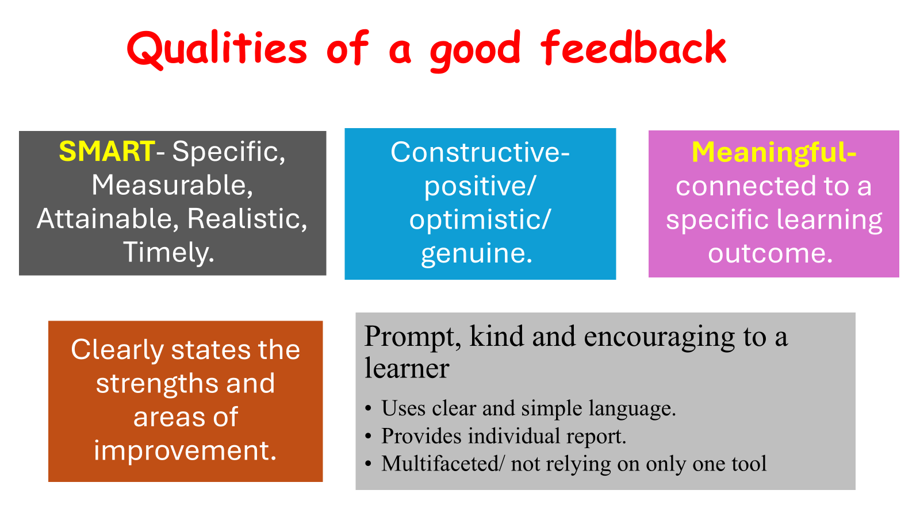

Slide 14
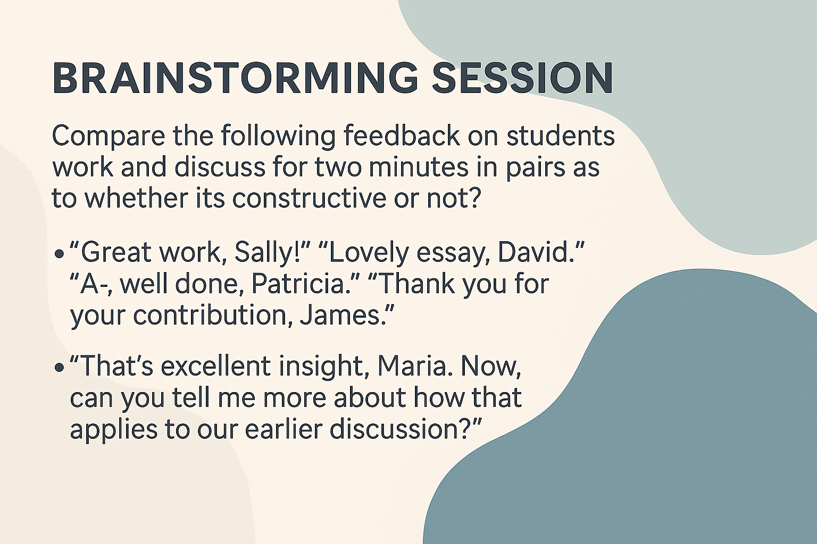

Slide 15
EXPLANATION ON THE FEEDBACK
The first feedback is ego centred while the second one is task centred.
Ego centred feedback is often considered superficial; it does not move the discussion forward. While it may help a student feel good, it gives them little direction for further development.
Task-focused feedback, on the other hand, can help students dive deeper into their own learning

Slide 16
Assessment Feedback Modalities
These are different ways or formats through which feedback is delivered to the learners.
They are methods teachers use to give feedback to learners on their performance on tasks or assignment done.

Slide 17
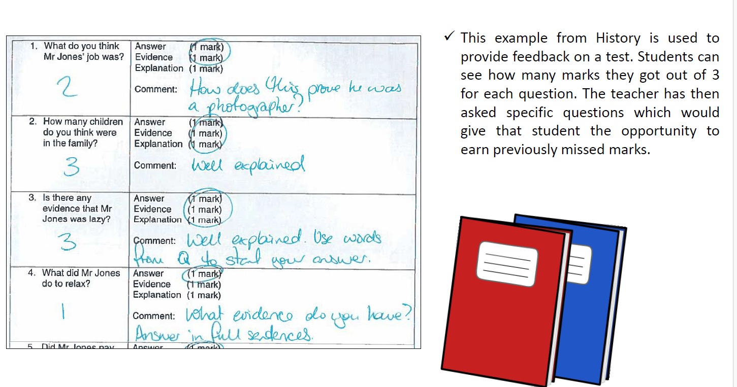
Example of Feedback

Slide 18
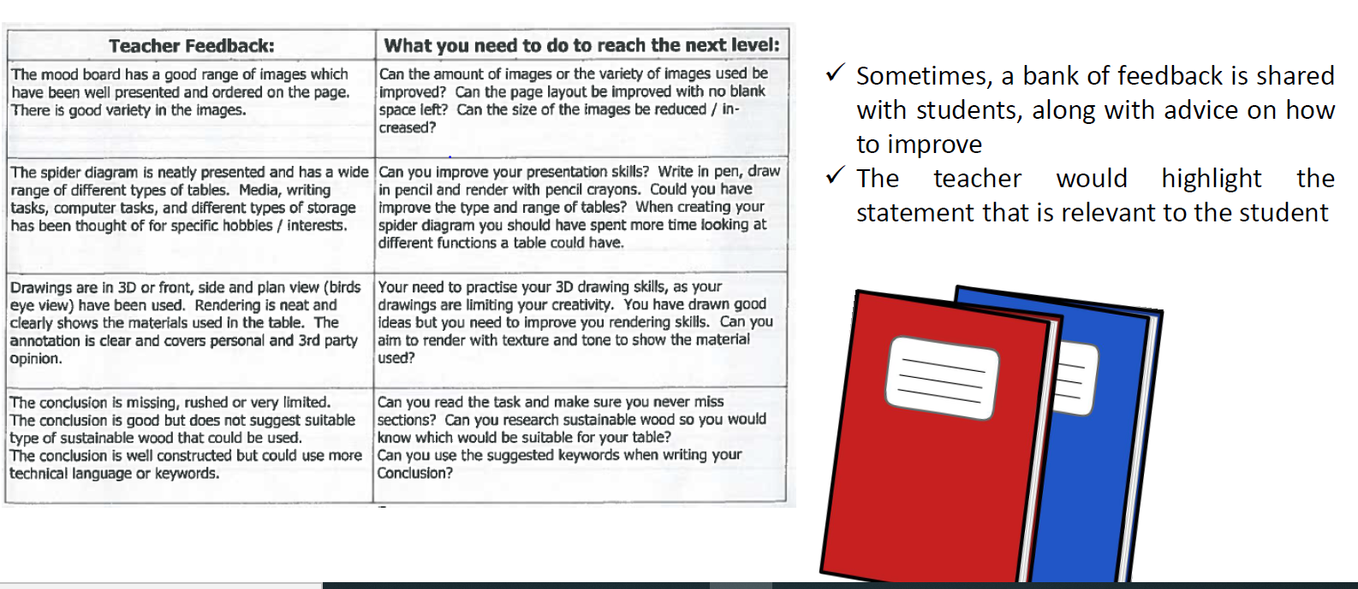
EXAMPLE 2

Slide 19
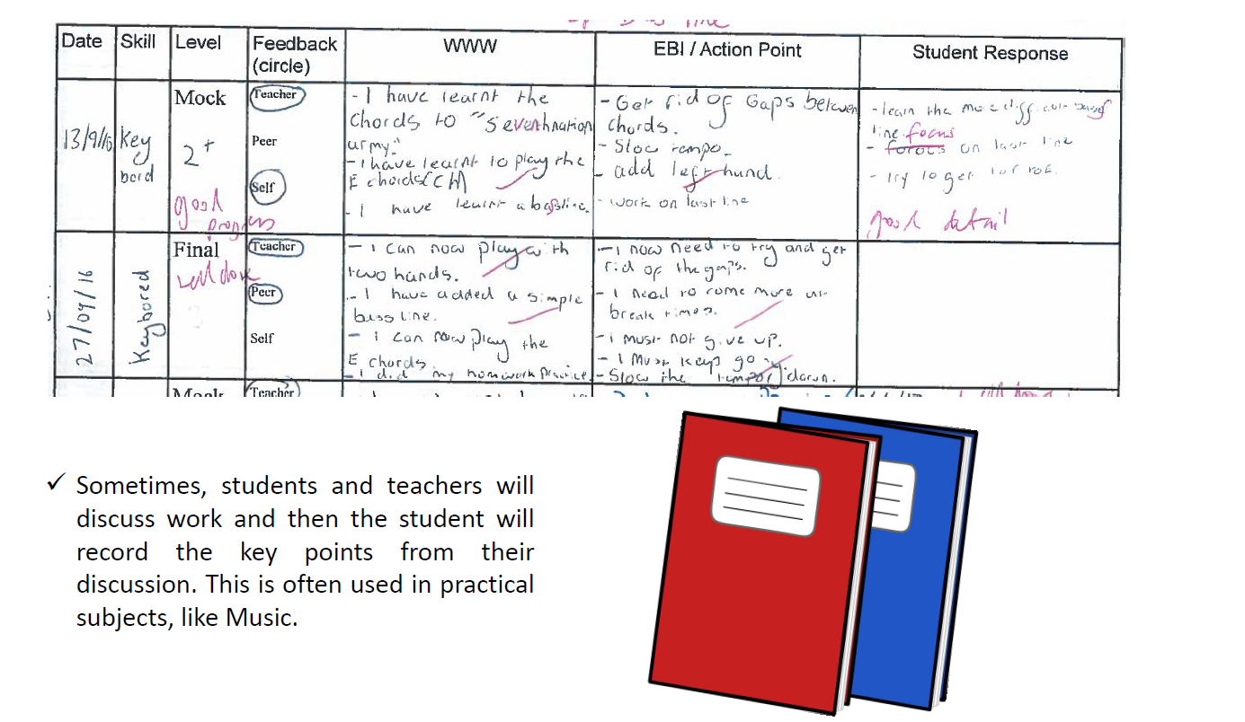
EXAMPLE 3

Slide 20

Feedback Modalities
Written comments, rubrics, peer reviews.
Digital platforms and interactive tools.

Slide 21
Feedback Modalities Cont’d
Oral/verbal feedback
Examples:
One on one discussion
Teacher student conference

Slide 22
GROUP TASK
In groups discuss the advantages and limitations of the following assessment feedback modalities
Written Feedback
Oral/ verbal feedback
Digital/online feedback

Slide 23
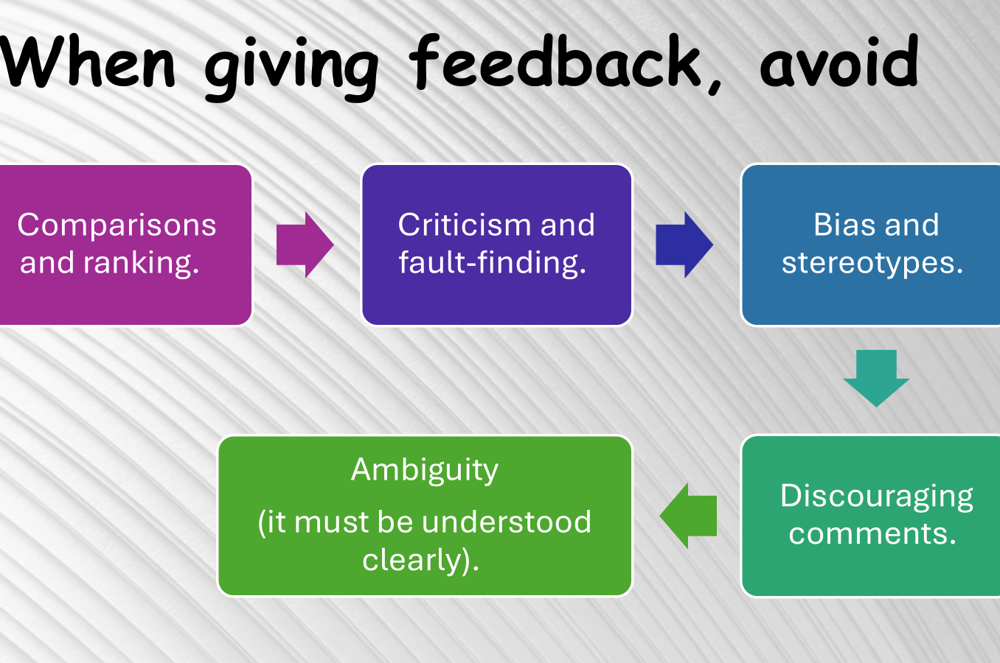
Notes:
Promotes unhealthy competition
Damages self esteem
Focuses on relative performance
Overlooks individual strengths
Encourages fixed mindset
Focus on providing constructive, timely feedback, growth of mindset and celebrating unique strengtj

Slide 24
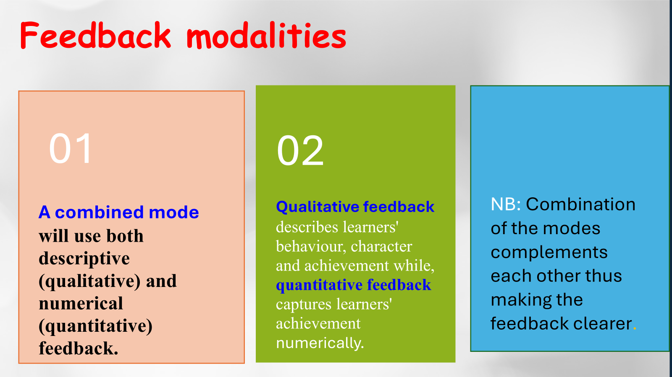
Notes:
Provides a complimentary picture of the strengths and weaknesses, provides teachers and parents reasons for scores, identifies areas of need, brings students, teachers and parents on the same page, improves communication

Slide 26
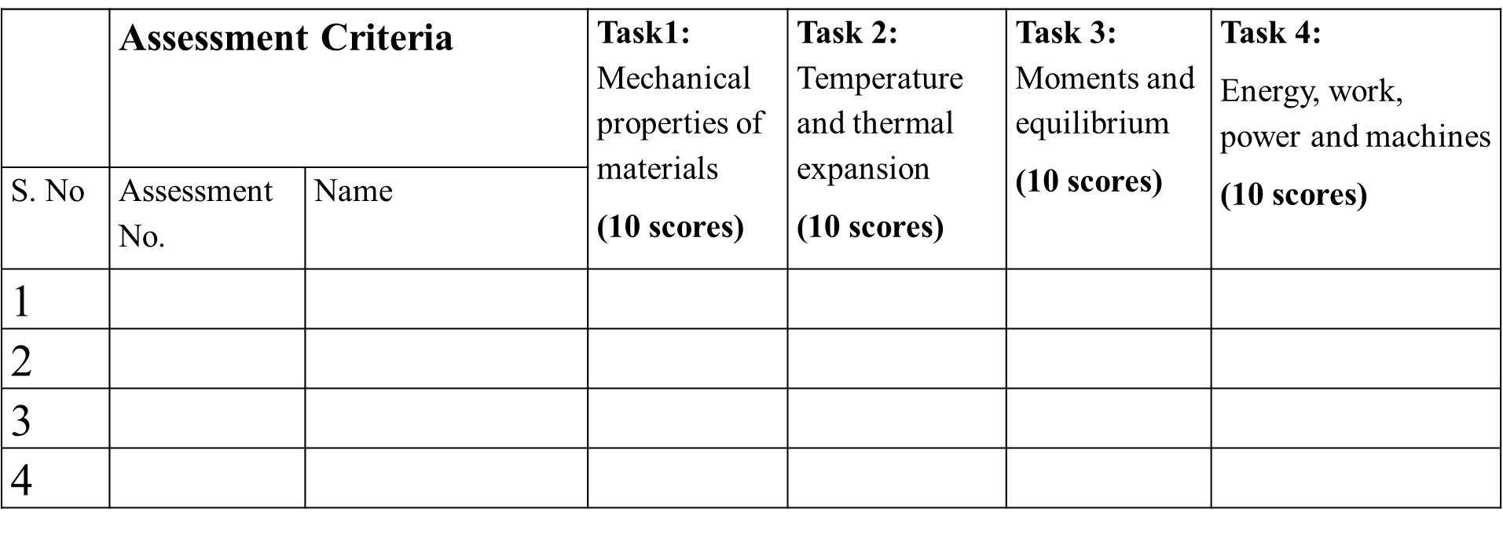
Sample Score Sheet
Example: Physics Grade 10 - Strand: Mechanics and Thermal Physics.

Slide 27

Reporting summative assessment outcomes
The CBAF identifies 4 types of feedback tools
1. Learner’s individual report
2. School specific reports
3. School Year Report
4. National report
School
Year
Report

Slide 28
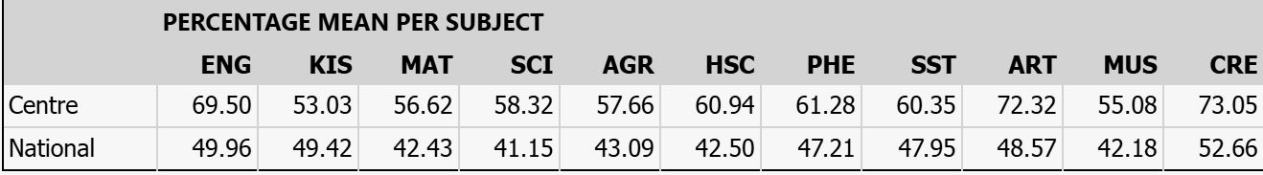
School Specific Report
School specific report will show the school mean in comparison to the national mean per subject as shown in the table.
SSR further gives performance on cognitive skills by subject.
CBA encourages schools to compete against the national standards.
This will avoid ranking of schools which results to undue competition.

Slide 29
Accessing School specific report
Click on the following links:
https://www.knec.ac.ke
Choose CBA portal
Log in using your school credentials
Click on view reports, then choose school specific report

Slide 30
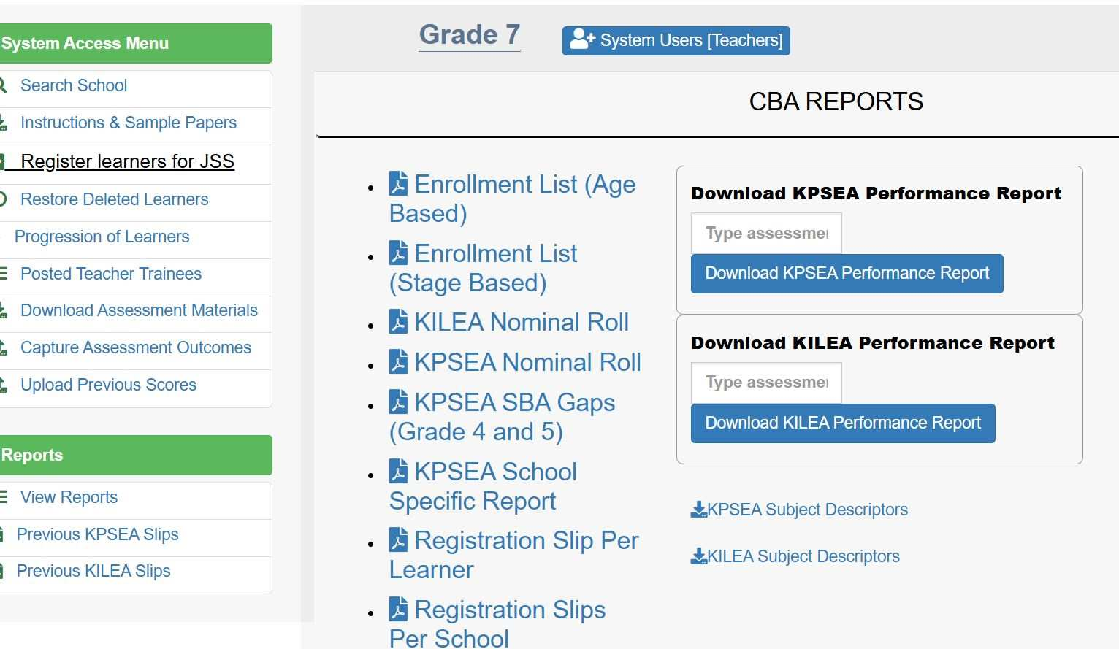

Accessing School specific report… Cntd

Slide 31
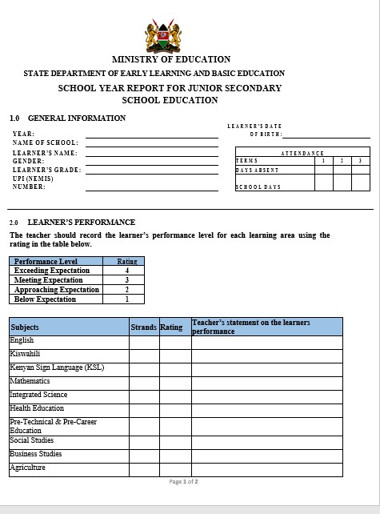
School Year Report
An annual report giving an account of a learner’s progress in the achievement /awareness of:
academic work
core competencies
core values
CSL
PCIs

Slide 32
National report
The Kenya National Examinations Council will write a national report to inform policy.
The report will be anchored on:
Achievements as guided by the Specific Learning Outcome.
Participation in Community Service Learning.
Acquisition of core competencies.
Acquisition of core values.
Pertinent and Contemporary Issues.

Slide 33


