Slide 1
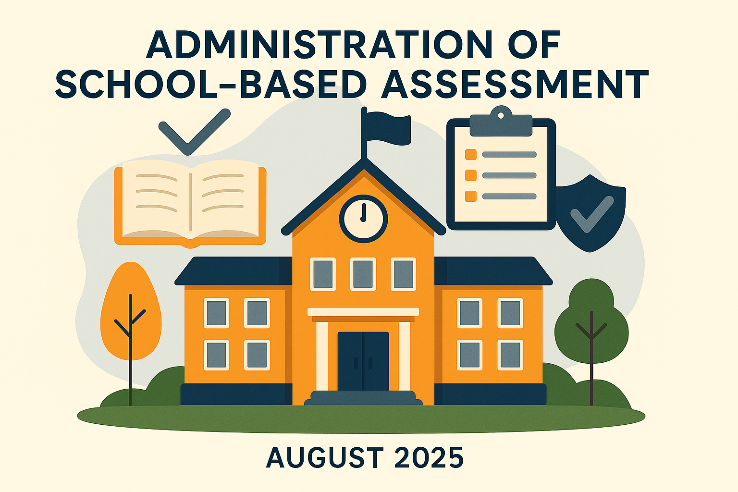
KNEC – DECEMBER 2025

Slide 2
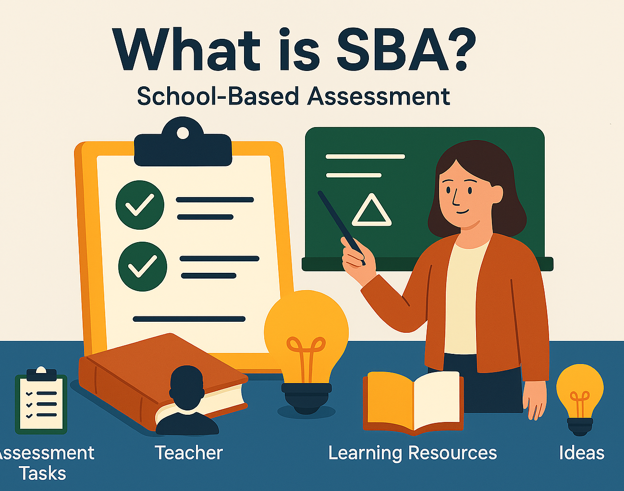
School-Based Assessment (SBA)
The process of gathering evidence of learning, that is administered by teachers within their own schools.

Slide 3
About SBA
Standardized assessments
Developed by KNEC
Administered and scored by the teachers
Scores are uploaded to the CBA portal.

Slide 4
Key Features of SBA
Teacher-Directed: Teachers are the primary assessors – They understand their learners' progress and context.
Continuous and Formative: Allows for real-time identification of strengths and weaknesses and adjustment of teaching strategies.
Holistic Evaluation: SBA assesses a broad range of learner skills
Varied Methods: It uses a wide range of tools to gather evidence of learning.
Authentic Tasks: Involves real-life application of knowledge and skills, promoting critical thinking and problem-solving.

Slide 5

Brainstorming Session 1
What practical steps can educators take to ensure the SBAs are both reliable and equitable?

Slide 6
Why SBA?
1. Gather data on learner performance over a period.
2. Engage learners in meaningful authentic activities.
3.Provide opportunities to demonstrate their competencies.
4. Cater for the diverse needs of learners- variety of tools are utilised.
5. Allow teachers to be leaders in the learning and assessment process
6. Reinforce achievement of learning outcomes, promote good instructional practices.
7. Promote development of core competencies and values among learners.
8. To give teachers insight into learner progress and areas needing support.
9. To reduce pressure from high-stake exams.

Slide 7
The SBA Processes
Development of SBA
(KNEC)
Uploading of tools to the SBA Portal –(KNEC)
Assessment Task/ Tool
Scoring Guide/ marking schemes/ scoring rubrics
Score sheets
Downloading tools, administering and scoring
(Teacher/school)
Use School login credentials
Download all tools, Scoring guides and Score sheets
Administer the tools & score
Practical Performance tasks/
Upload the scores
Written Assessments
Project Tasks

Slide 8

Guidelines for Administration
1. Download Tools from the official KNEC platform.
      a) Project/Practical Tasks: Learners carry out tasks guided by the teacher.
b) Written Assessments
          Print or photocopy for each learner, or
          Project the assessment and provide stationery.
          Administer under prescribed conditions and guidelines.
2. Scoring: Objectively as guided by the scoring guides. Enter marks per task.
3. Uploading Scores:
      To the KNEC CBA portal per task as guided by the scoresheet.
      Observe timeline.
4. Record Keeping: Keep copies of learner’s progress records/Portfolio for reference.

Slide 9
Accessing SBA Tools
Click on the following links:
https://www.knec.ac.ke
Choose CBA portal
Log in using your school credentials
Click on download assessment material

Slide 10
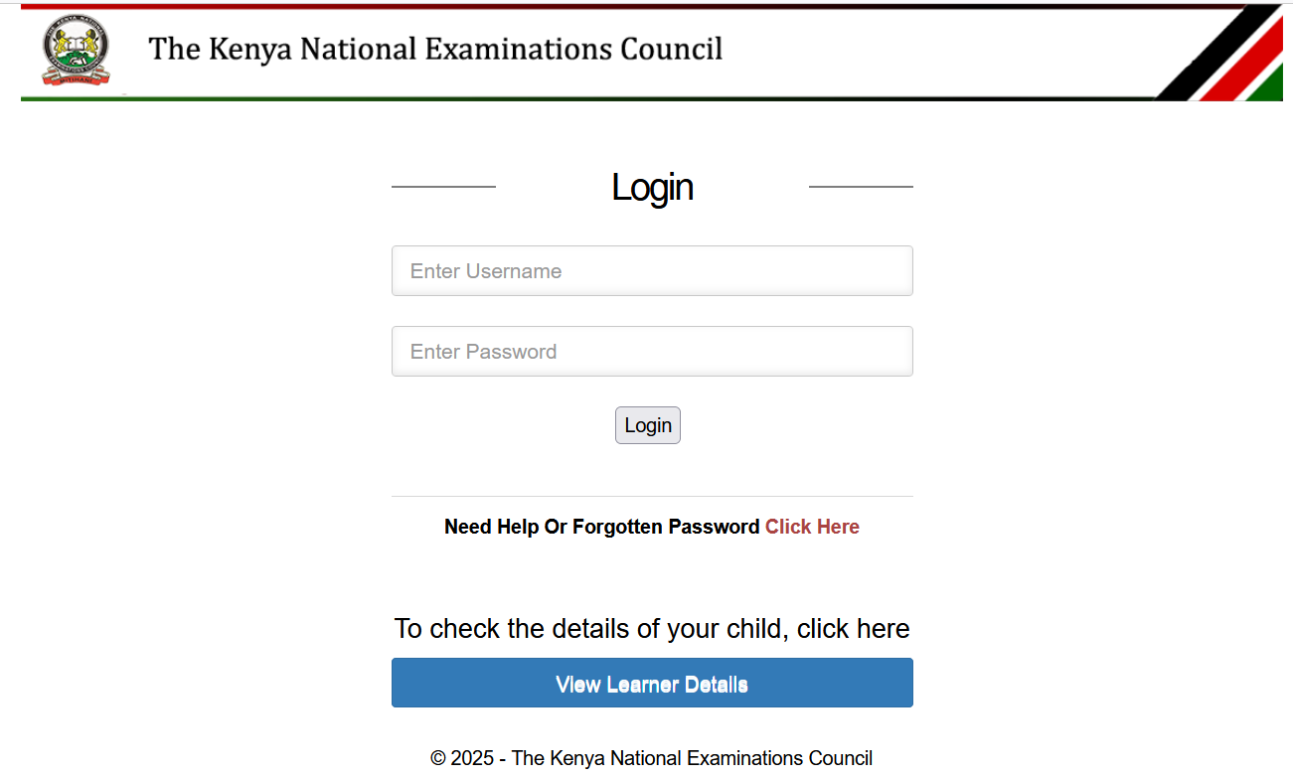
Login page
https://cba.knec.ac.ke

Slide 11
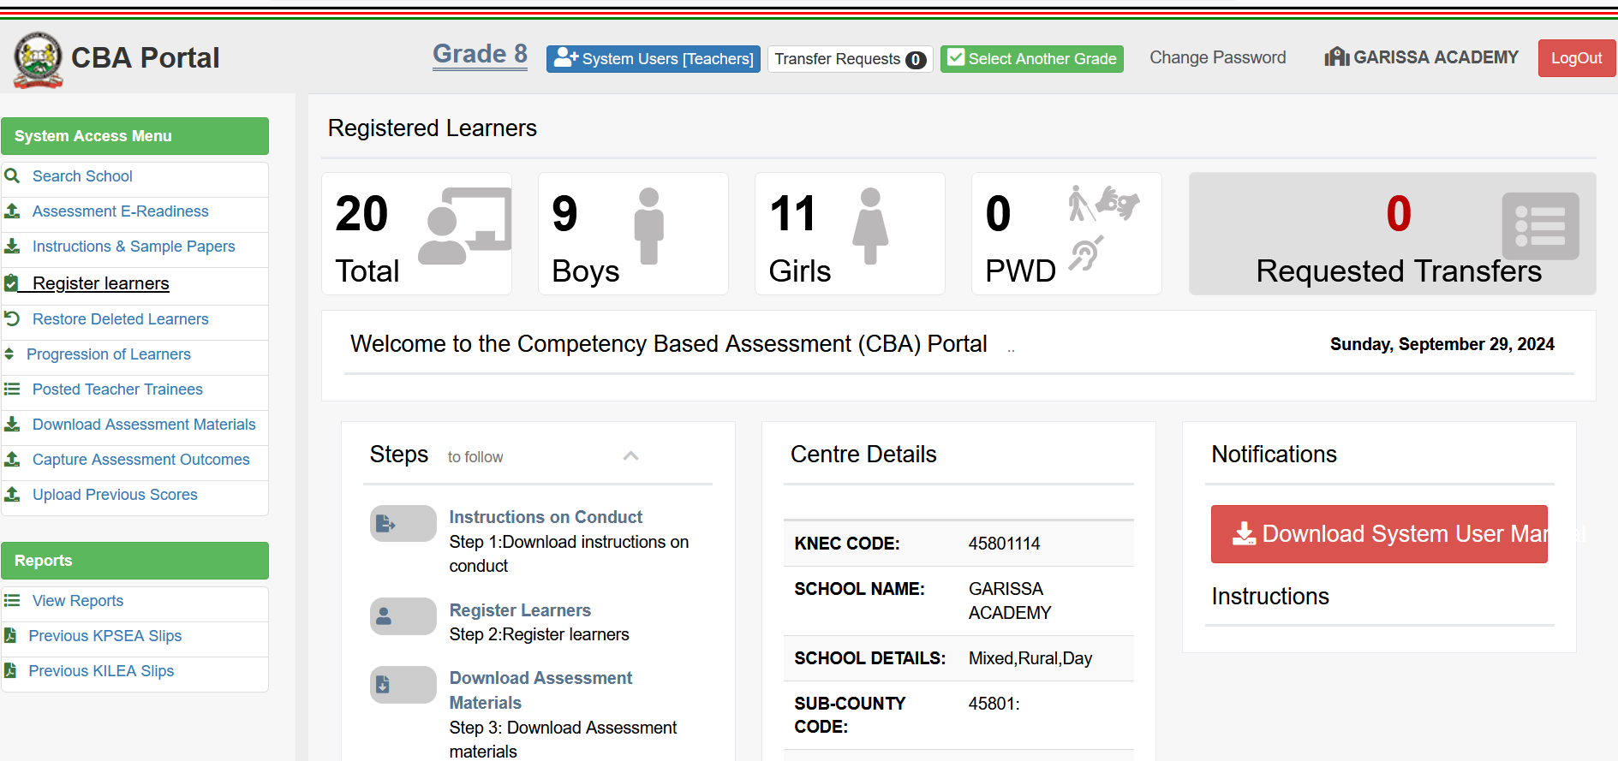
Accessing SBA Tools

Slide 13
Brainstorming Session 2
Identify some of the challenges that can be encountered during administration of School Based Assessments.
2. Suggest some of the possible solutions to each of the challenges

Slide 14

Additional information on Administration of SBAs
1. Provide adequate and consistent guidance/support to learners to enable them undertake the assessments as prescribed.
2. Maintain Accurate Assessment Records
3. Encourage all learners to be present and undertake SBAs
4. Be keen on SBA Timelines
5. Administer the SBA Tools as downloaded from the CBA portal Avoid using compressed or mutilated assessment materials

Slide 15
Cont…
6. Utilize Feedback from the CBA Portal: Always use feedback provided through the CBA portal to improve learning.
7. Promote Authentic Assessment Practices: Encourage original work by guiding learners to be creative
8. Collaborate with other teachers
9. Engage Parents and Guardians: Keep parents informed about SBA timelines and expectations so they can support learners at home.
10. Reflect and Improve: After each SBA cycle, reflect on what worked for you and what didn’t. Make necessary improvements

Slide 16

ENSURE INTEGRITY IN ALL
ASSESSMENT PROCESSESS!

Slide 17


